Slide 1
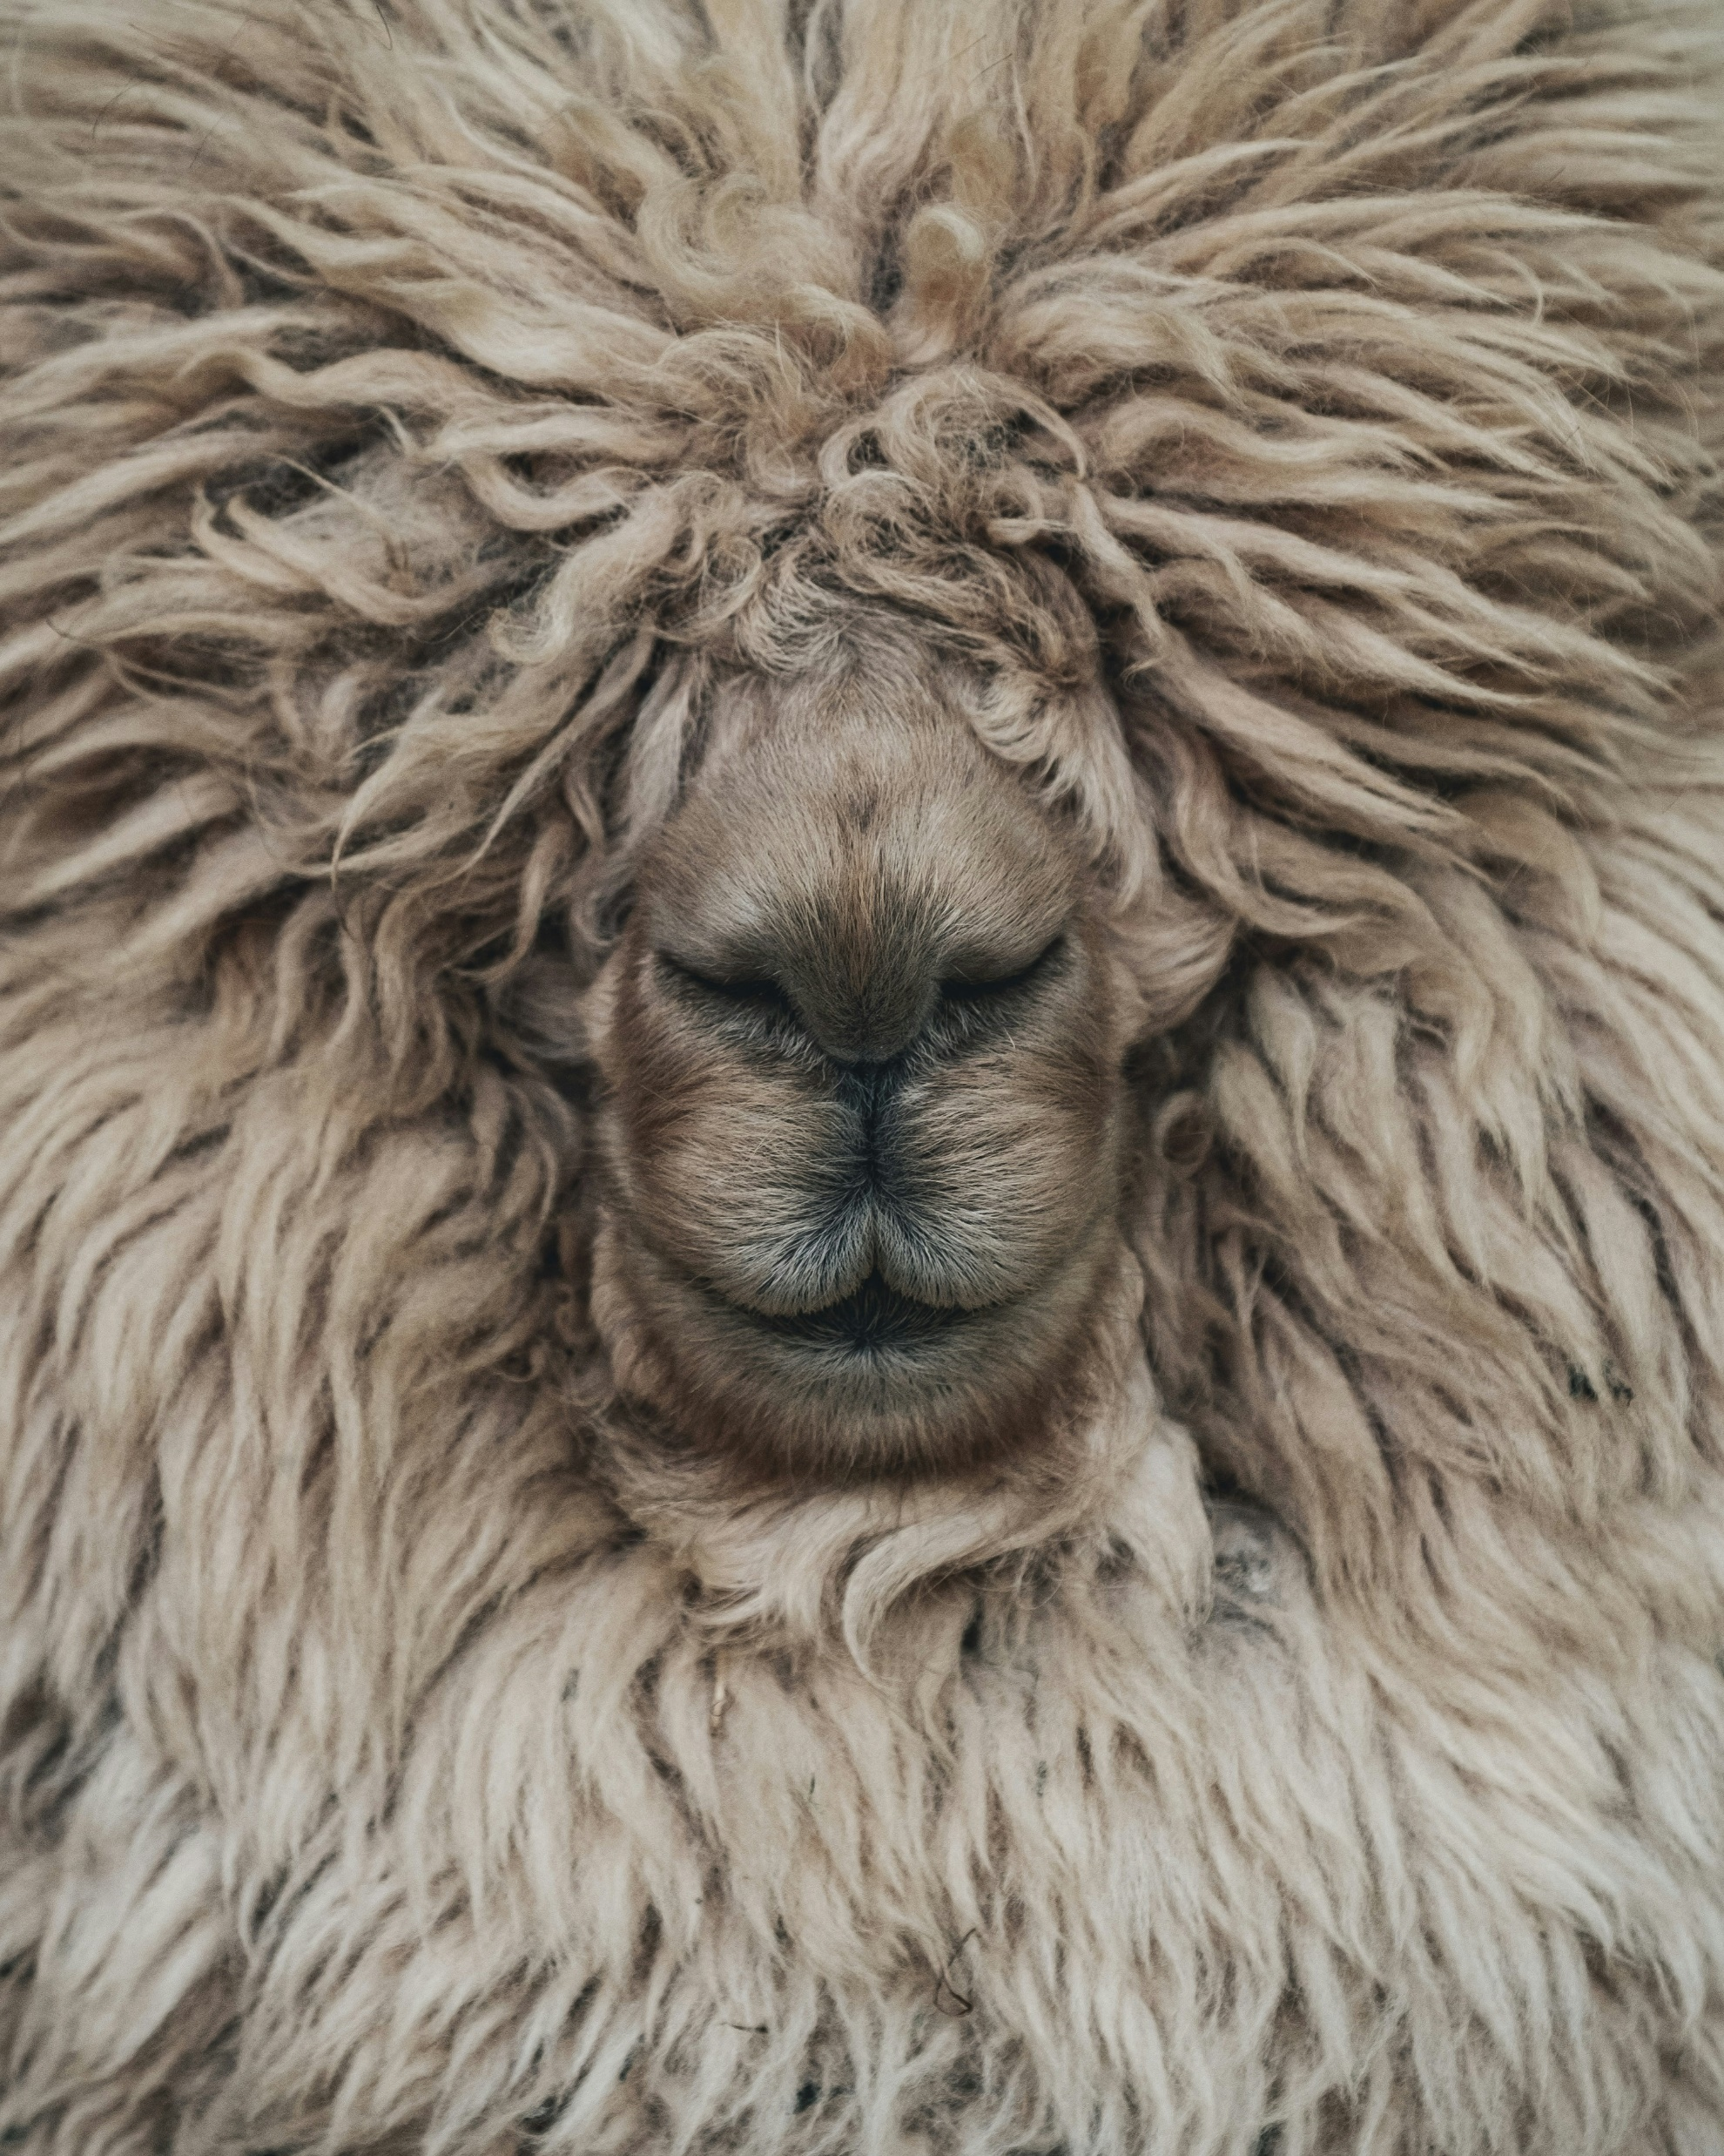
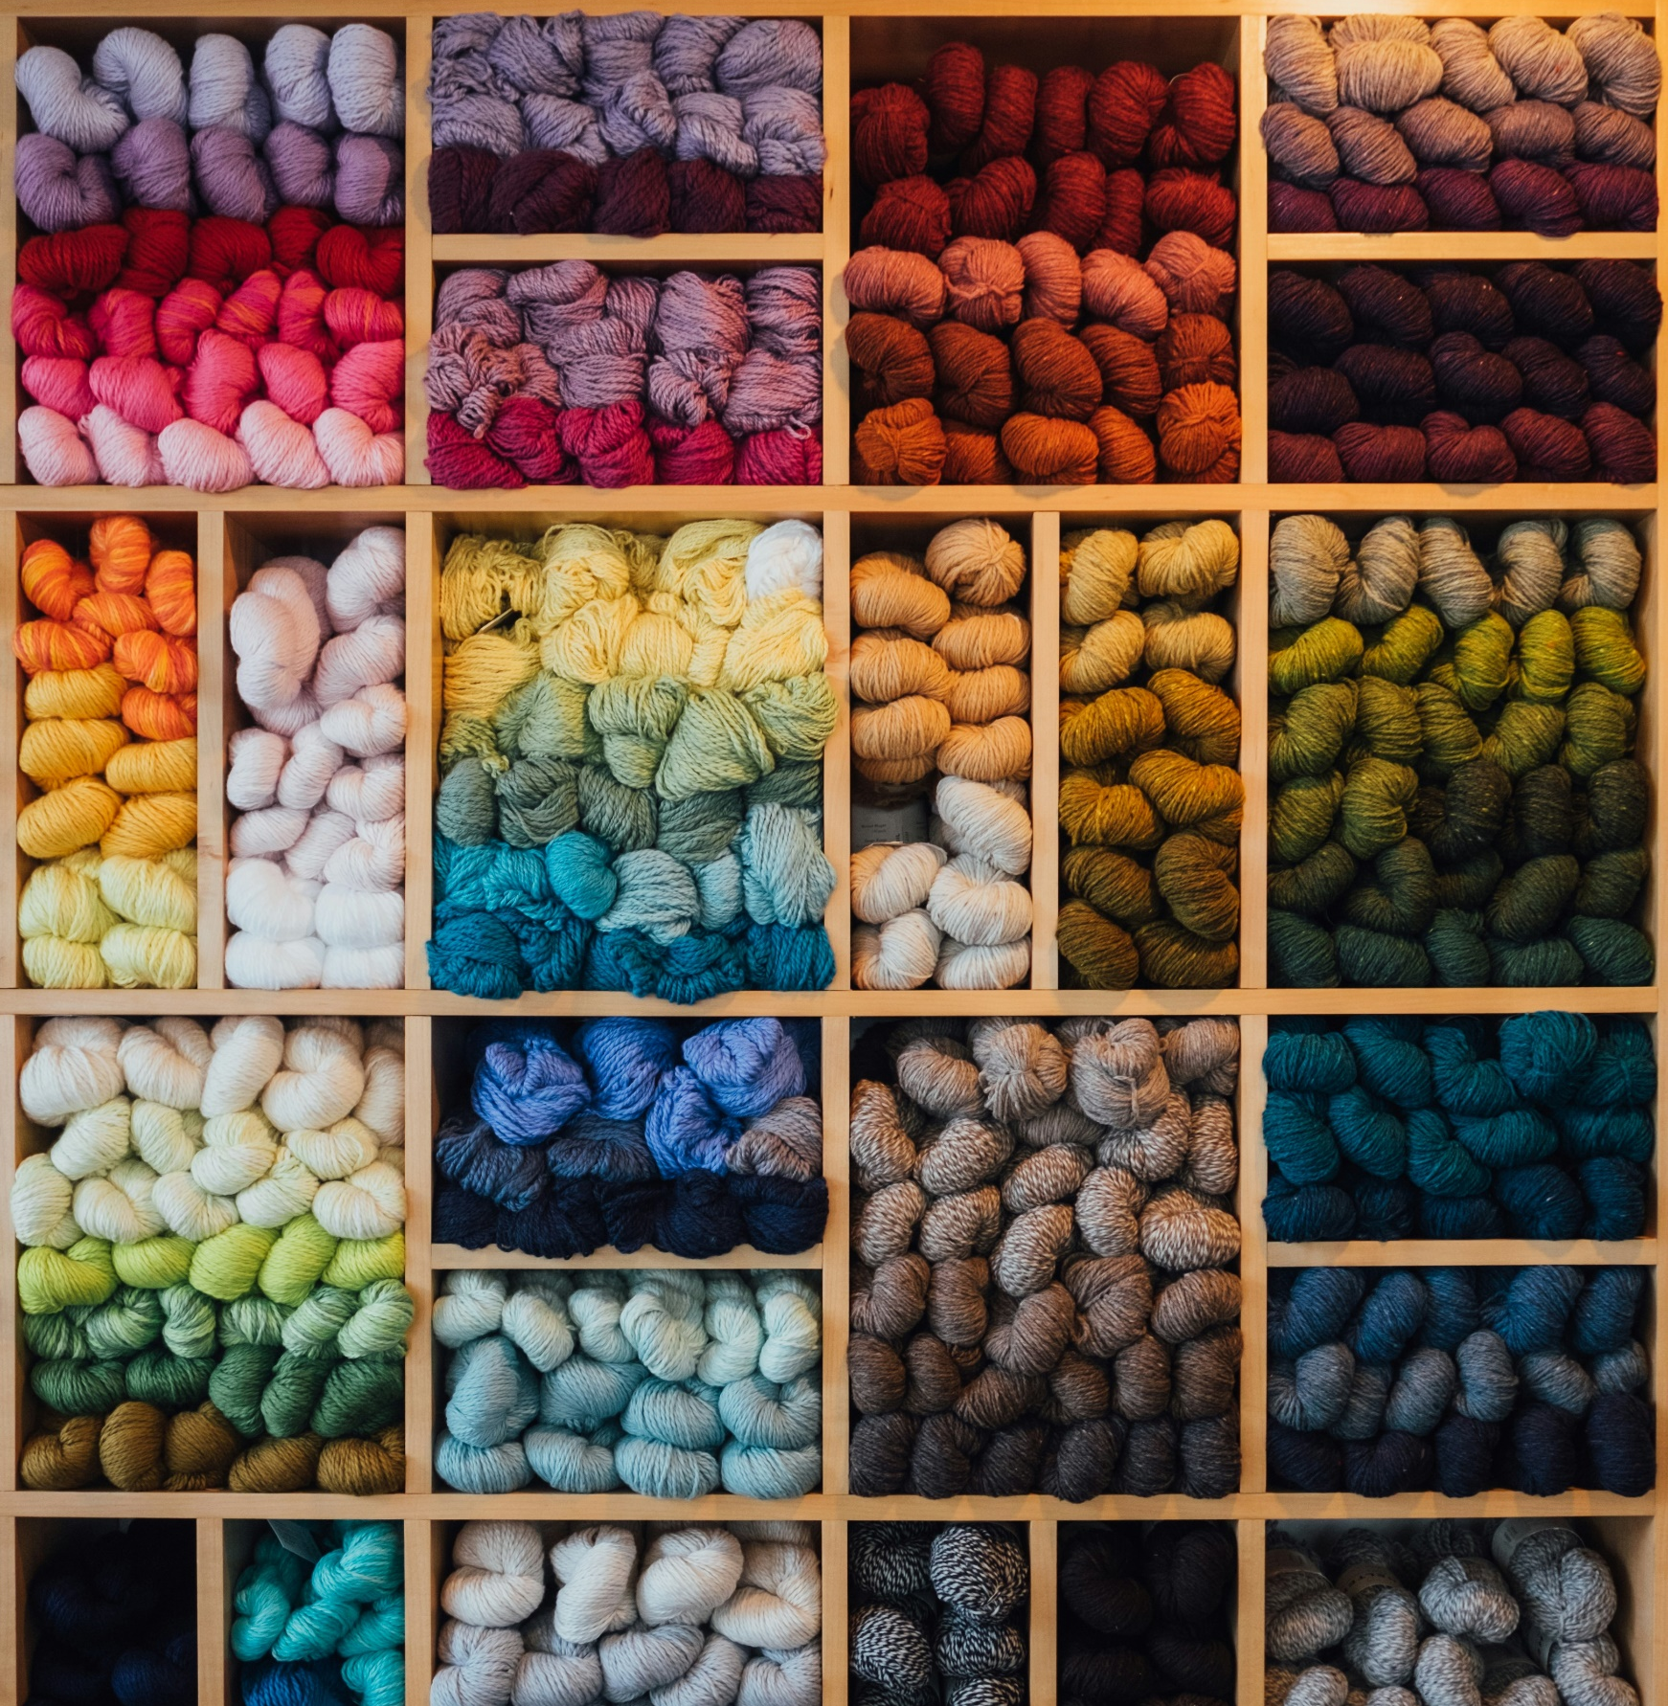
Woolly Wonders
EXPLORING WOOL AND MICRON COUNTS
Photo: Georgi Kalaydzhiev
Photo: Paul Hanaoaka

Slide 2
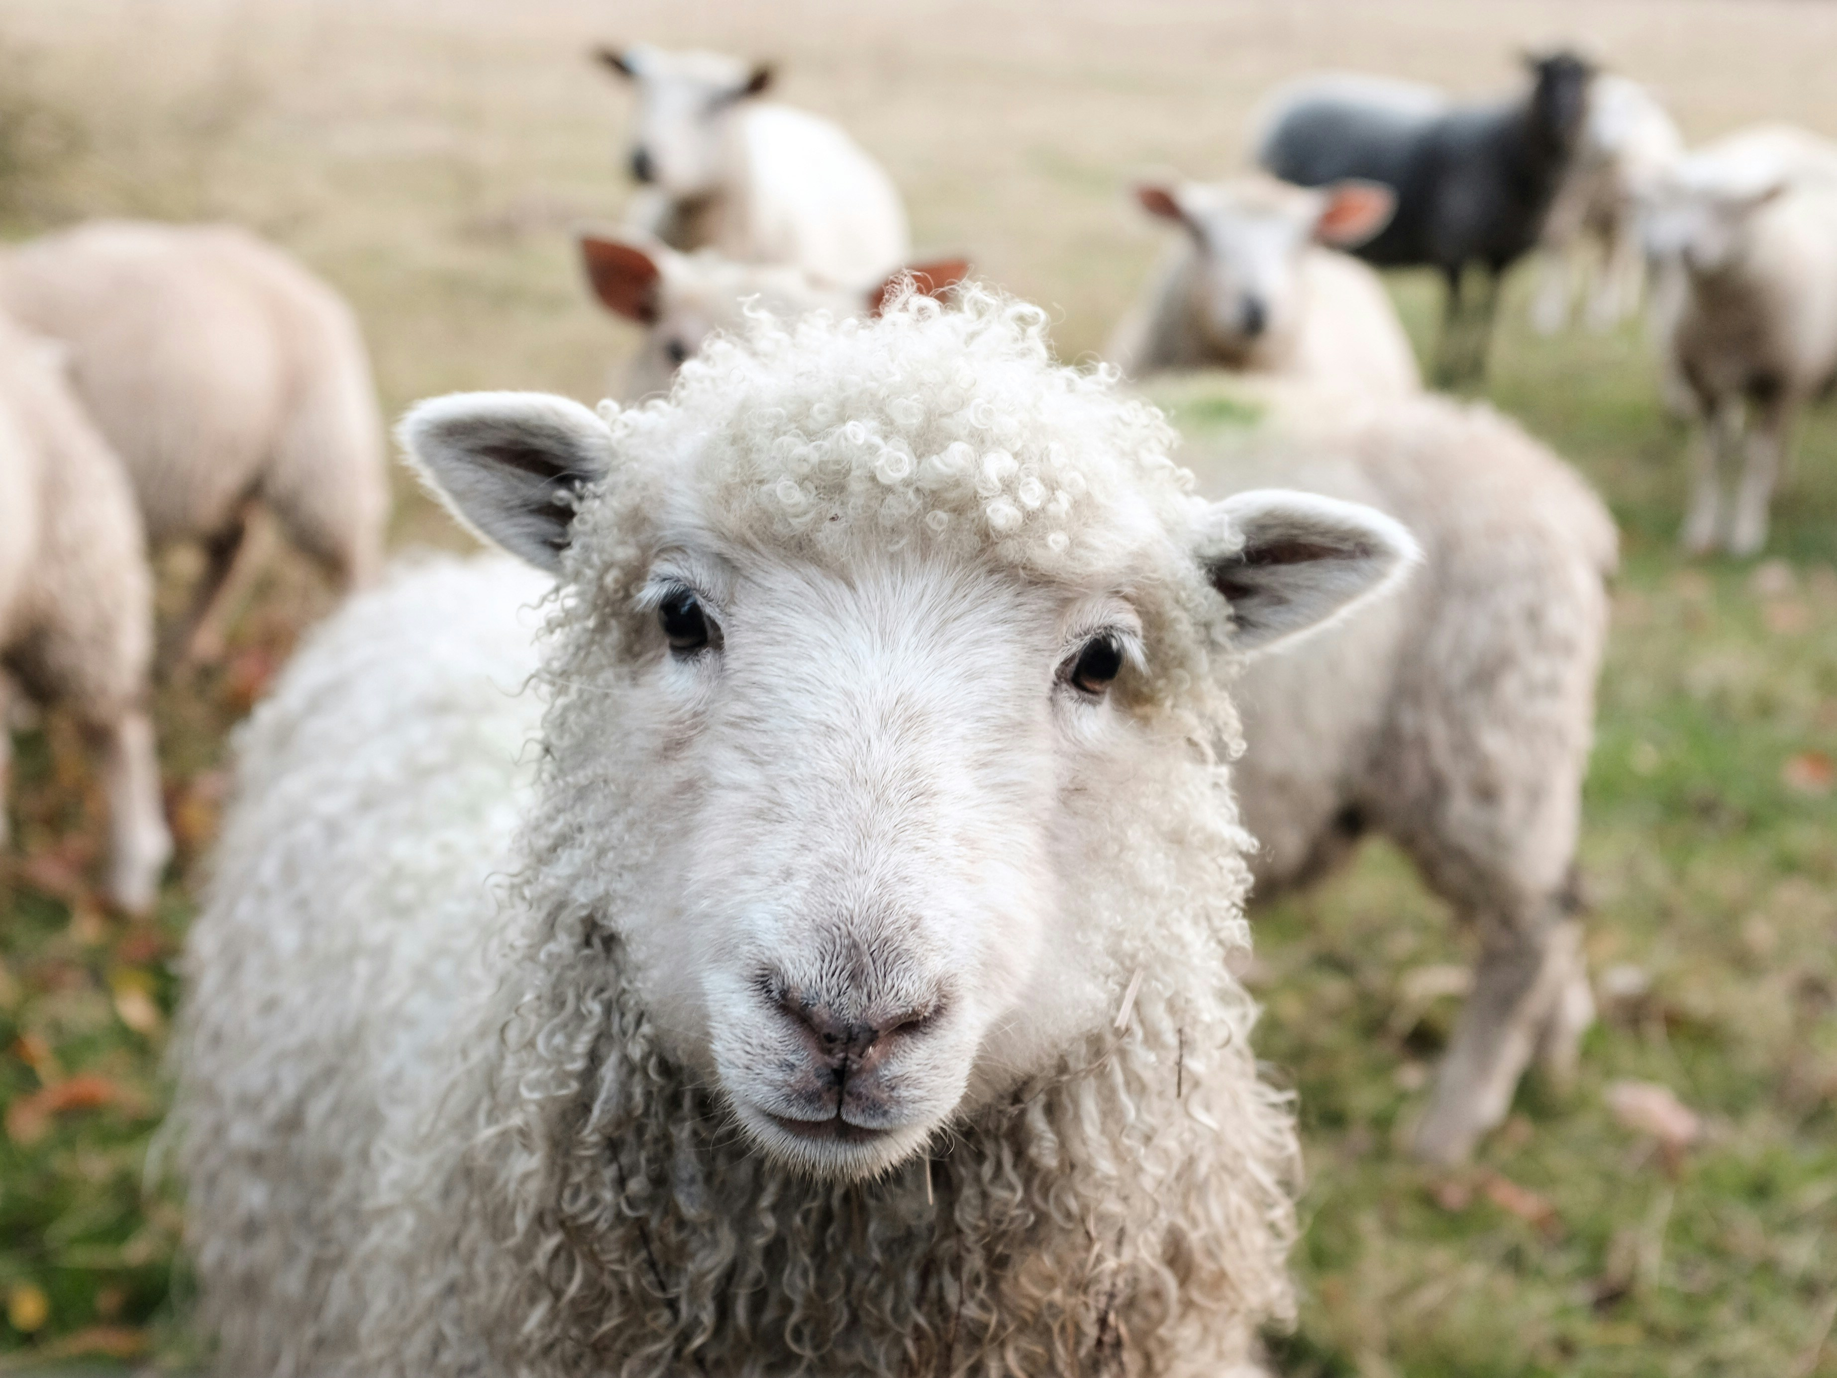
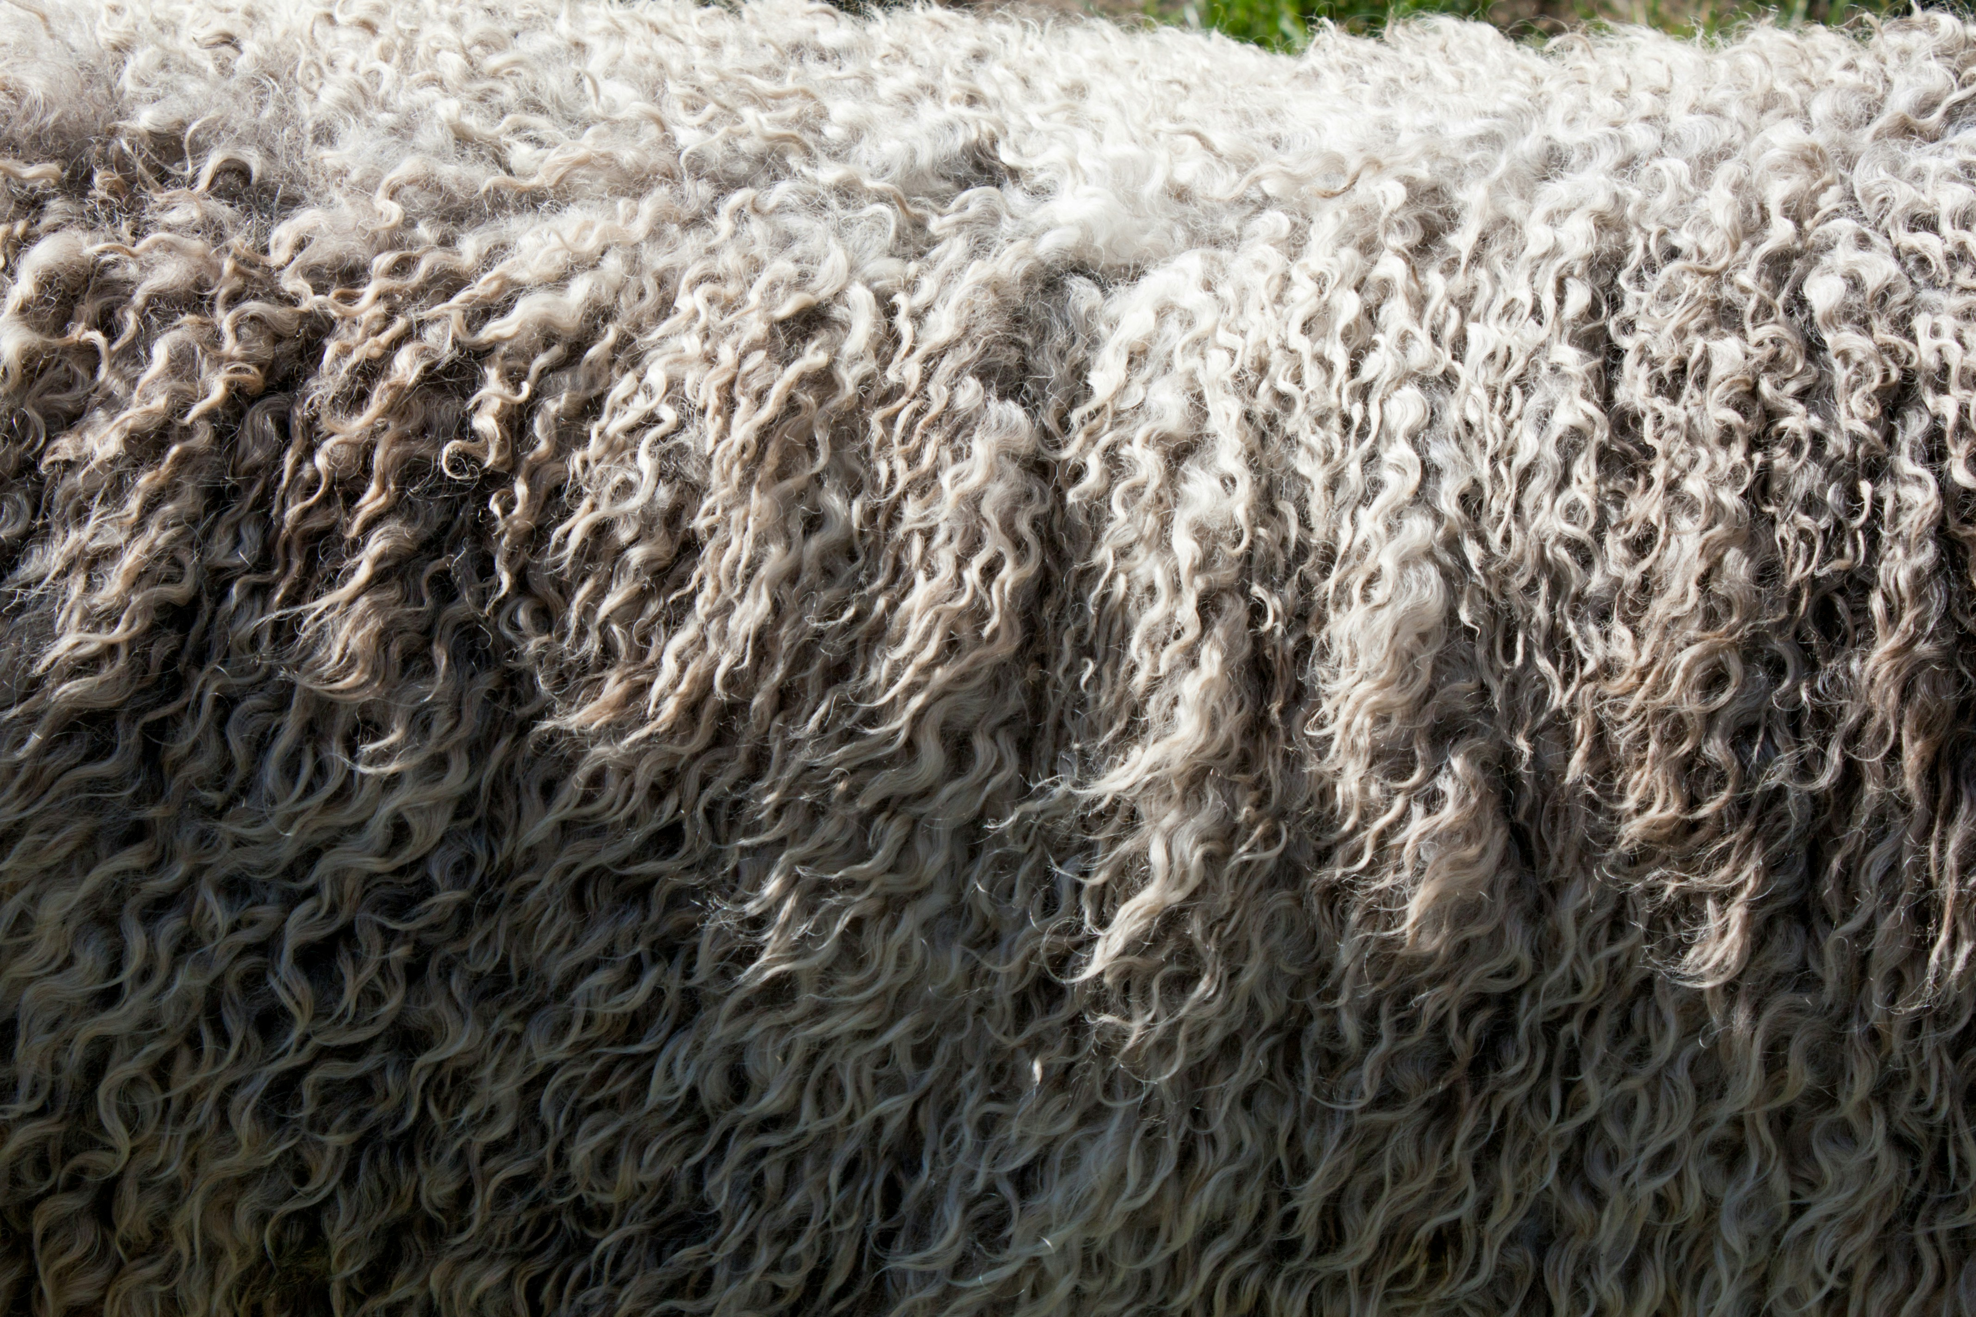
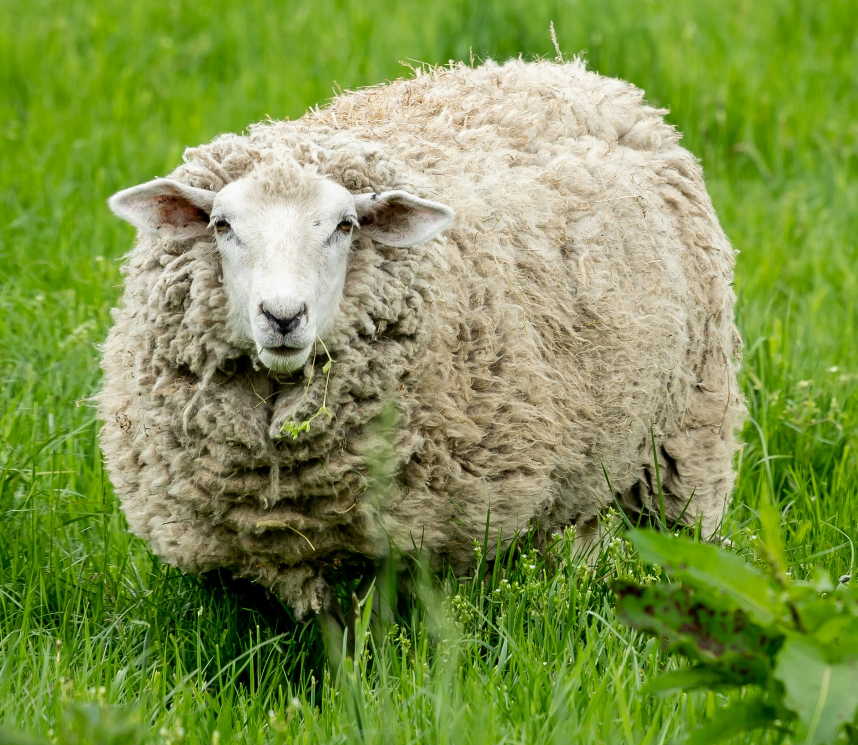
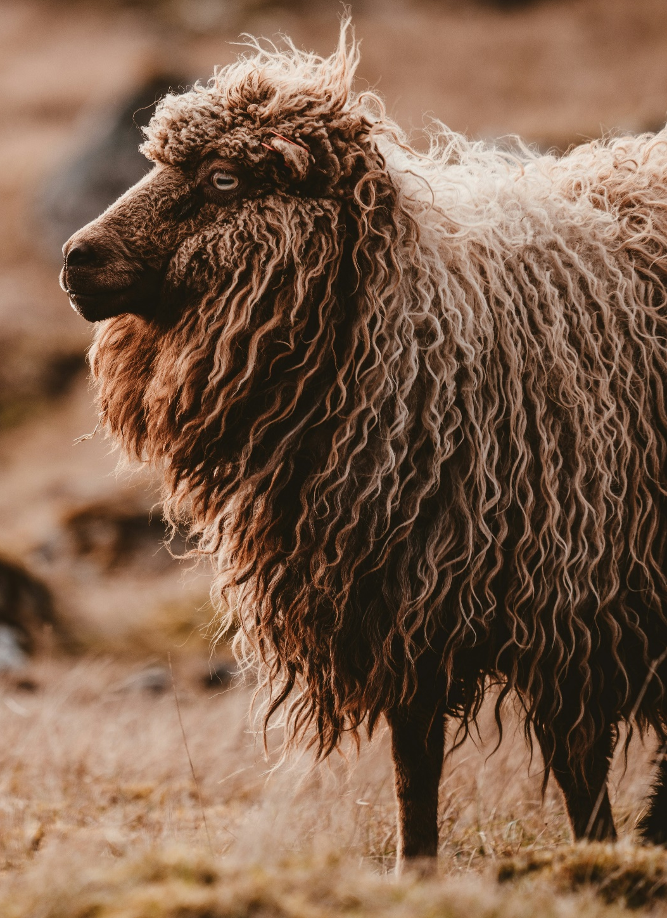
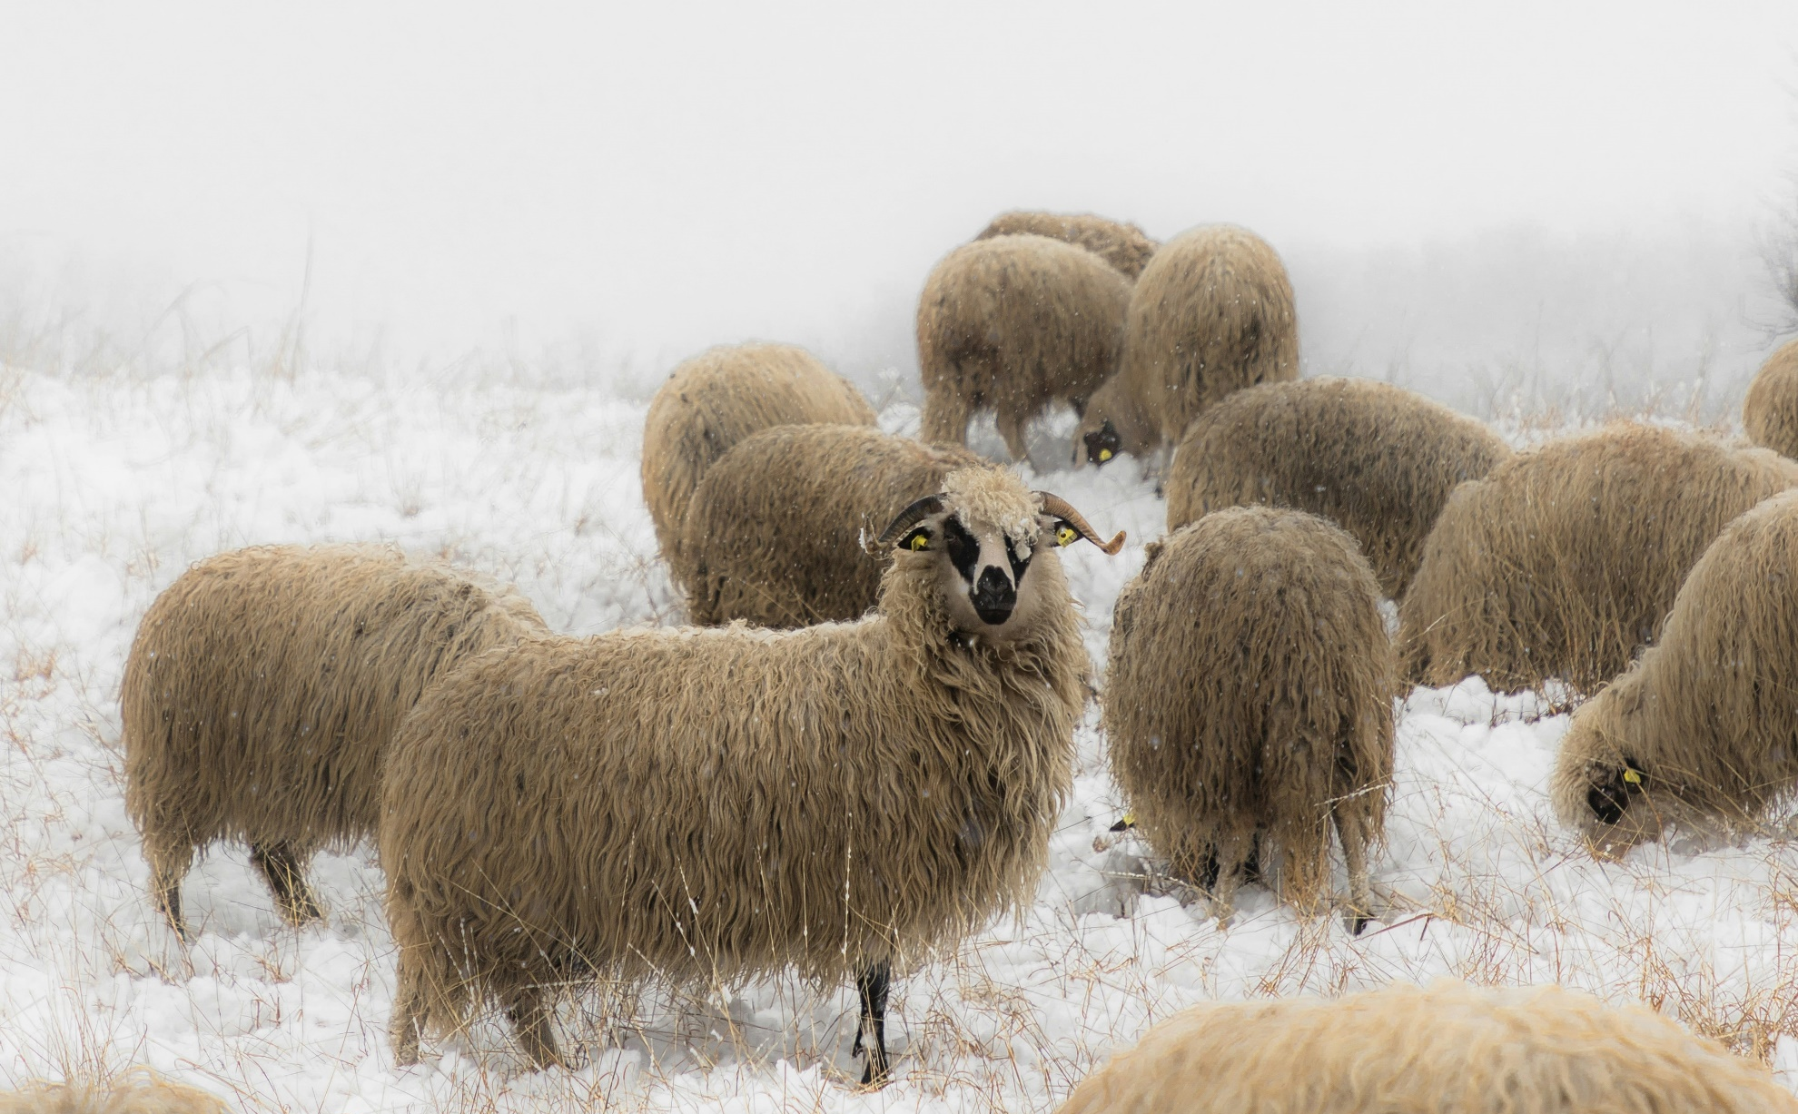
What’s up with Wool?
Photo: Phillip Deus
Photo: Vince Veras
Photo: Sam Carter
Photo: Jovan Vasiljevic
Photo: Annie Spratt
How does the climate and geography of a region where different breeds of sheep come from affect their wool?

Slide 3
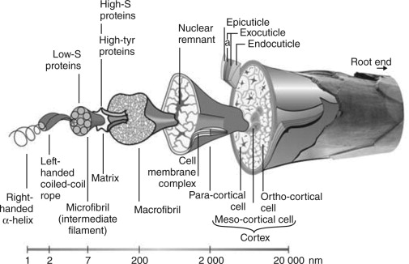
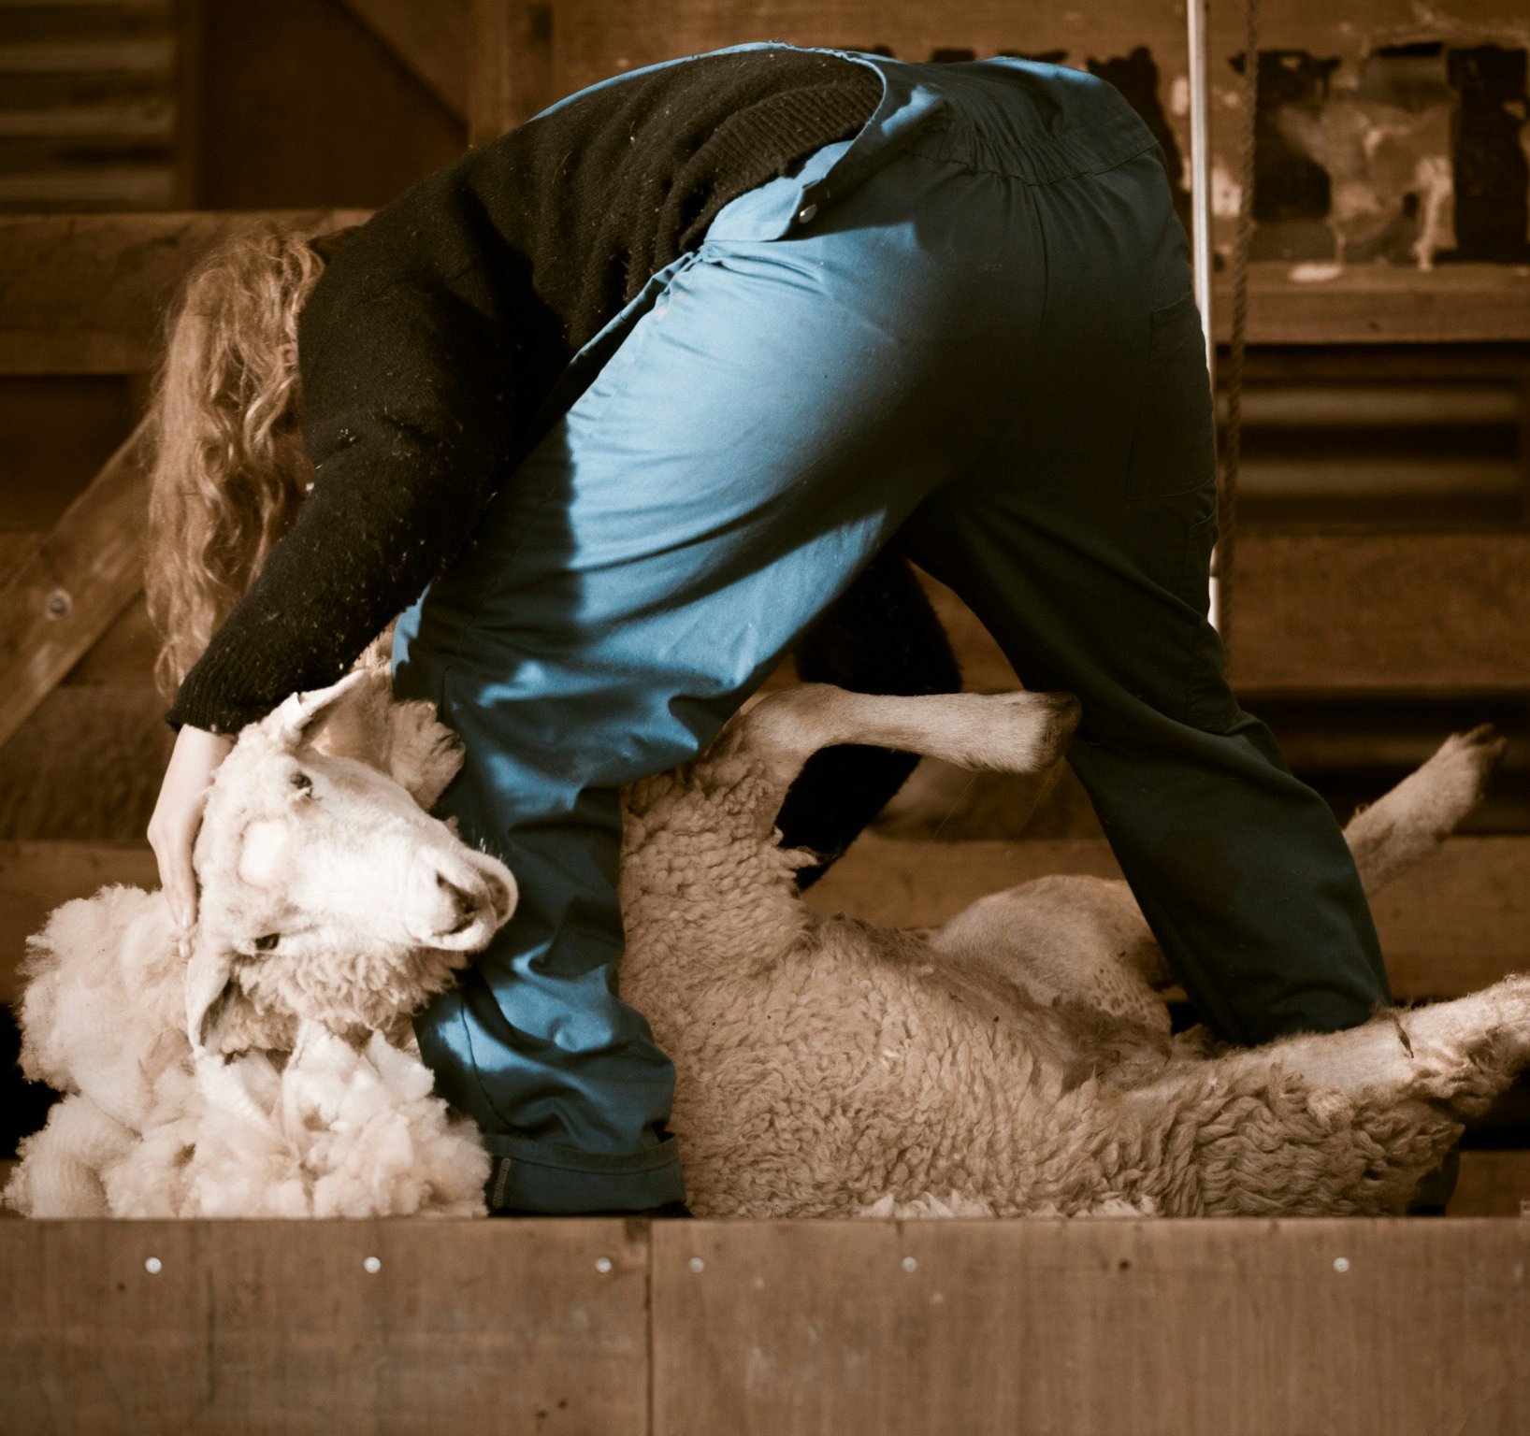
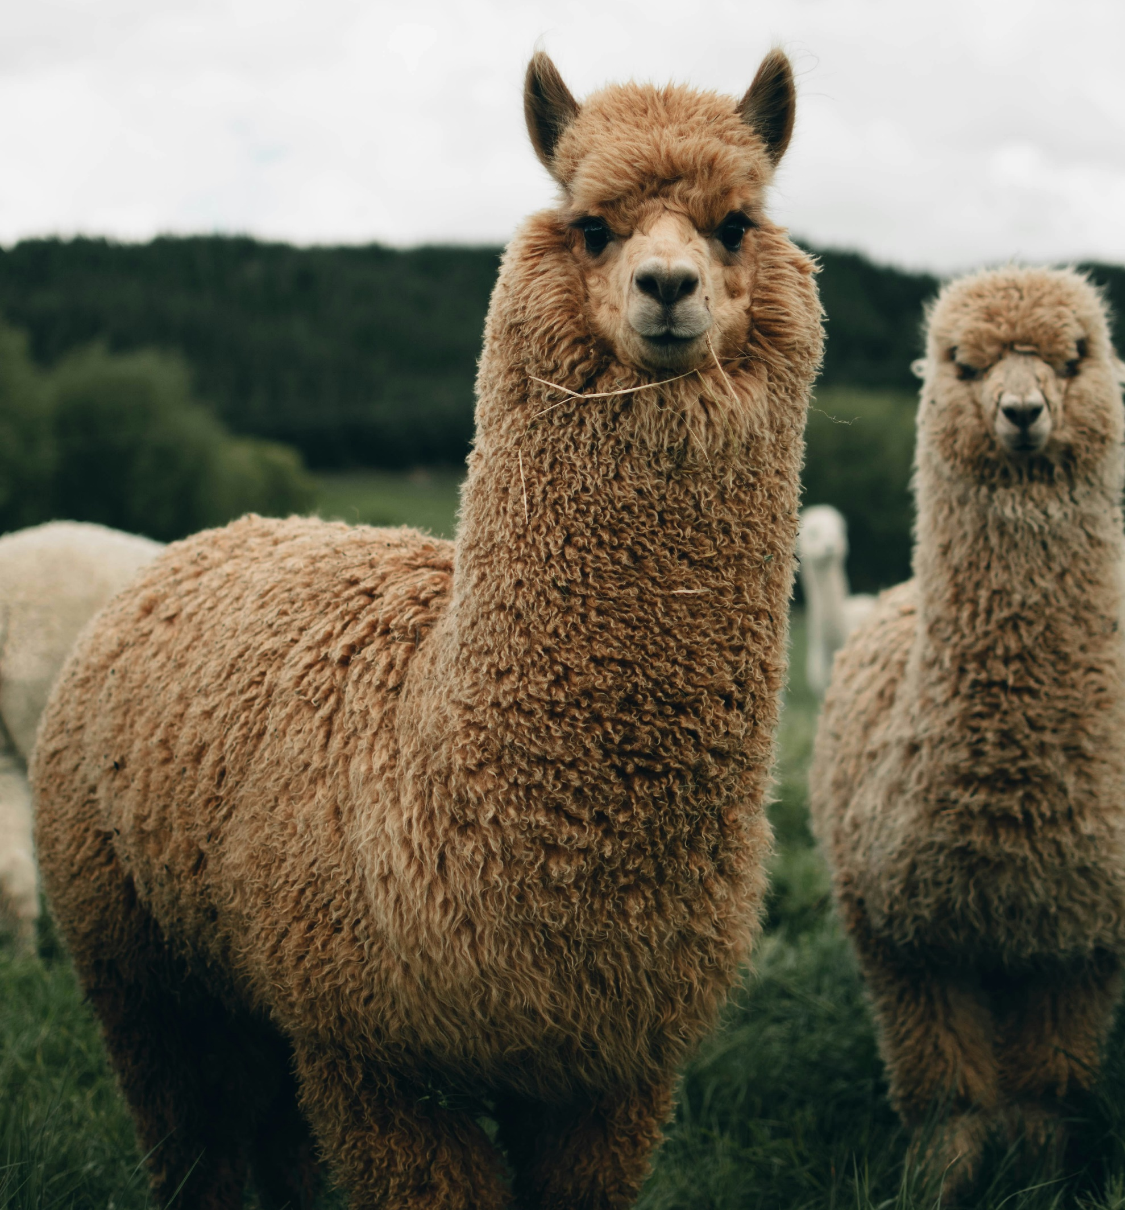
What is Wool?
Wool comes from the fleece of animals like sheep, goats, and alpacas.
Properties of Wool: Warmth, Moisture-Wicking, Durability
Photo: Ardiss Hutaff
Photo: Josiah Farrow
Wool Fiber Structure. CSIRO Materials Science & Engineering Textile and Fibre Technology Program Graphics by H.Z. Roe, 1992 & Lipson 2008, based on a drawing by R.D.B. Fraser, 1972.
Notes:
Wool Fiber Structure graphic from: Russell, I.M. 2009. Sustainable wool production and processing. Sustainable Textiles: Life Cycle and Environmental Impact p.63-87. https://doi.org/10.1533/9781845696948.1.63

Slide 4

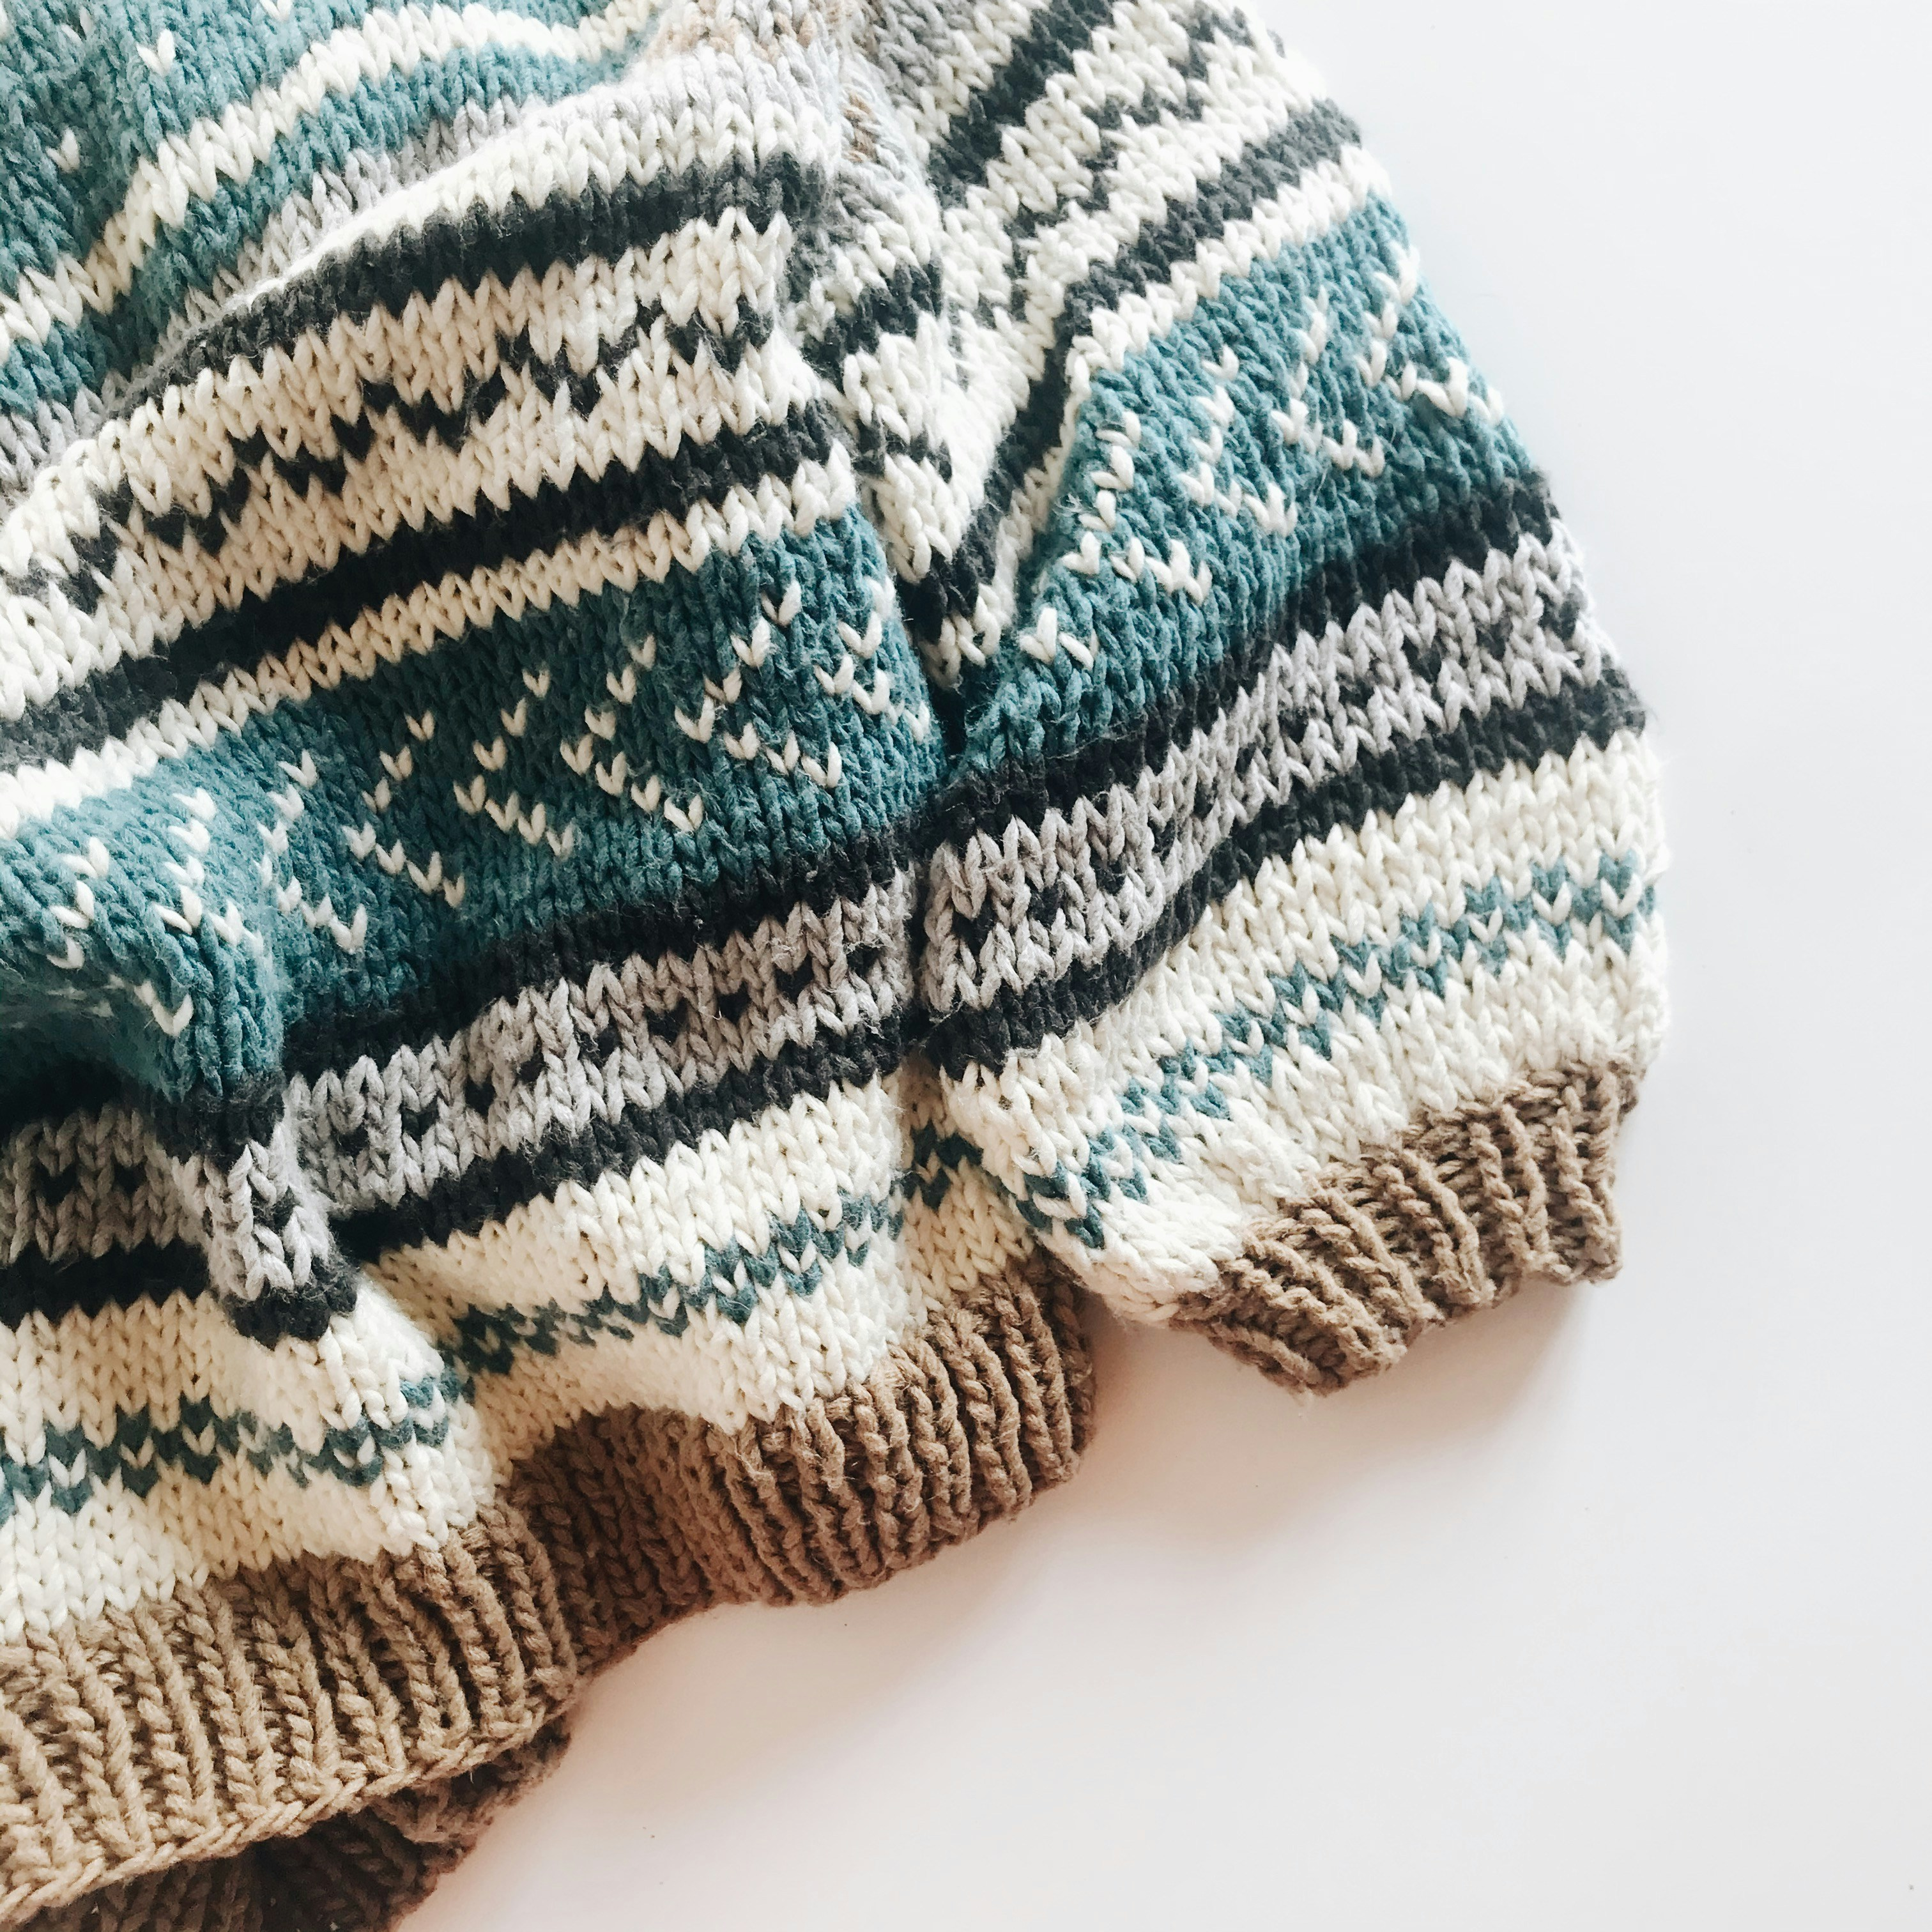
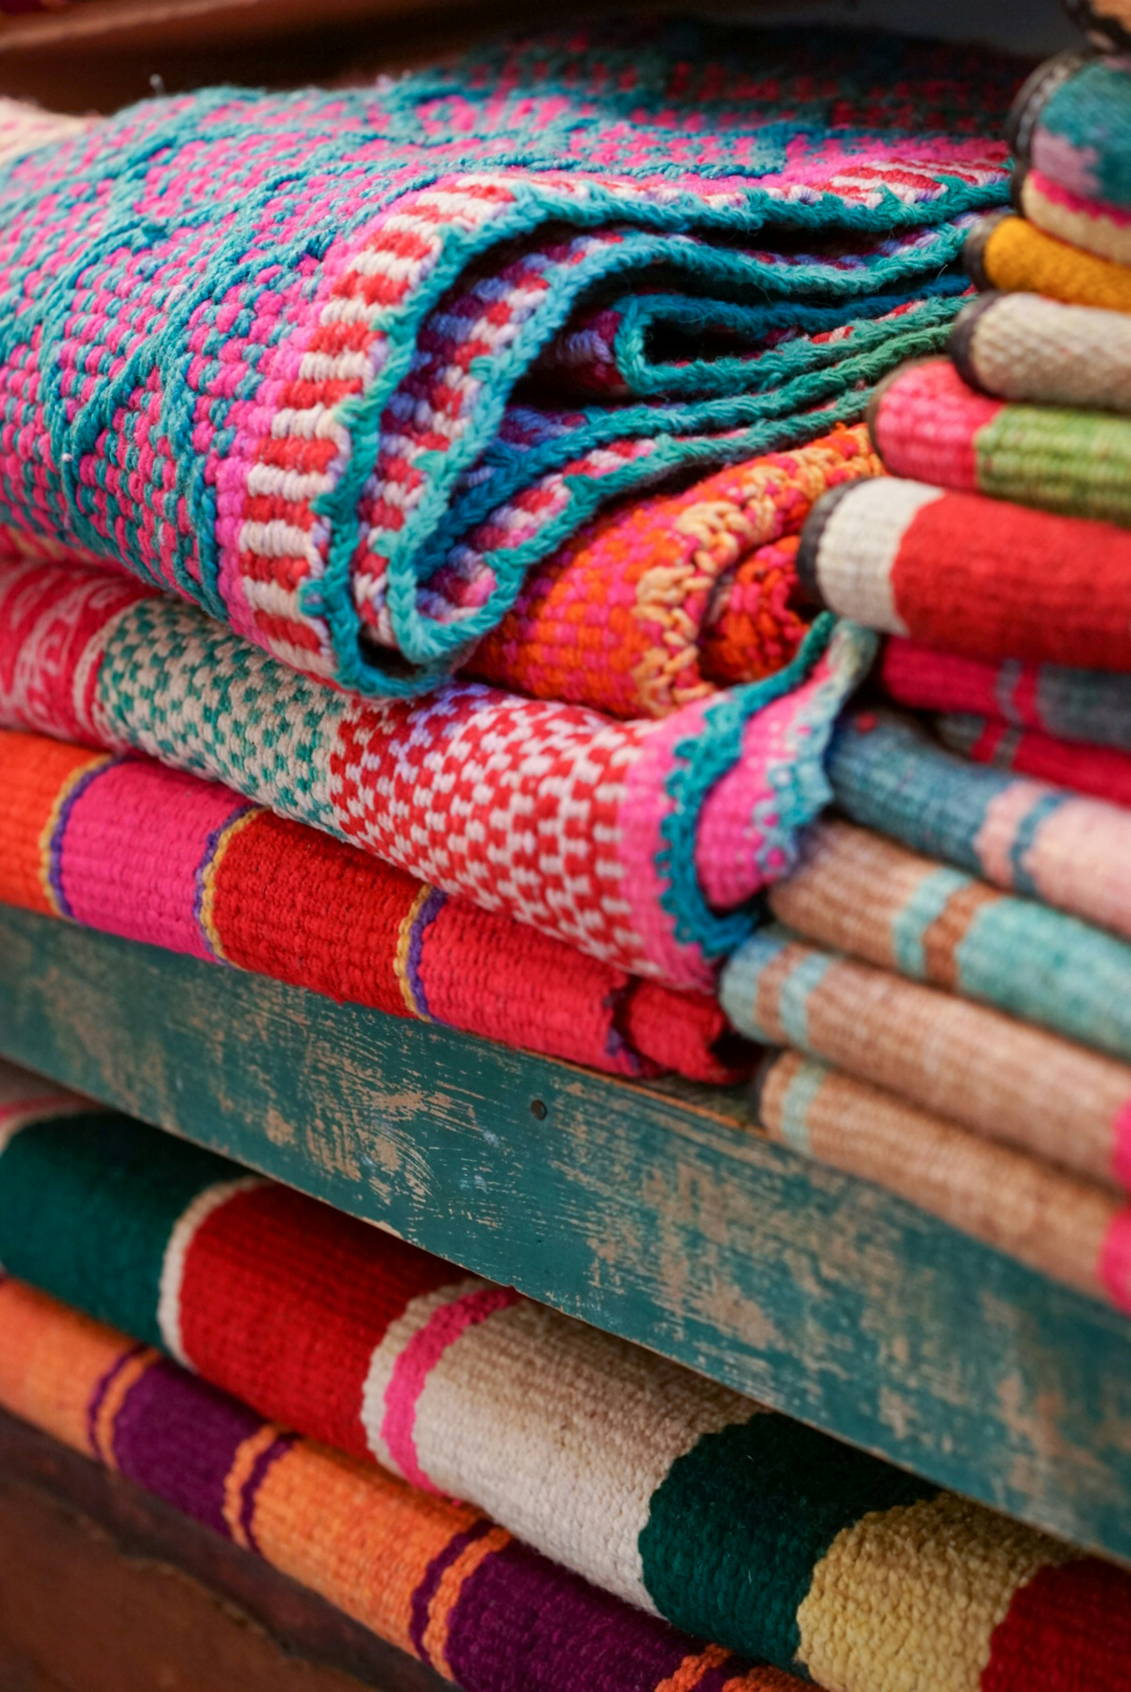
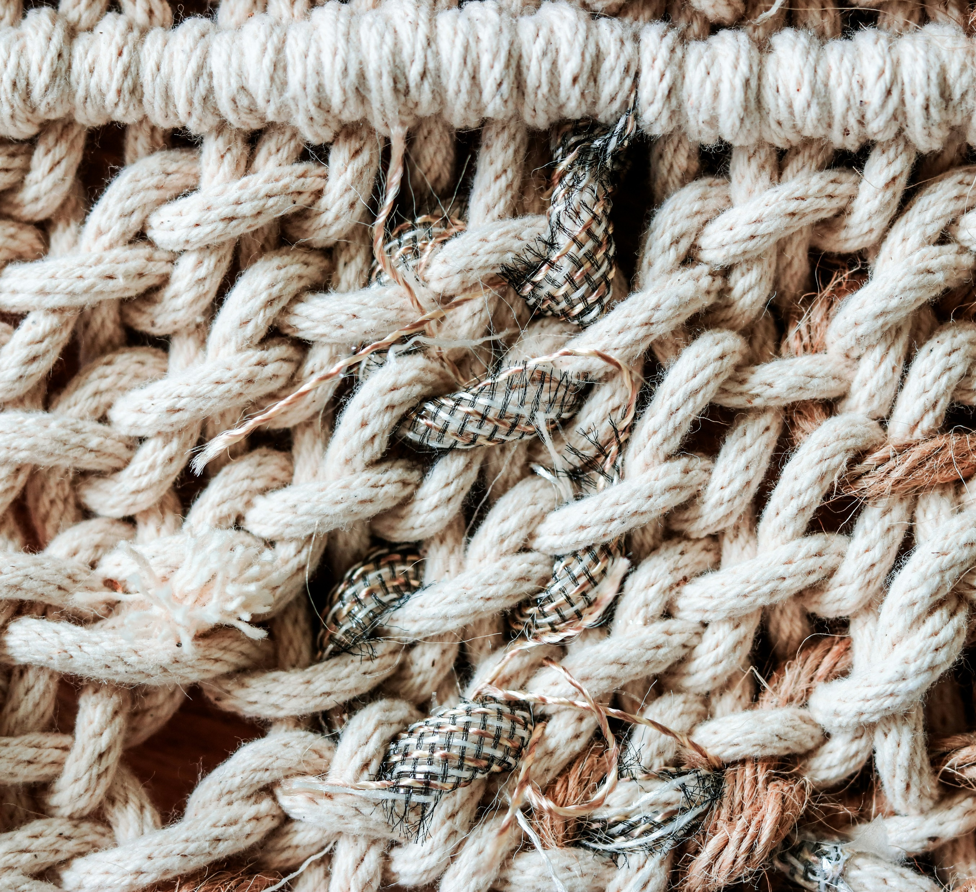
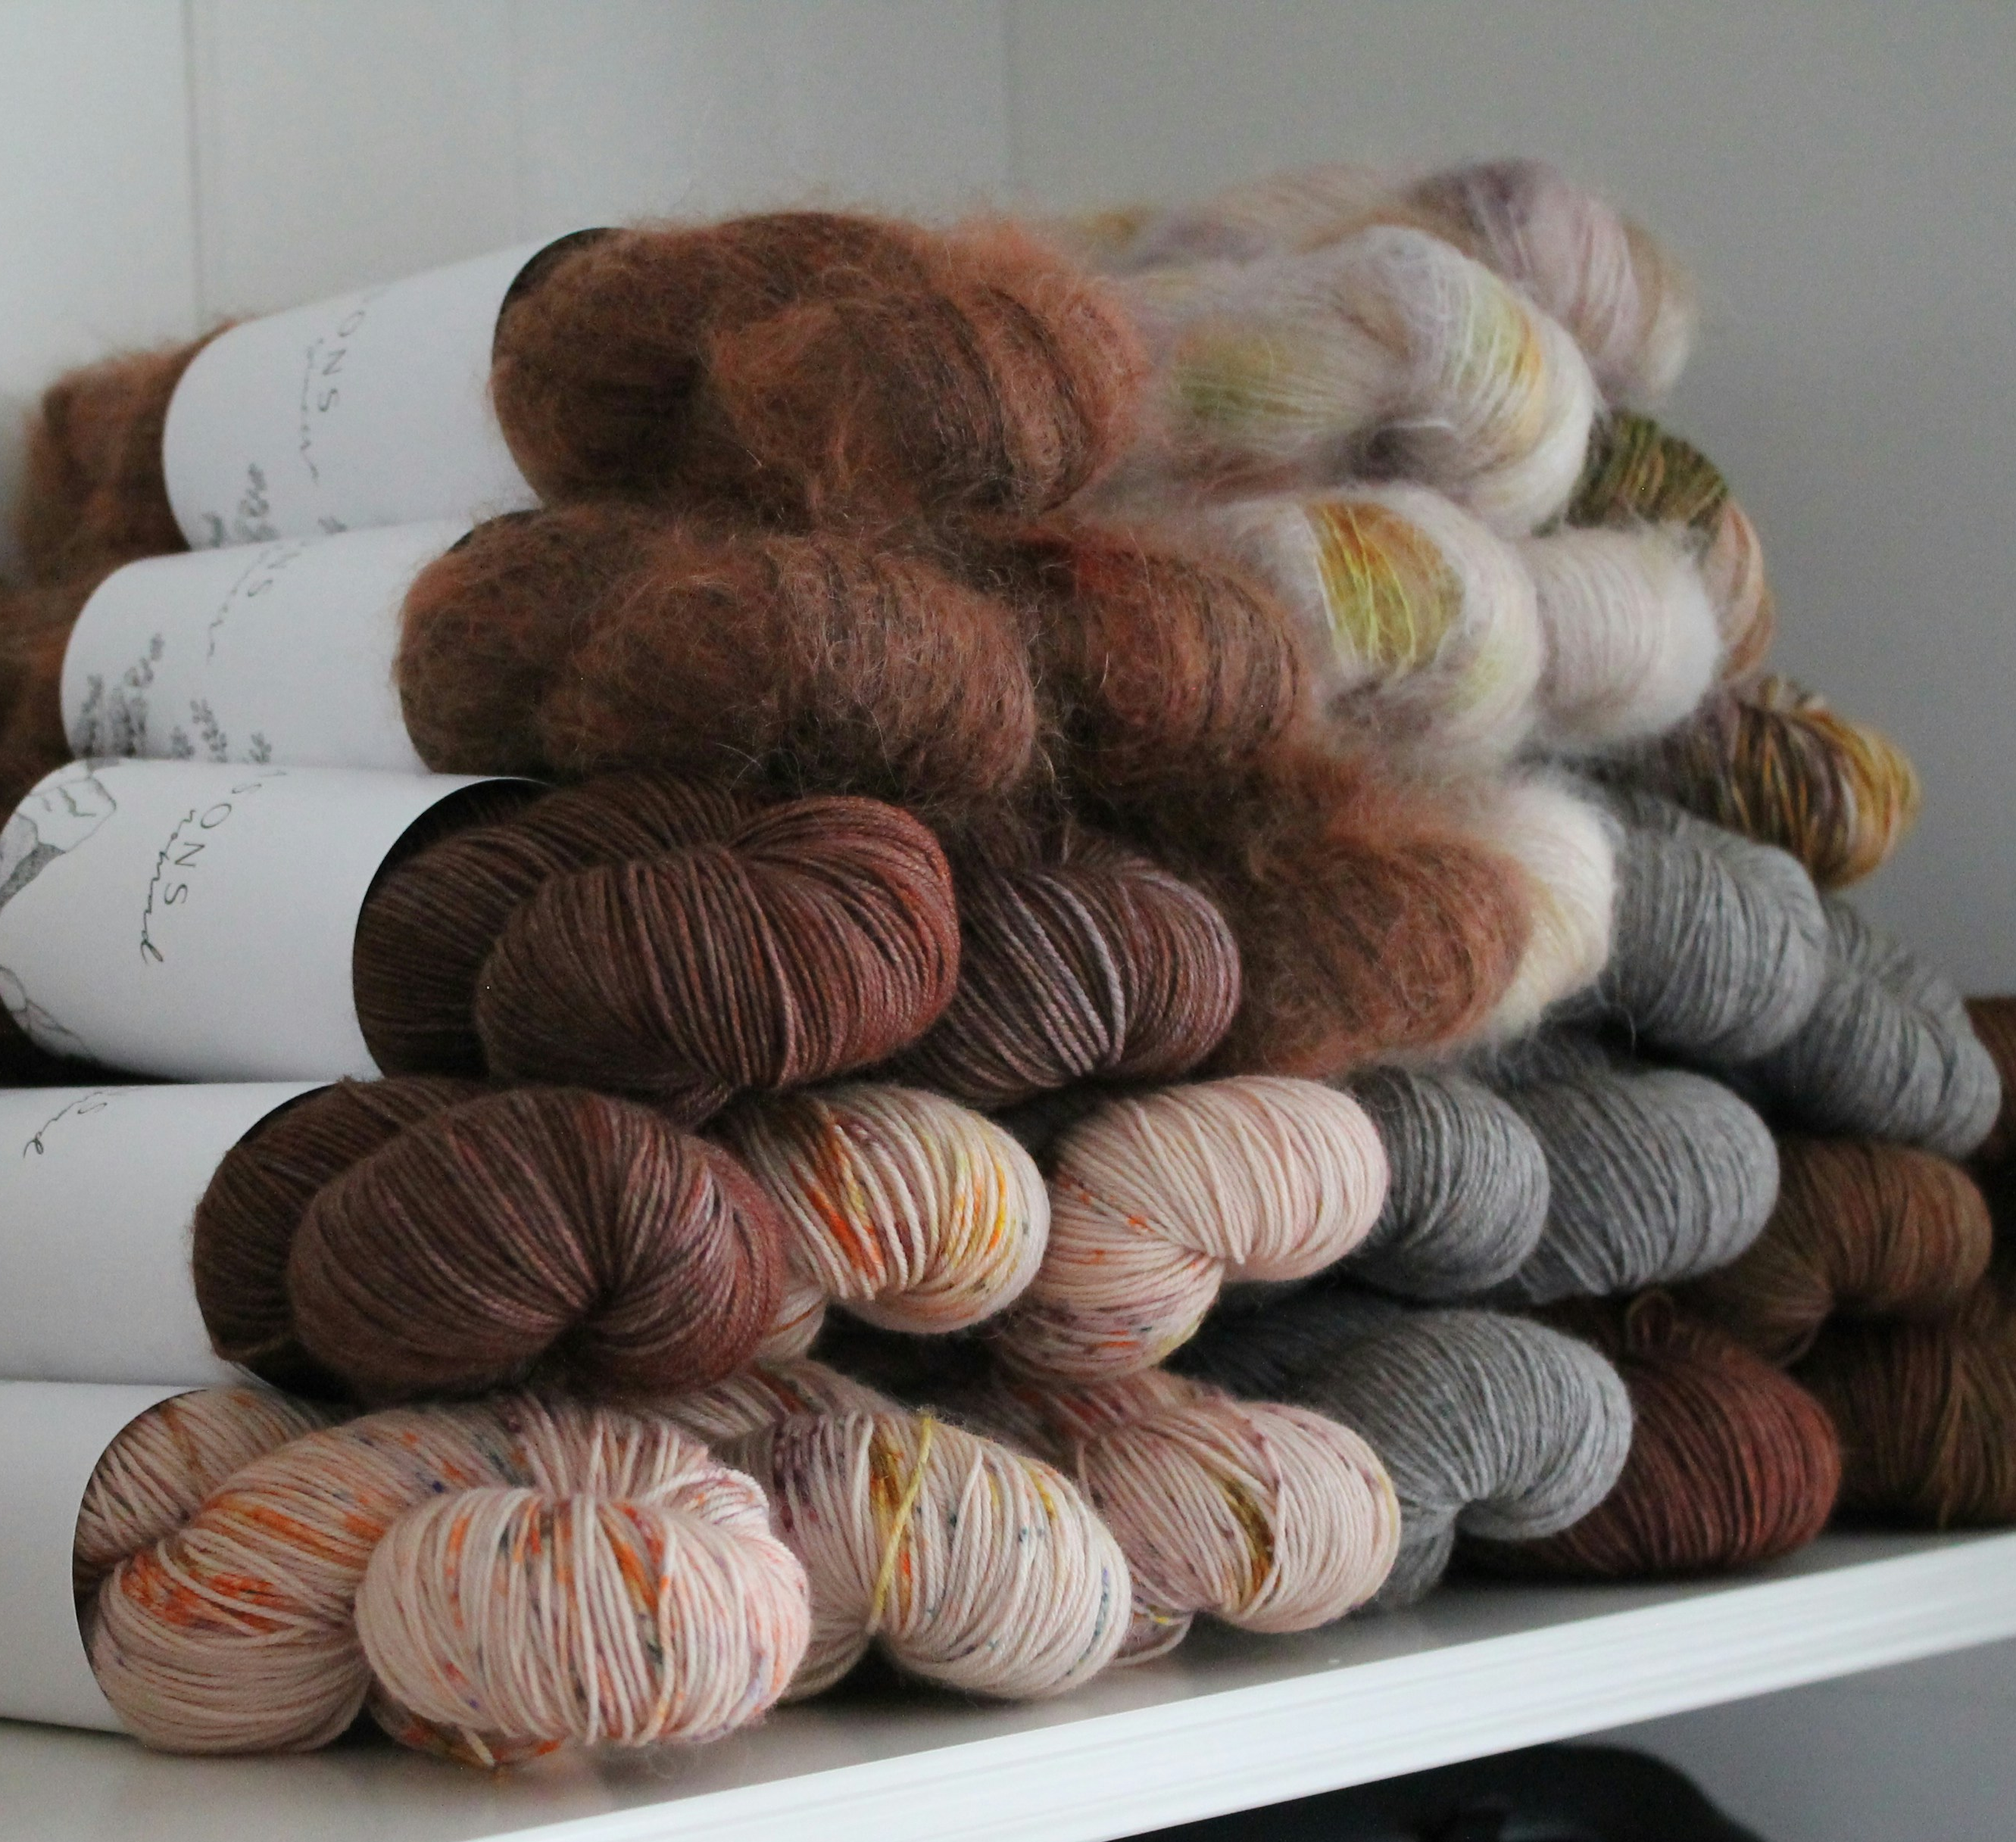
Wool Industry
Photo: Haley Powers
Photo: rocknwool
Photo: Kate McLean
Photo: Nynne Schroder
Photo: Megan Bucknall

Slide 5
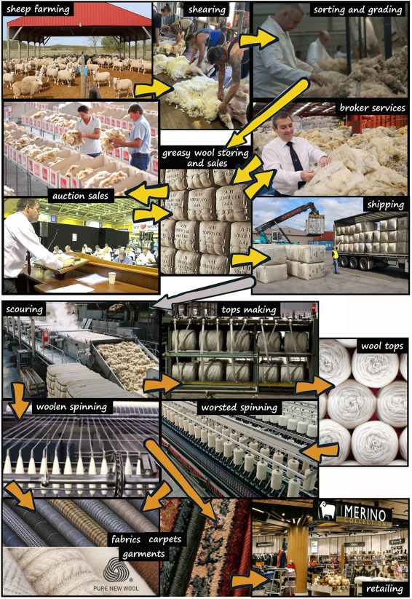
Producing Wool
Wool Growing - Sheep husbandry, breeding, feeding, health monitoring
Harvesting - Shearing
Preparation - Sorting, grading, scouring, pressing
Production - Combing, spinning, manufacturing
Retailing - Wool is distributed and sold all around the world
Figure from: Ozek, H.Z. 2024. Wool production steps and global trade with recent statistics. The Wool Handbook: Morphology, Structure, Properties, Processing, and Applications p. 25-74. https://doi.org/10.1016/B978-0-323-99598-6.00024-4
Notes:
Figure from: Ozek, H.Z. 2024. Wool production steps and global trade with recent statistics. The Wool Handbook: Morphology, Structure, Properties, Processing, and Applications p. 25-74. https://doi.org/10.1016/B978-0-323-99598-6.00024-4

Slide 6
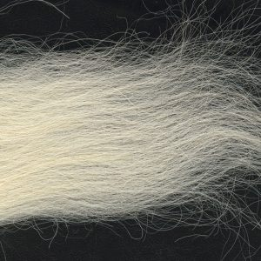
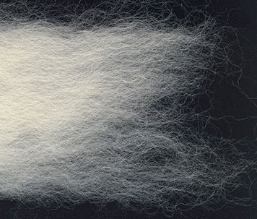
Understanding Micron Counts
Micron counts are a measure of wool fiber diameter, or wool thickness.
A micron is equal to one-millionth of a meter.
The larger the number, the coarser the fiber.
Photo: George Weil
Photo: George Weil
Micron Count: 24-28
(Example: Bluefaced Leicester)
Finer Wool
Micron Count: 36-40+
(Example: Devon Longwool)
Coarser Wool

Slide 7
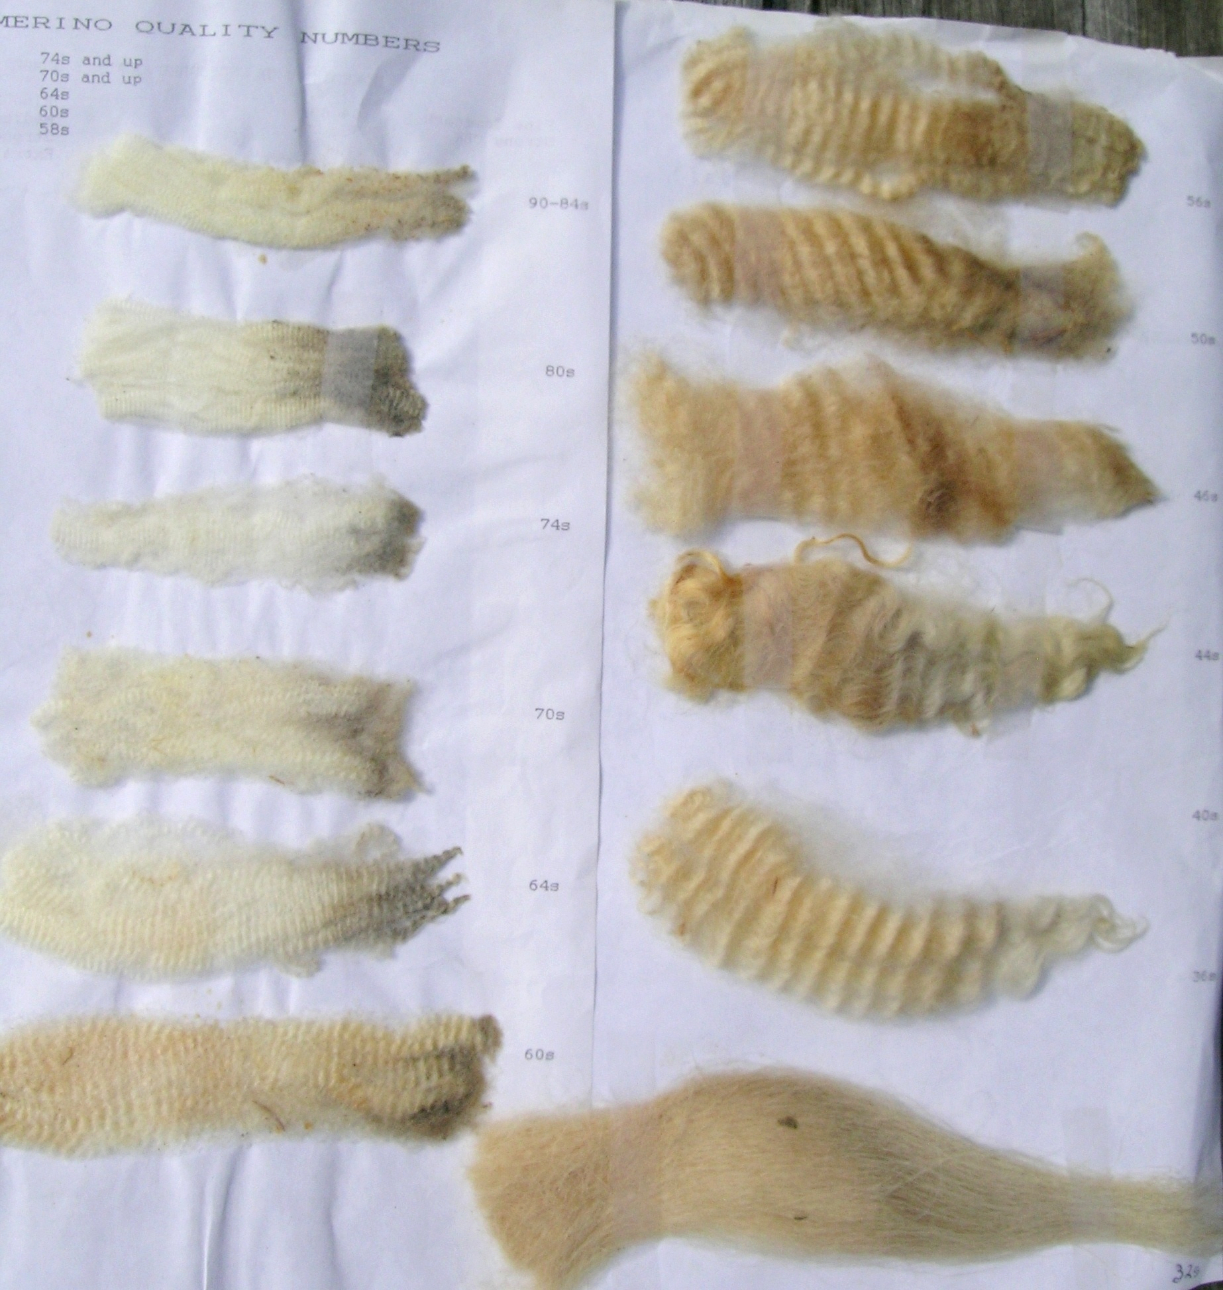
Other Wool Measurements
Staple Length – length of wool after it has been sheared, often in millimeters.
Staple Strength – amount of force required to break a bundle of wool with a given thickness.
Yield – amount of wool remaining after being cleaned.
Crimp – level of curl the wool has.
Staple
Photo: C. Goodwin

Slide 8
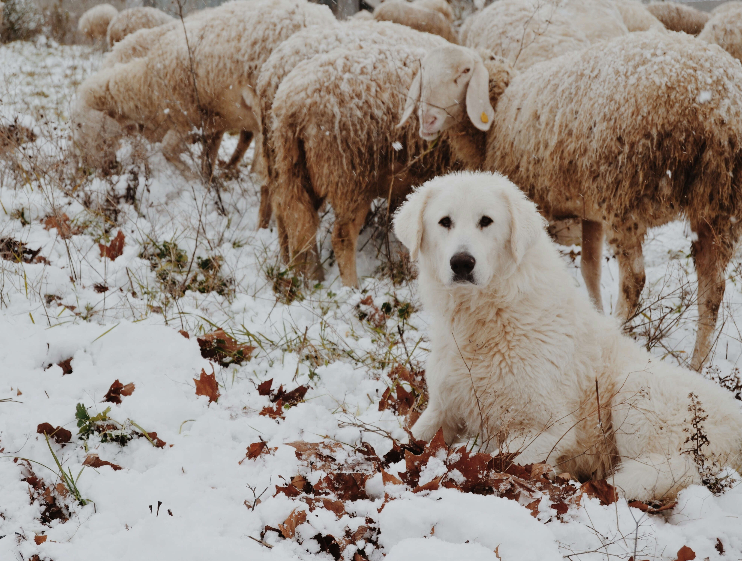
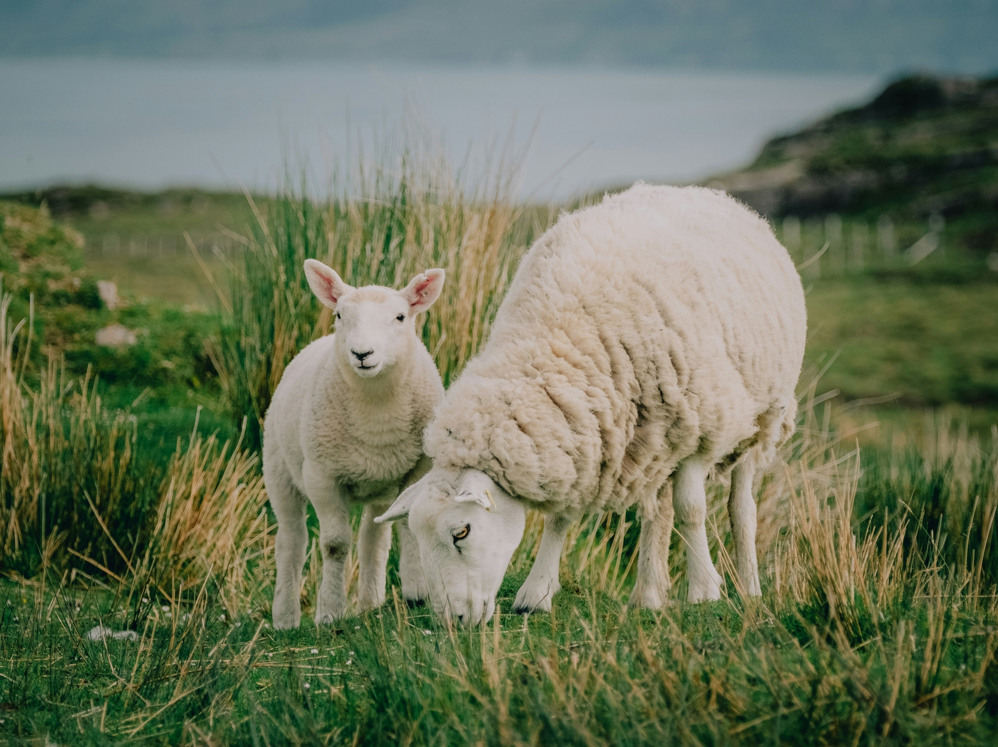
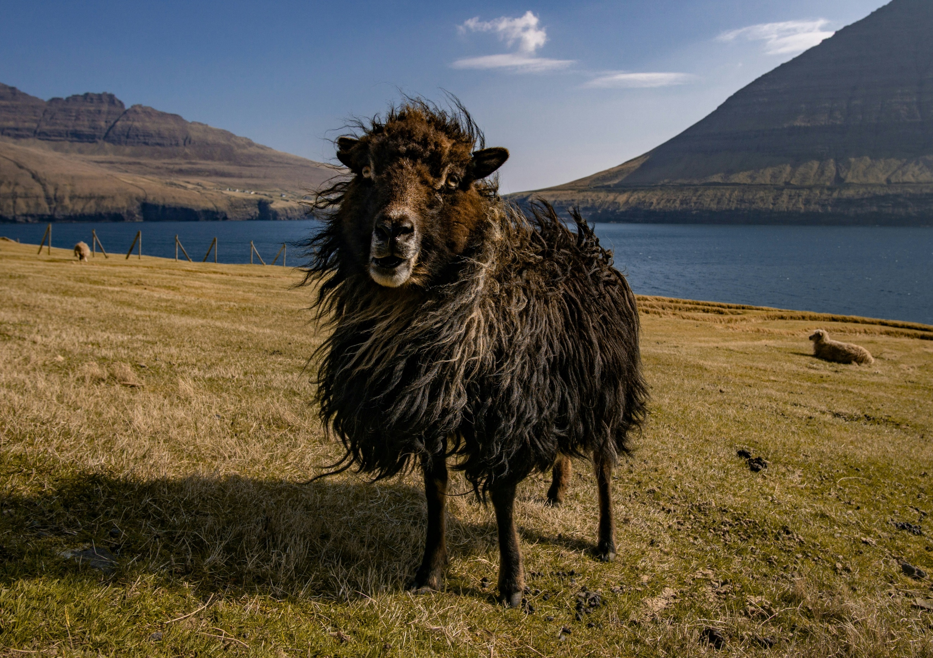
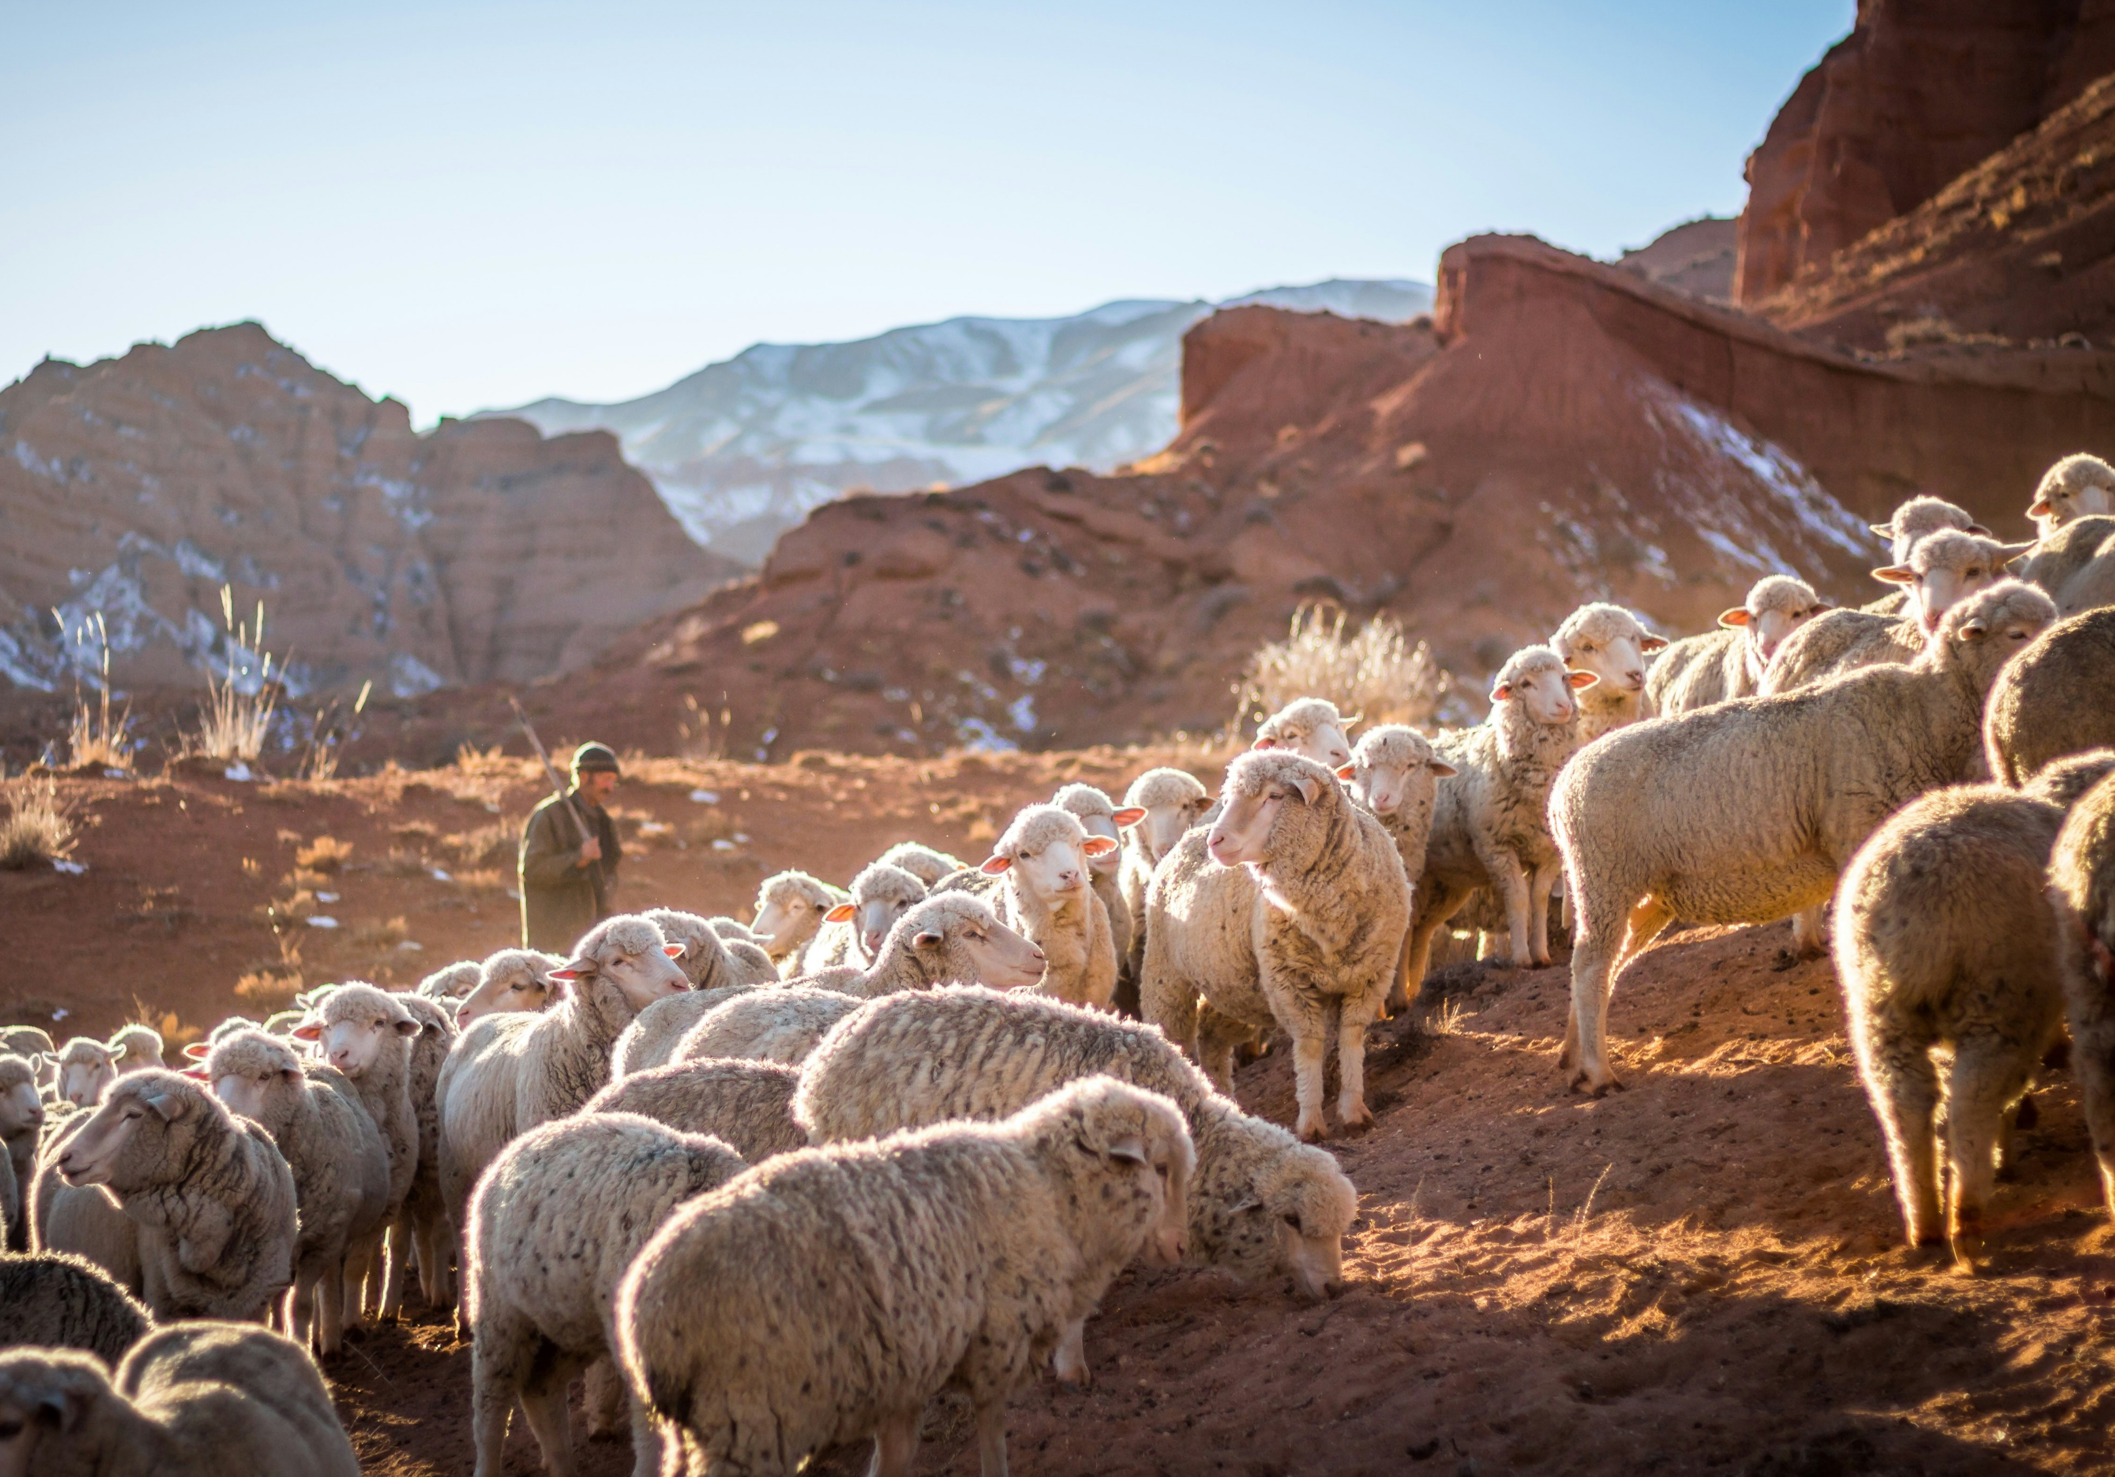
Sheep Biogeography
The study of the distribution of life across space and how it has changed through time.
Geography and Environmental Factors can impact wool characteristics.
Climate
Vegetation and Diet
Genetic Adaptation
Cultural Traditions
Photo: Federica Giusti
Photo: Mitchell Orr
Photo: Michael Fousert
Photo: Patrick Schneider
Bio – geo - graphy
Life – Earth – Describe

Slide 9
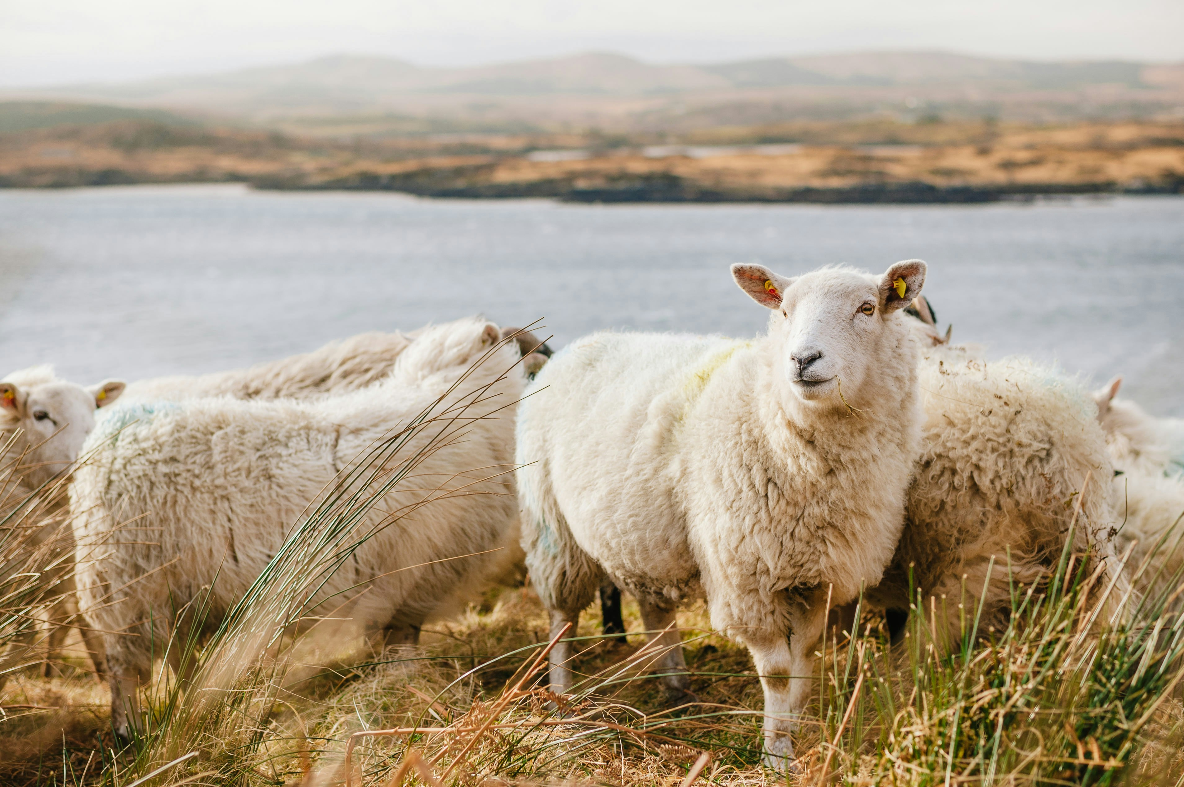
Common Sheep Breeds Around the World
Merino
Rambouillet
Border Leicester
Romney
Shetland
Suffolk
Karakul
Hampshire
Columbia
Cormo
Junin
Photo: J. Schiemann

Slide 10
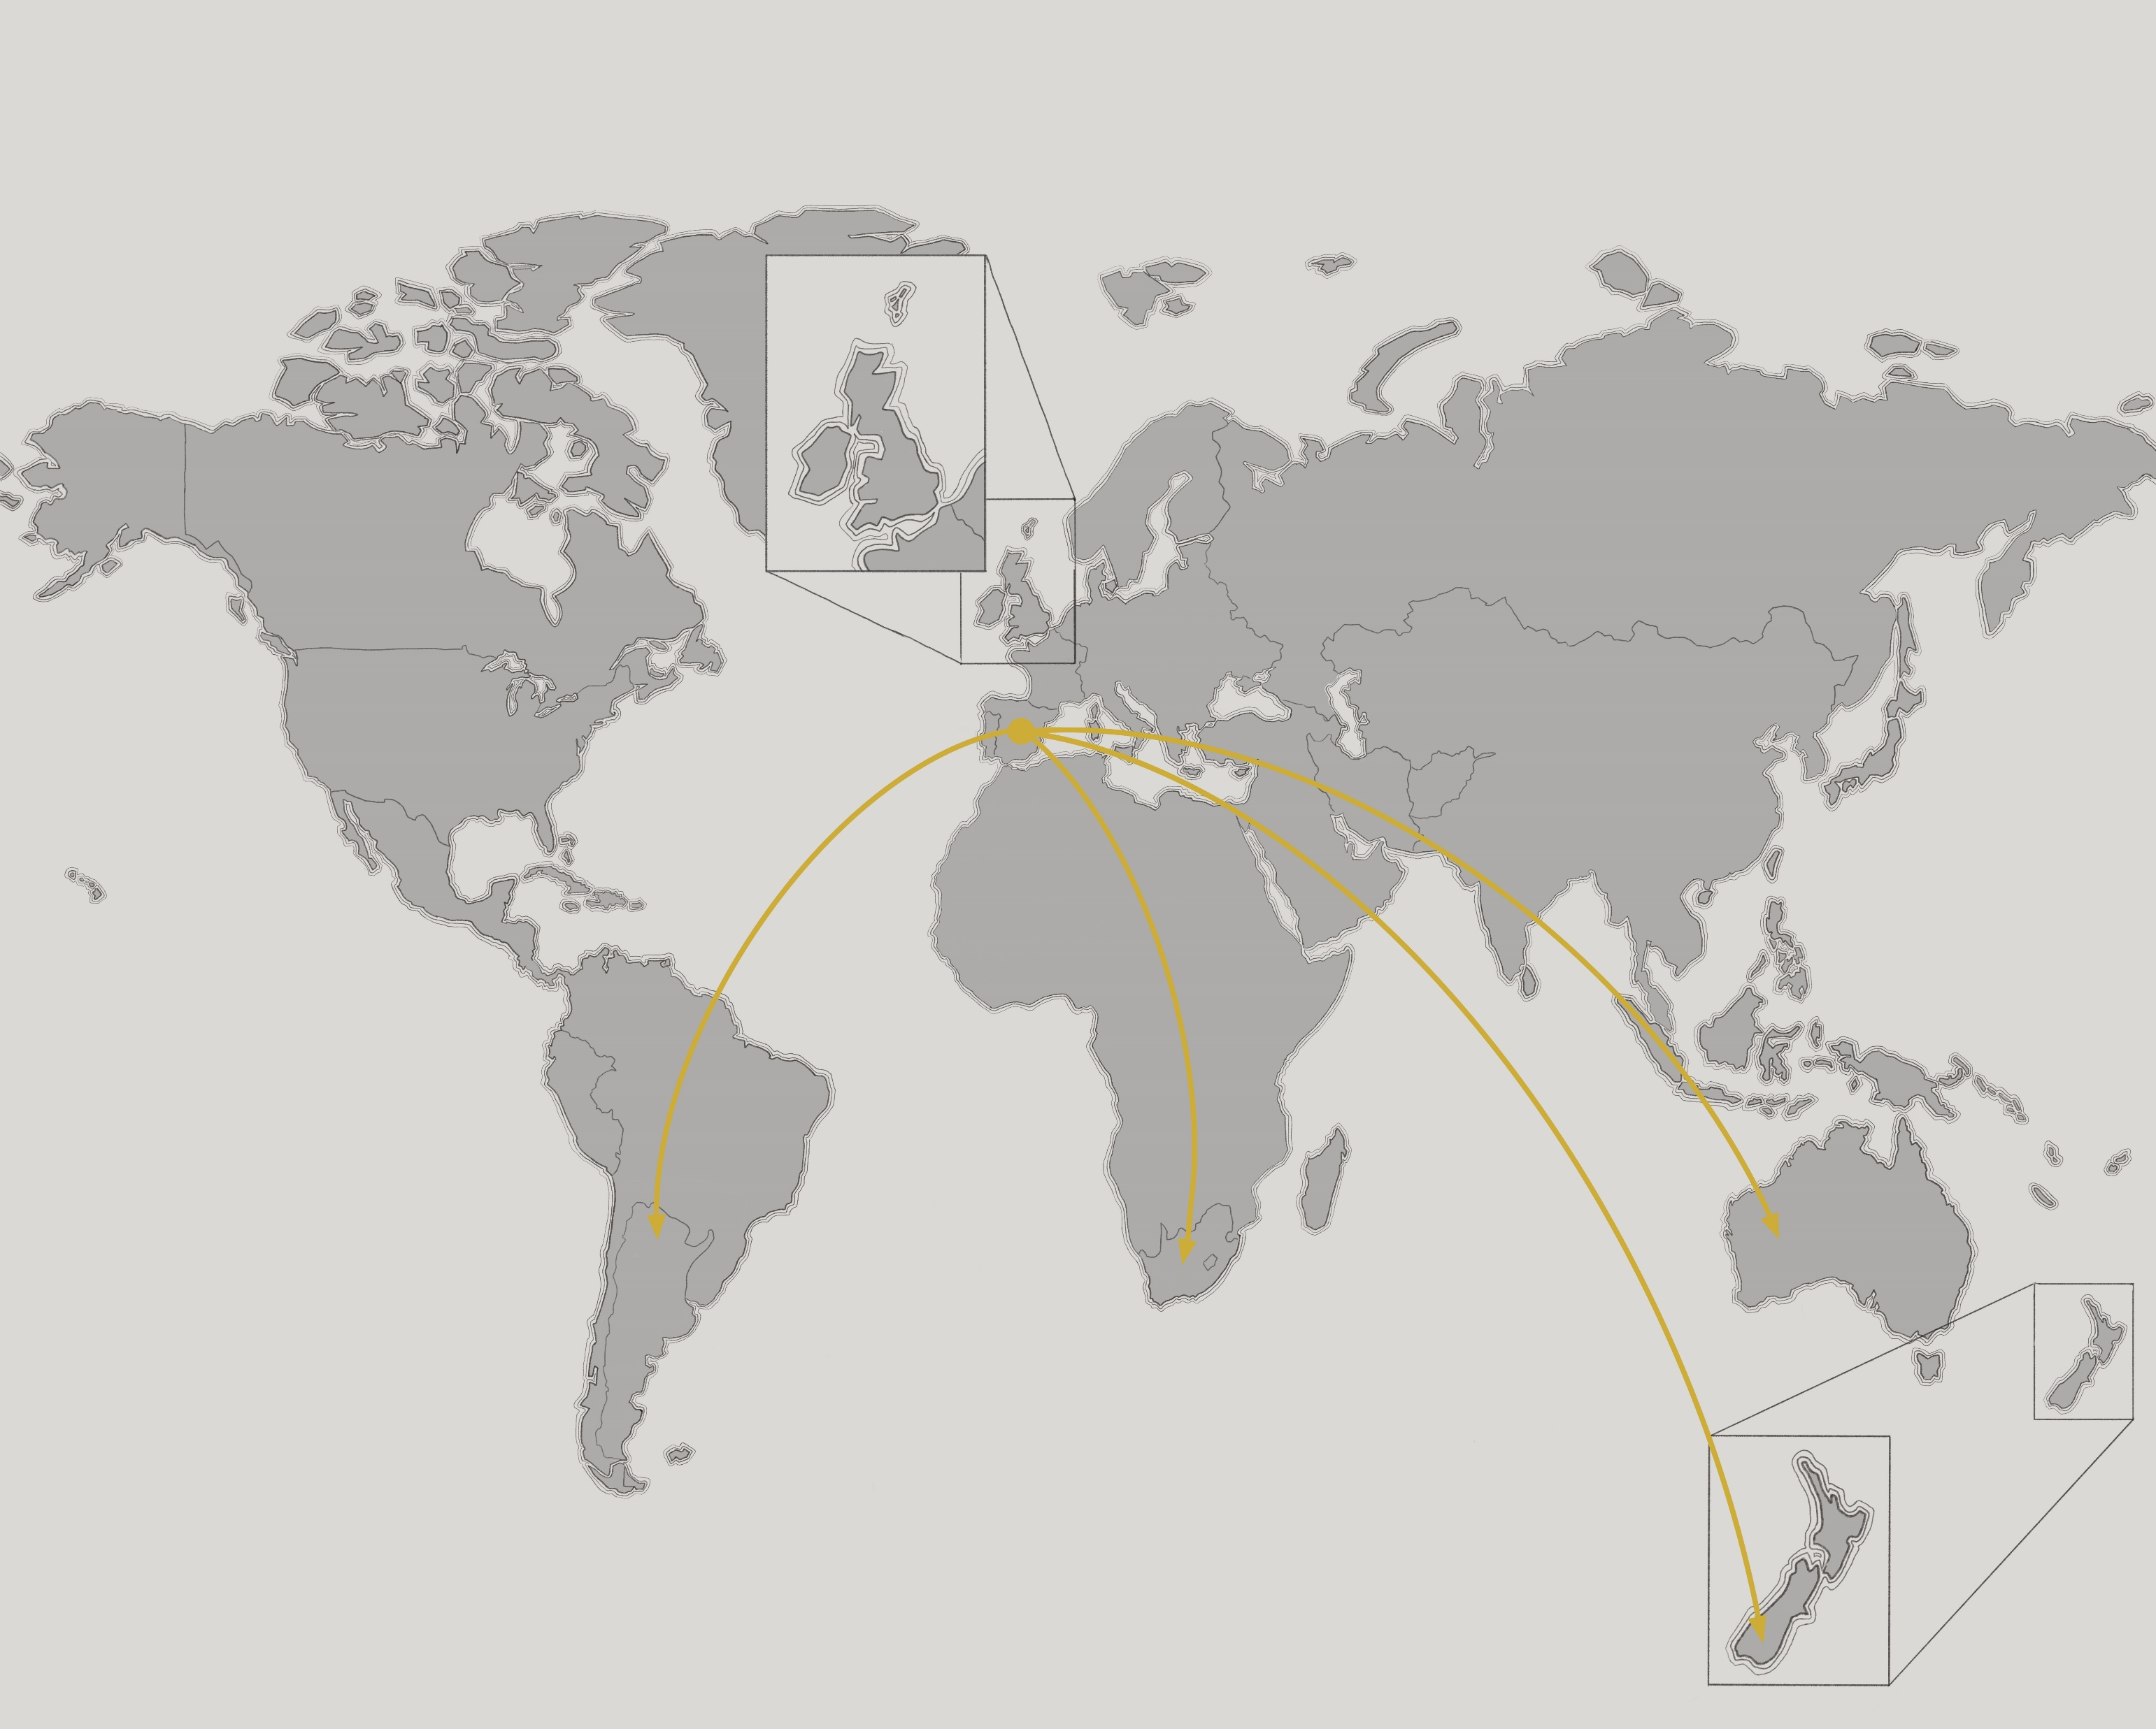
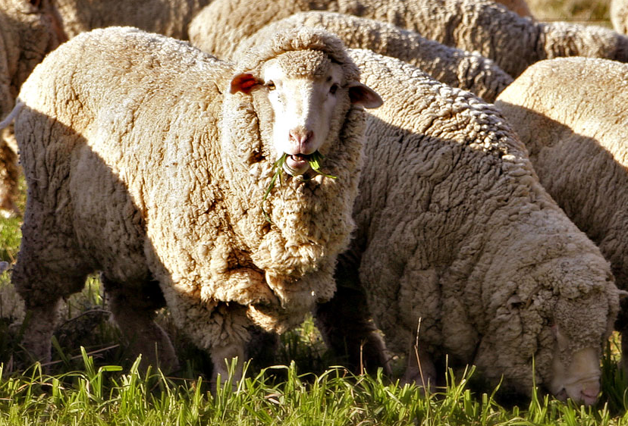
Merino
Origin: Spain
Today: Australia, New Zealand, Argentina, South Africa
Known for fine and soft wool
Micron Count: 11.5-26
Photo: Charles Esson

Slide 11
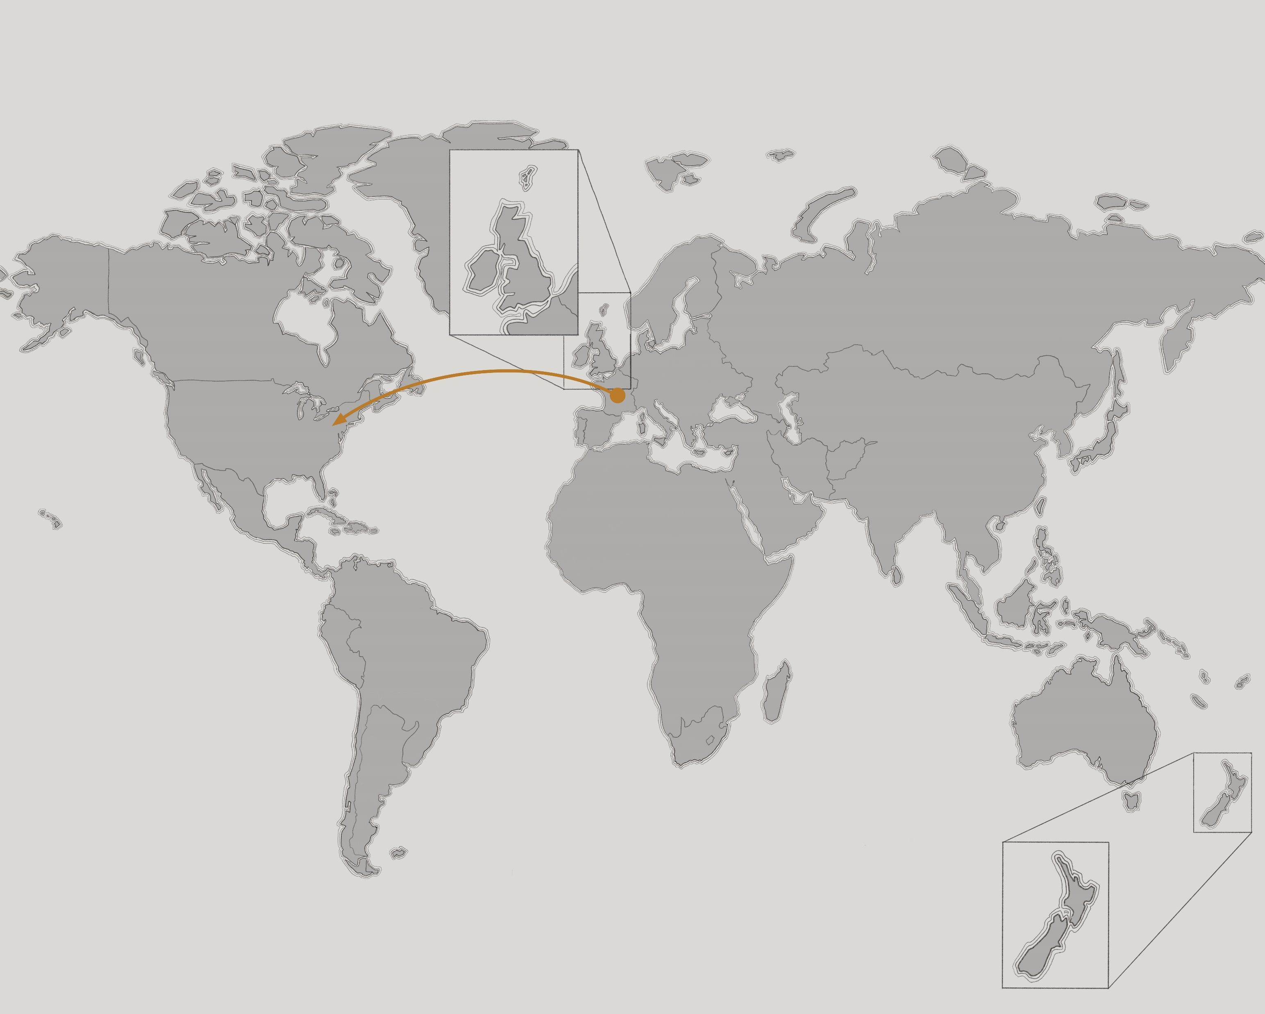
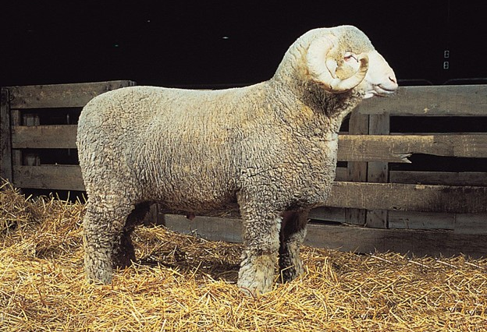
Rambouillet
Origin: France
Today: France and United States
Known for hardiness and ability to graze western rangelands
Micron count: 18-24
Photo: Britannica

Slide 12
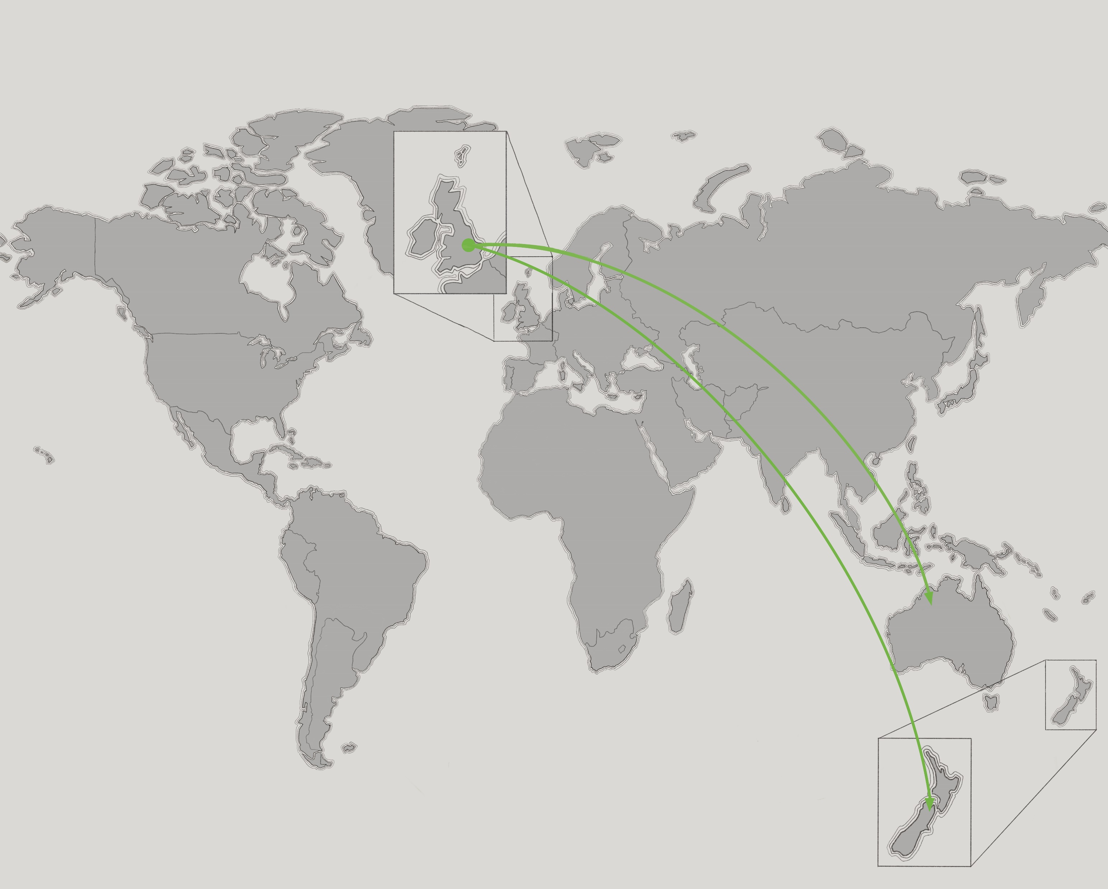
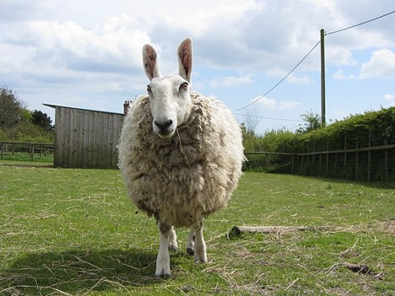
Border Leicester
Origin: England
Today: United Kingdom, Australia, New Zealand
Renowned for long wool with good spinning properties
Micron count: 29.25-40 (variable by geographic location and breeder)
Photo: Gareth James

Slide 13
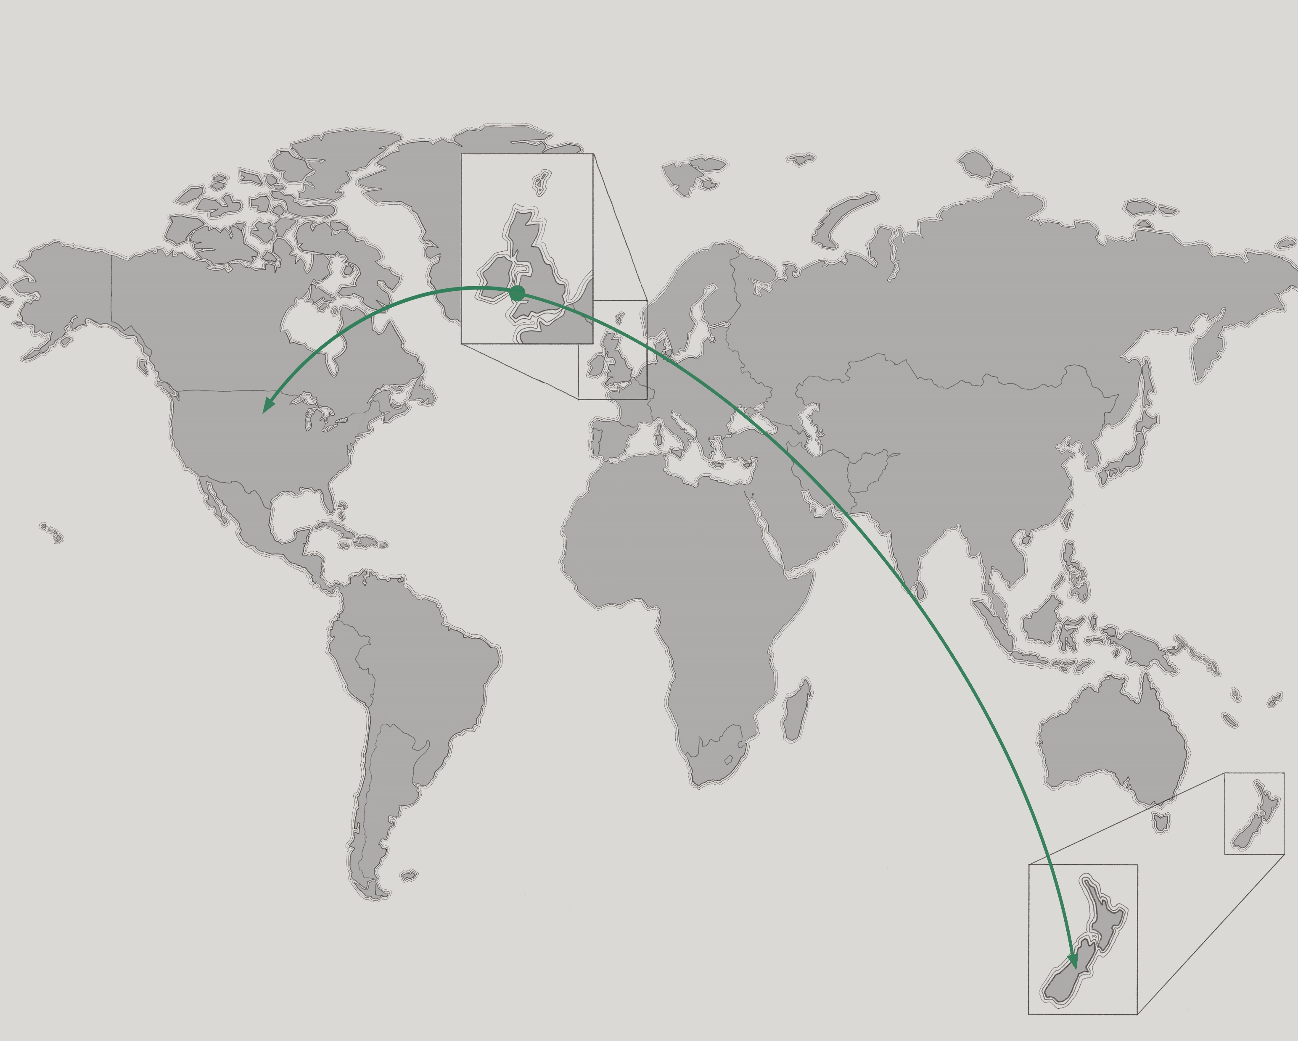
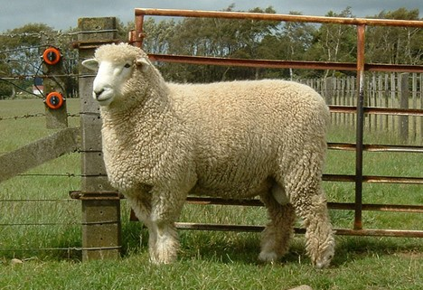
Romney
Origin: England
Today: United States and New Zealand
Valued for versatile wool
Named after Romney Marsh in SE England
Grows high-quality wool even in damp conditions
Micron count: 29-37
Photo: Wikimedia

Slide 14
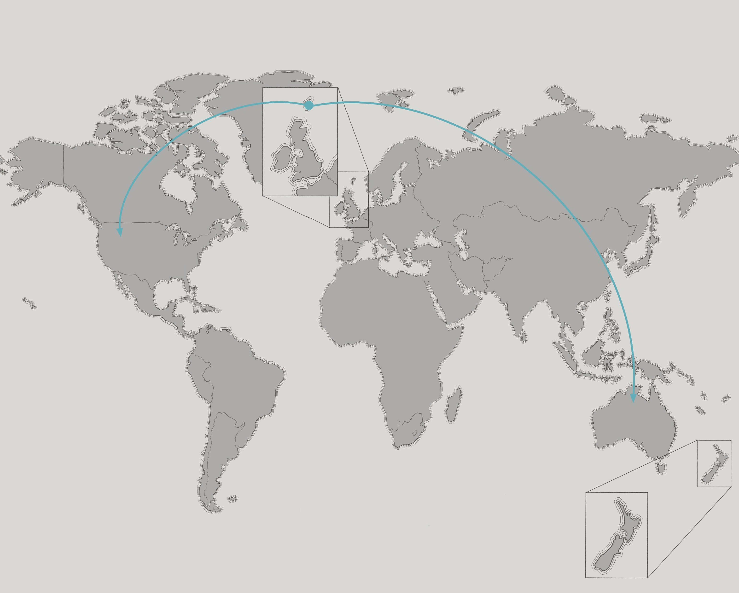
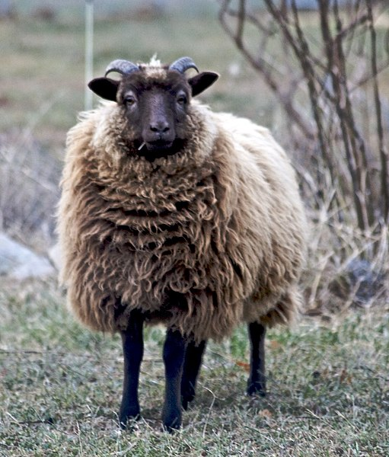
Shetland
Origin: Scotland
Today: North America and Australia
Produces fine wool with a wide color range
Micron count: 20-30
Photo: Wikimedia

Slide 15
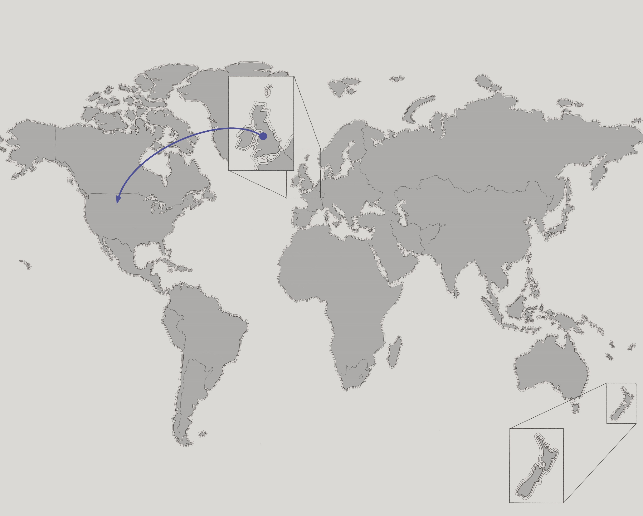
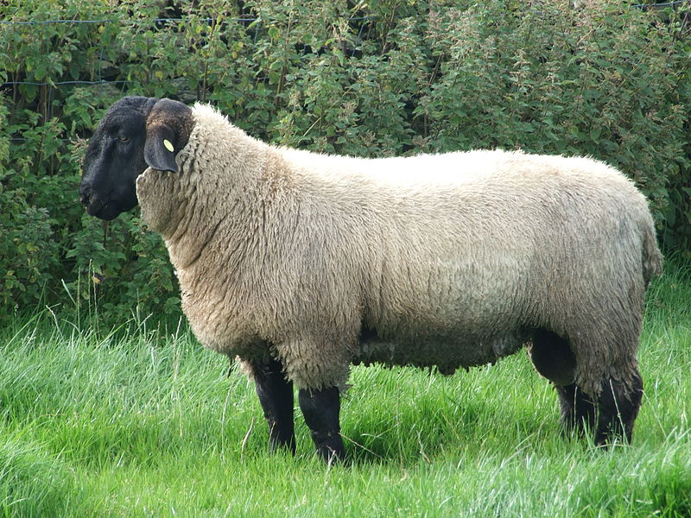
Suffolk
Origin: England
Today: United Kingdom and United States
Meat production
Medium-coarse wool, durable
Micron count: 25-33
Photo: J. Gareth

Slide 16
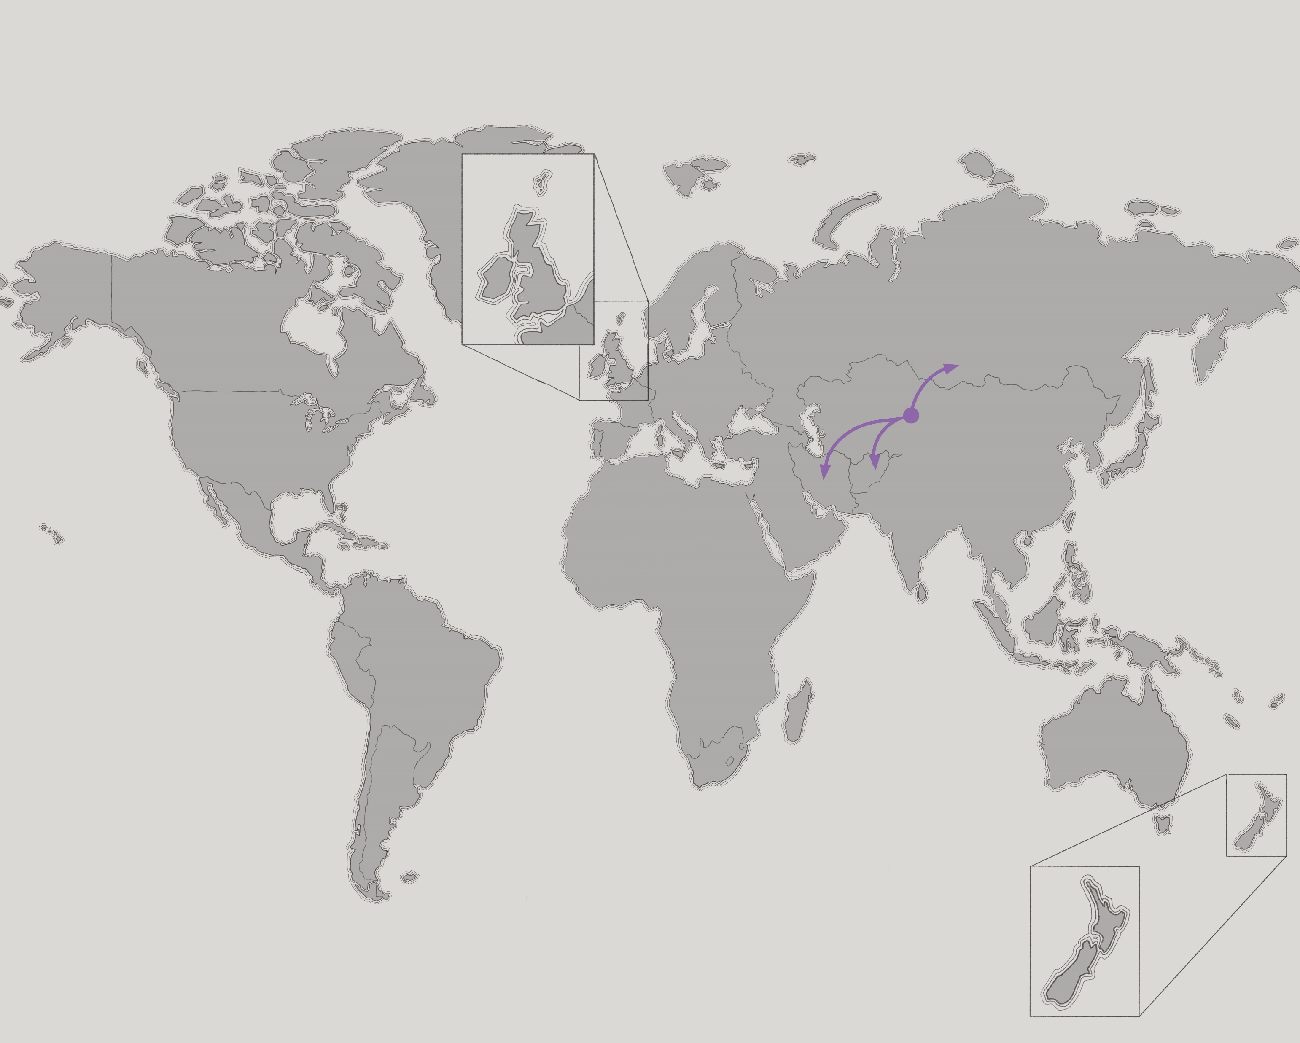
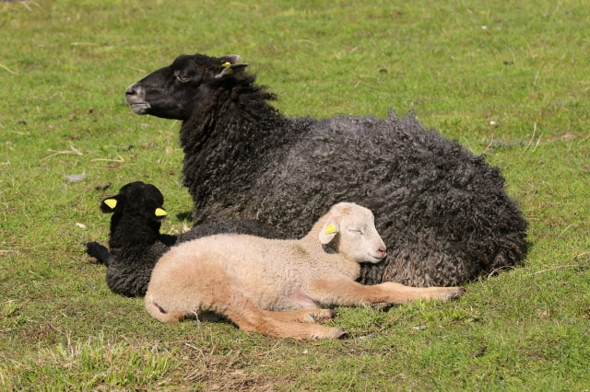
Karakul
Origin: Central Asia
Today: Afghanistan, Iran, Russia
Uniquely strong wool fibers
Resilient breed that can withstand harsh, arid climates
Micron count: 25-36
Photo: raisingsheep.net

Slide 17
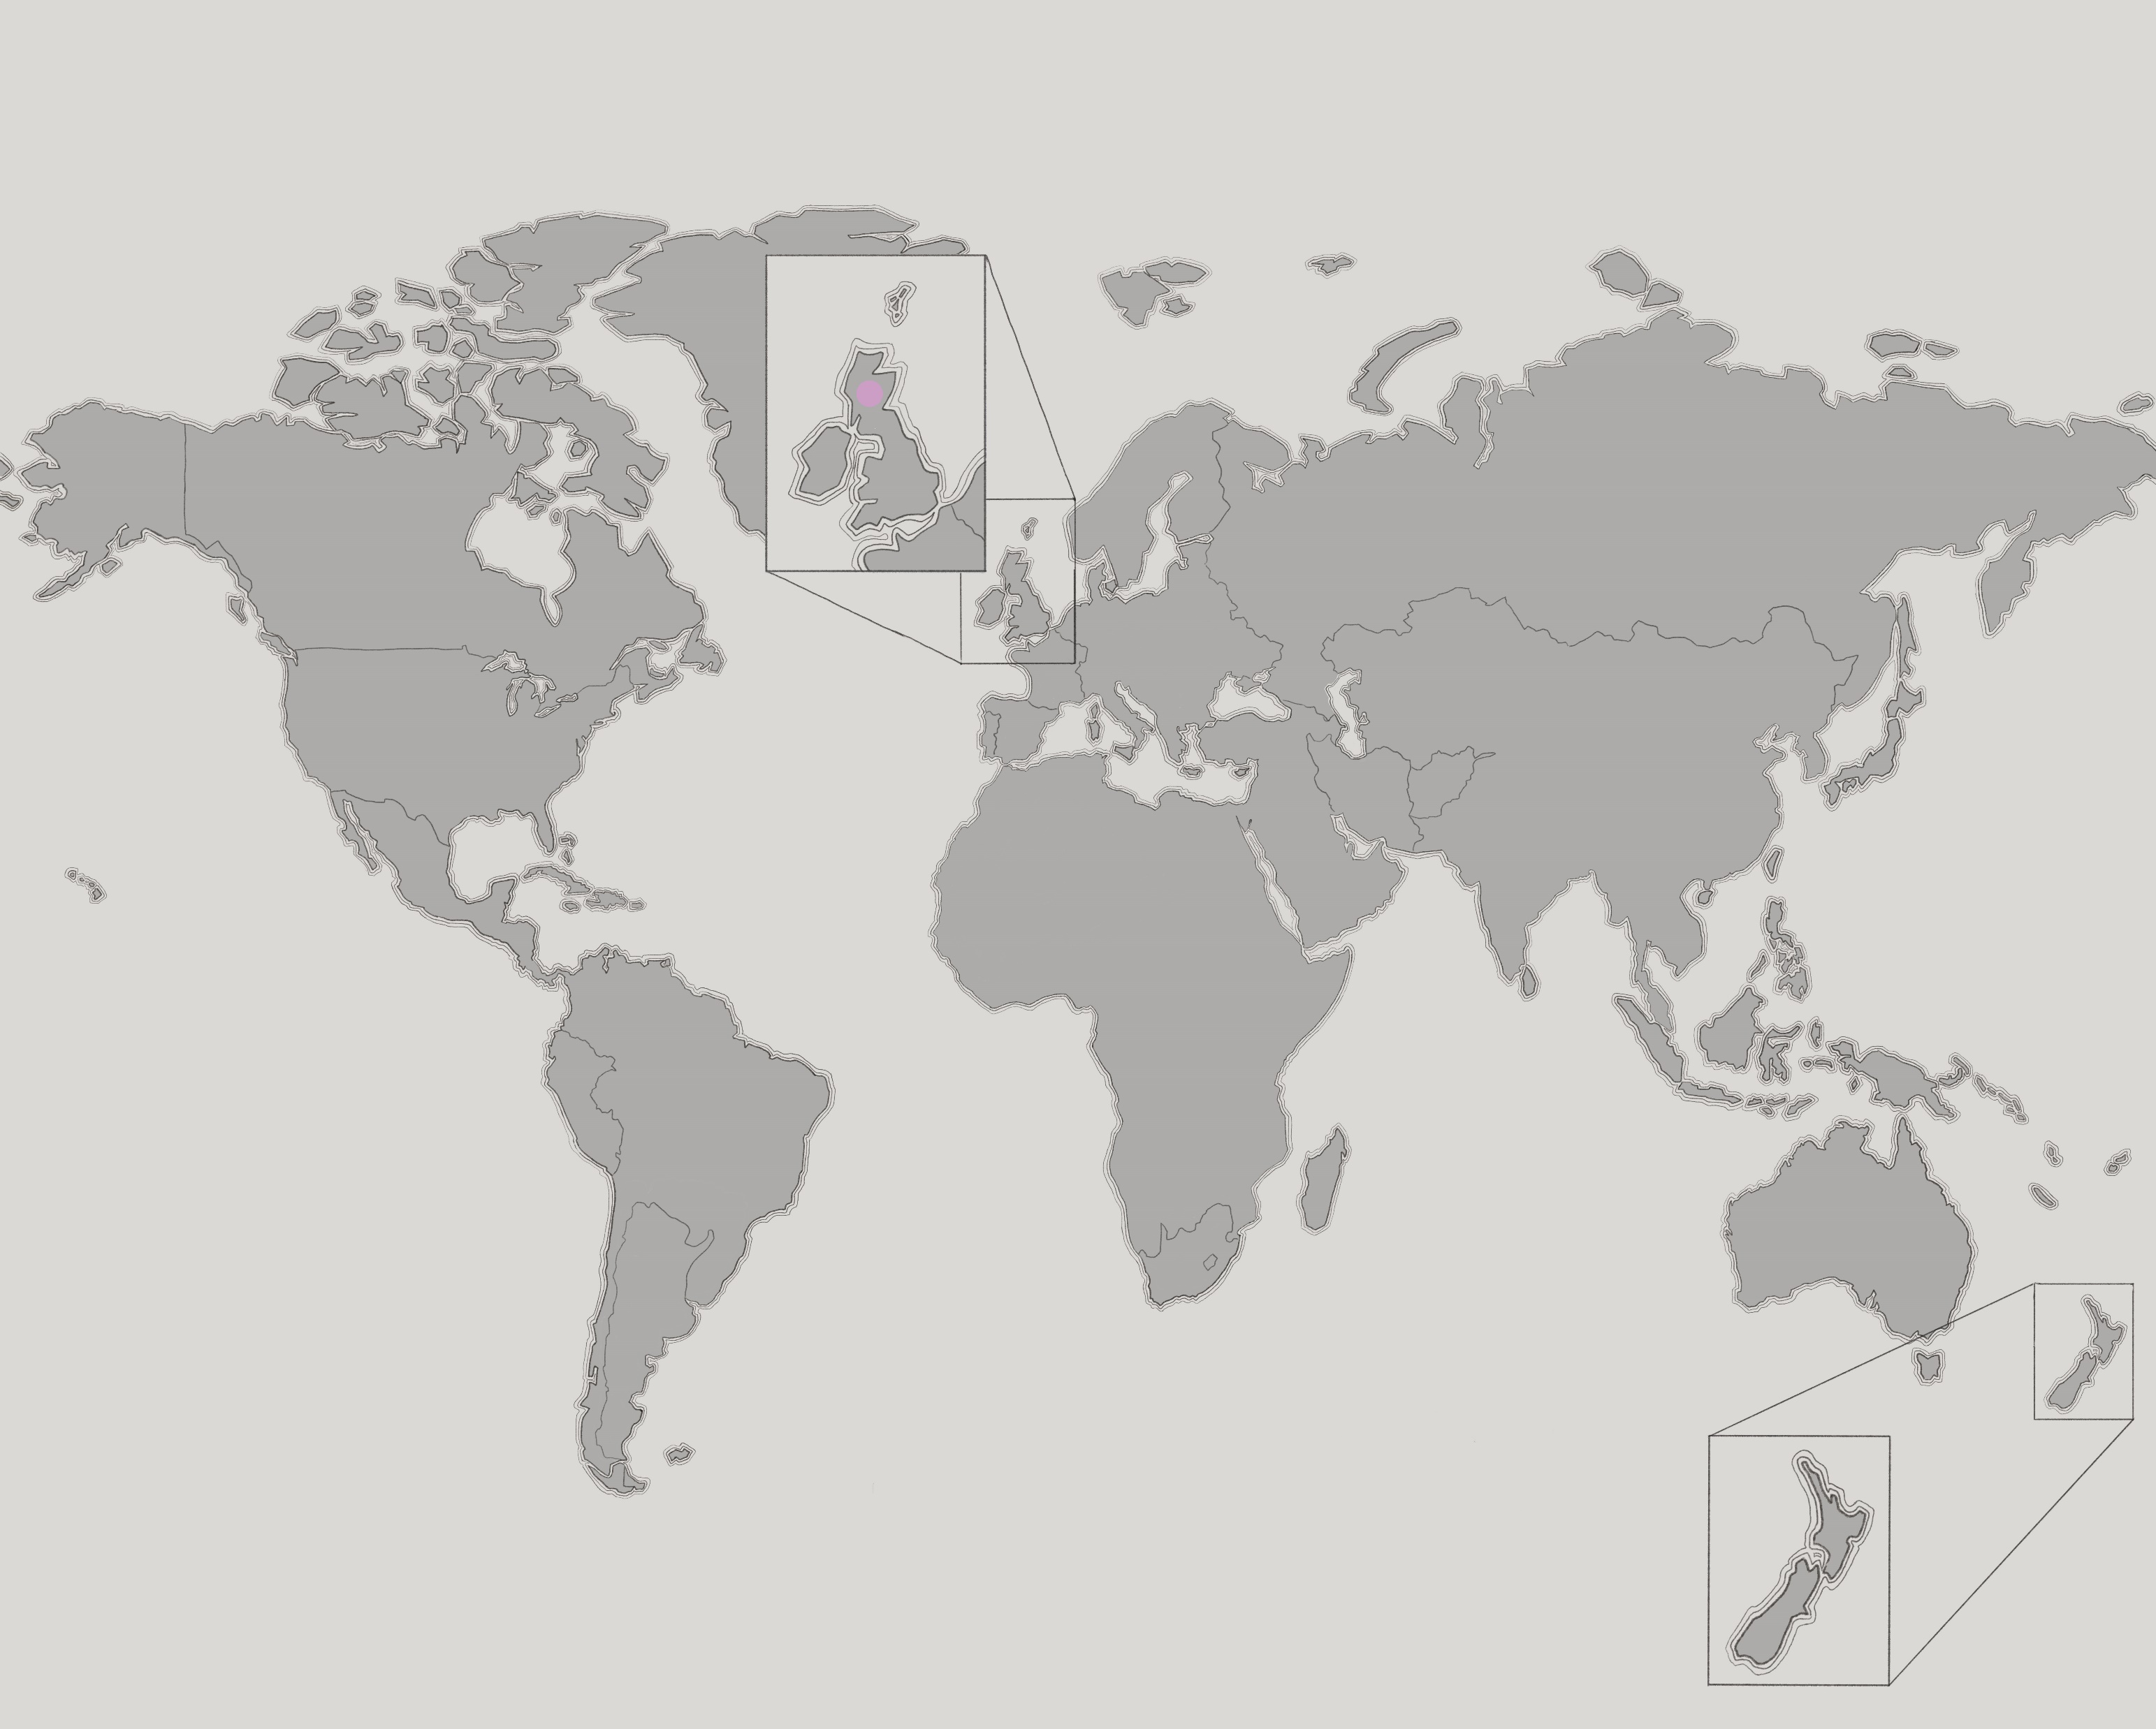
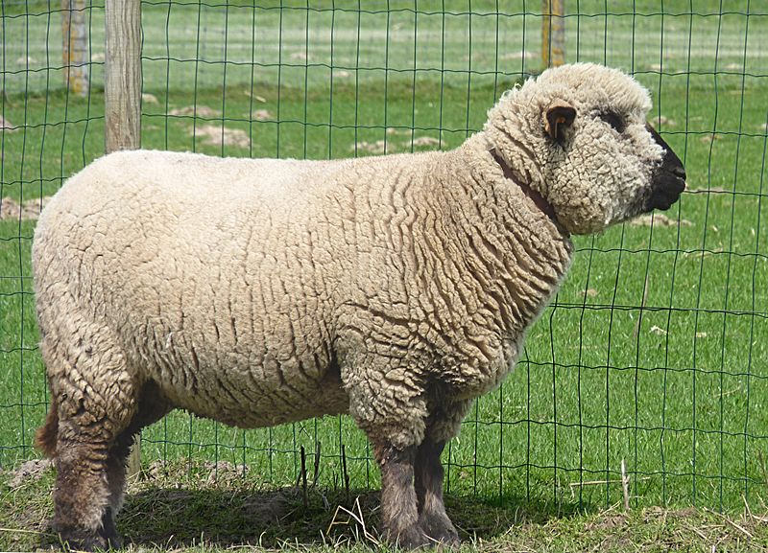
Hampshire
Origin: England
Today: All over the world
One of the most popular sheep breeds in the world
Fleece strong and springy
Micron count: 24-33
Photo: Wikimedia

Slide 18
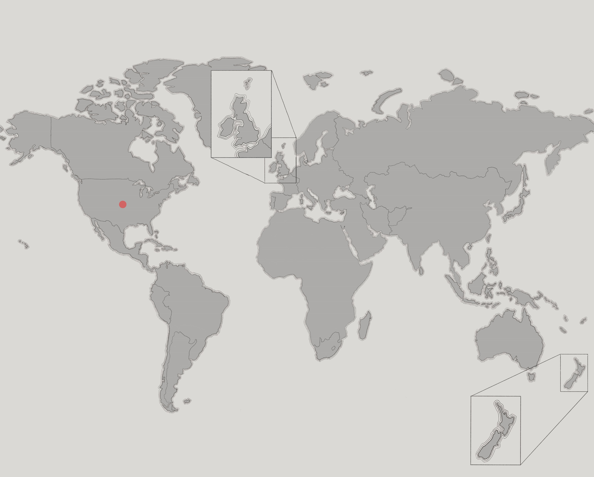
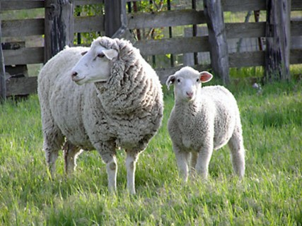
Columbia
Origin: United States
First sheep breed to originate in the U.S.
Fine fibers, white or brown
Micron count: 23-31
Photo: livestockoftheworld.com

Slide 19
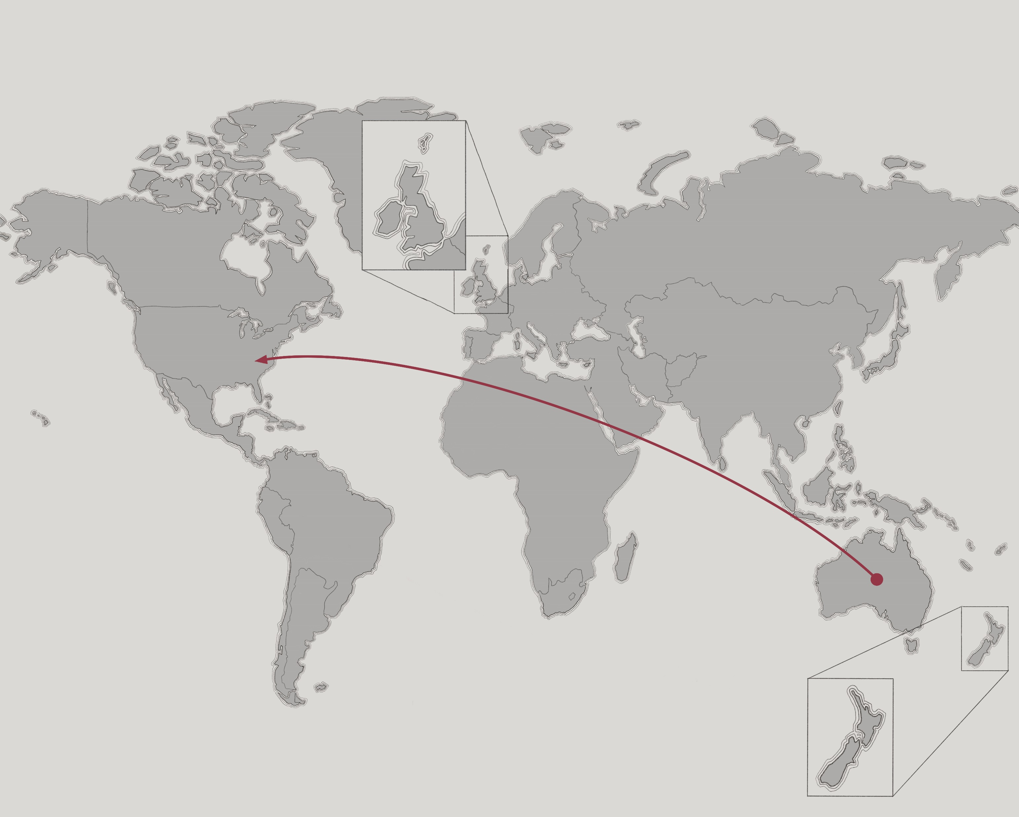
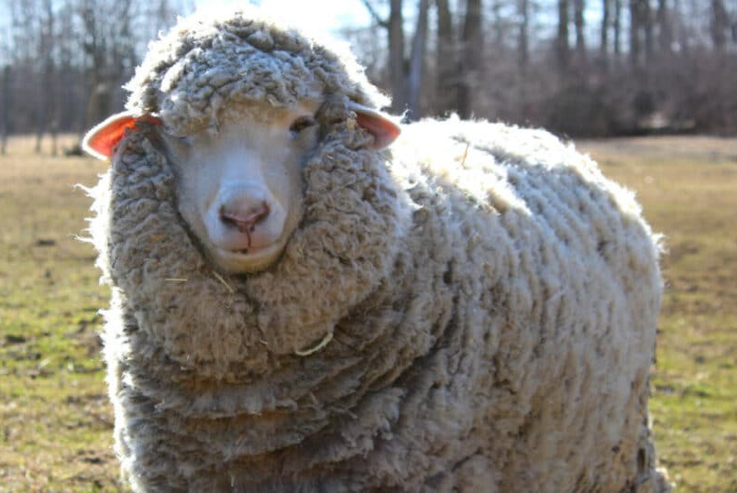
Cormo
Origin: Tasmania
Today: United States, Australia
Fluffy wool ideal for gentle-touch clothing
Micron count: 17-23
Photo: raisingsheep.net

Slide 20
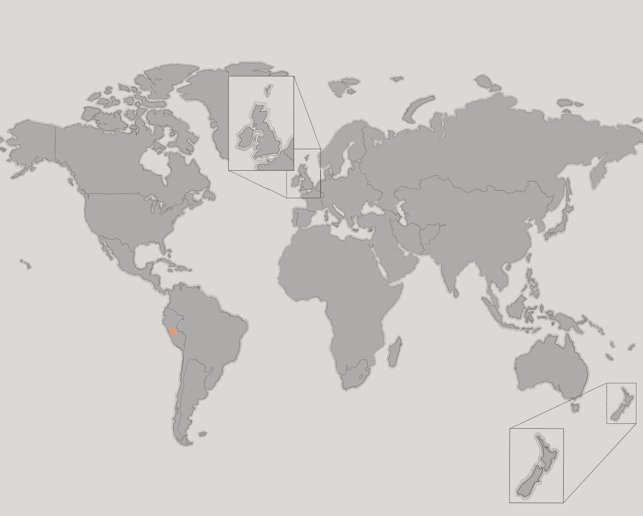
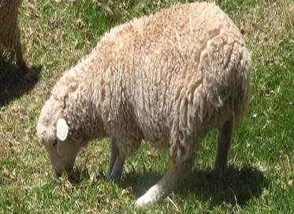
Junin
Origin: Peruvian Andes
Well-adapted to harsh, high-altitude regions.
Dense fleece
Robust build
Photo: Sais Tupac Amaru

