Slide 1
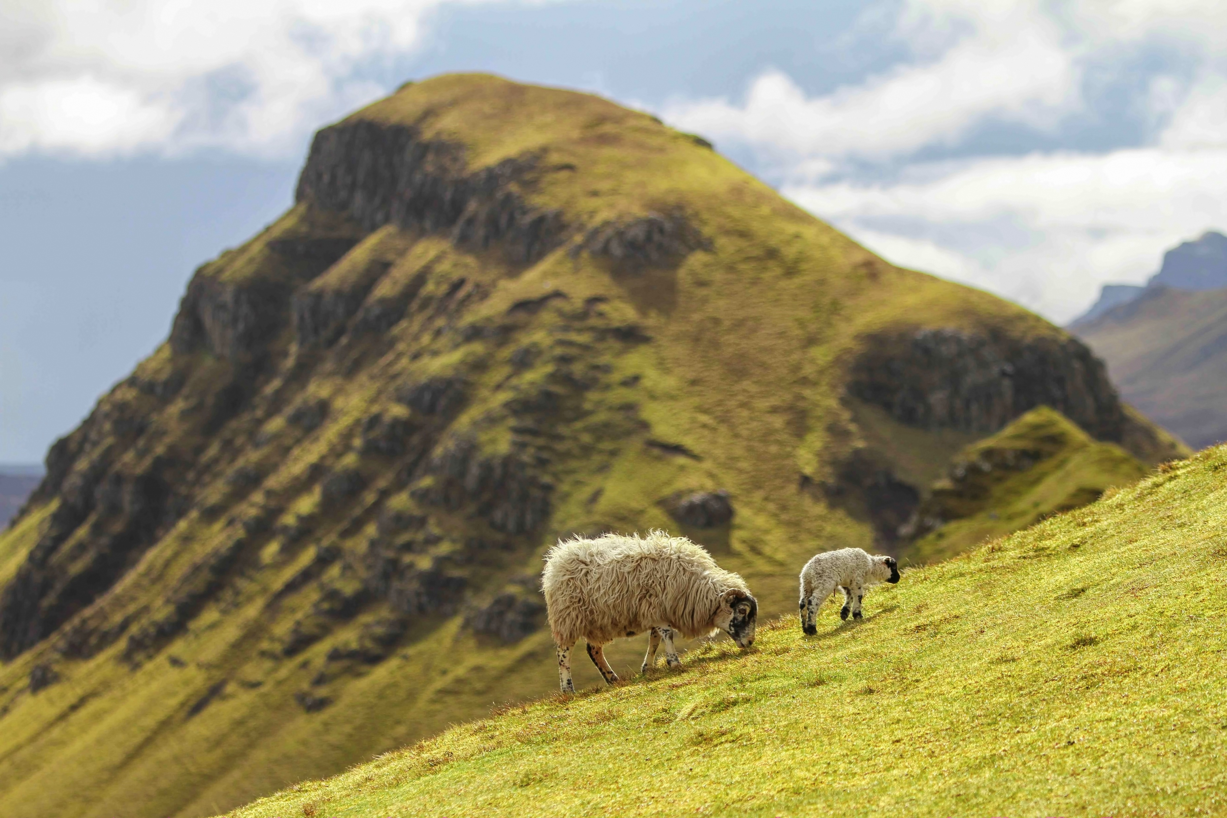
Unlocking the Power of Targeted Grazing
Grazing with sheep to address environmental challenges

Slide 2
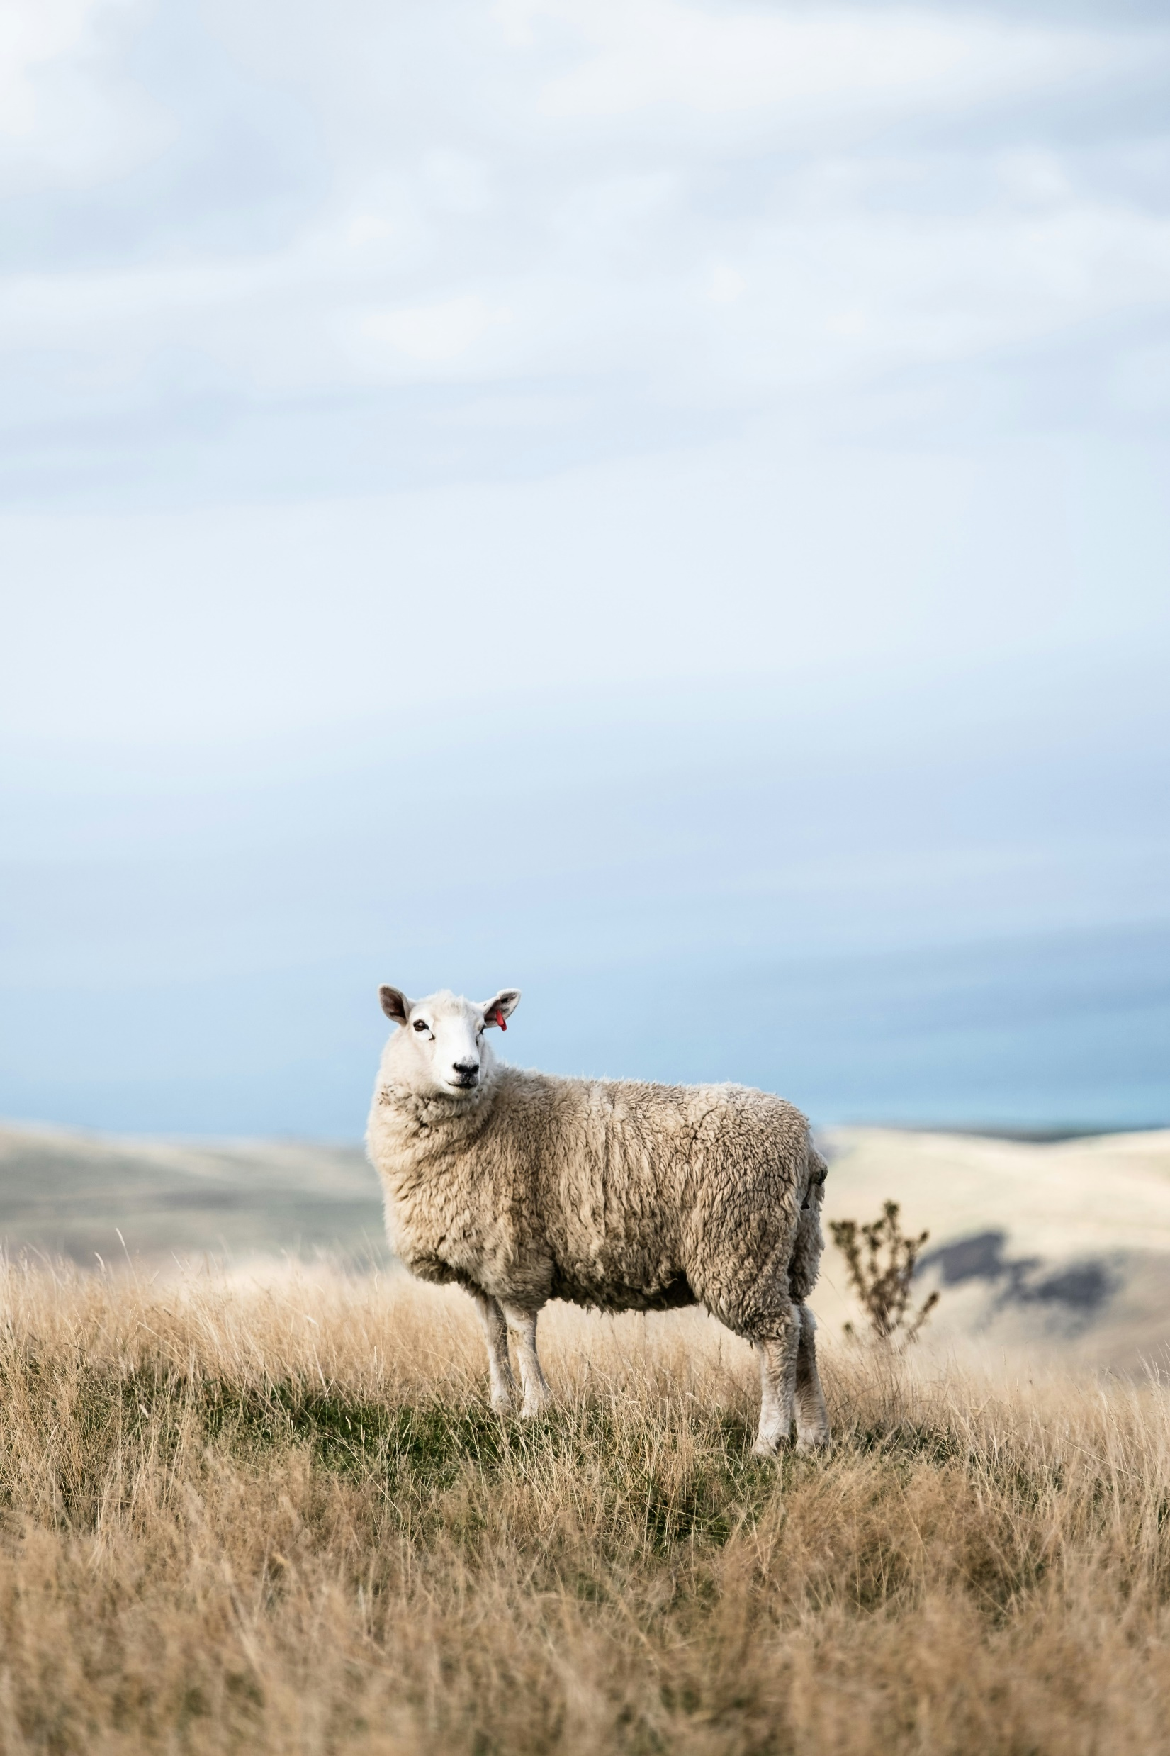
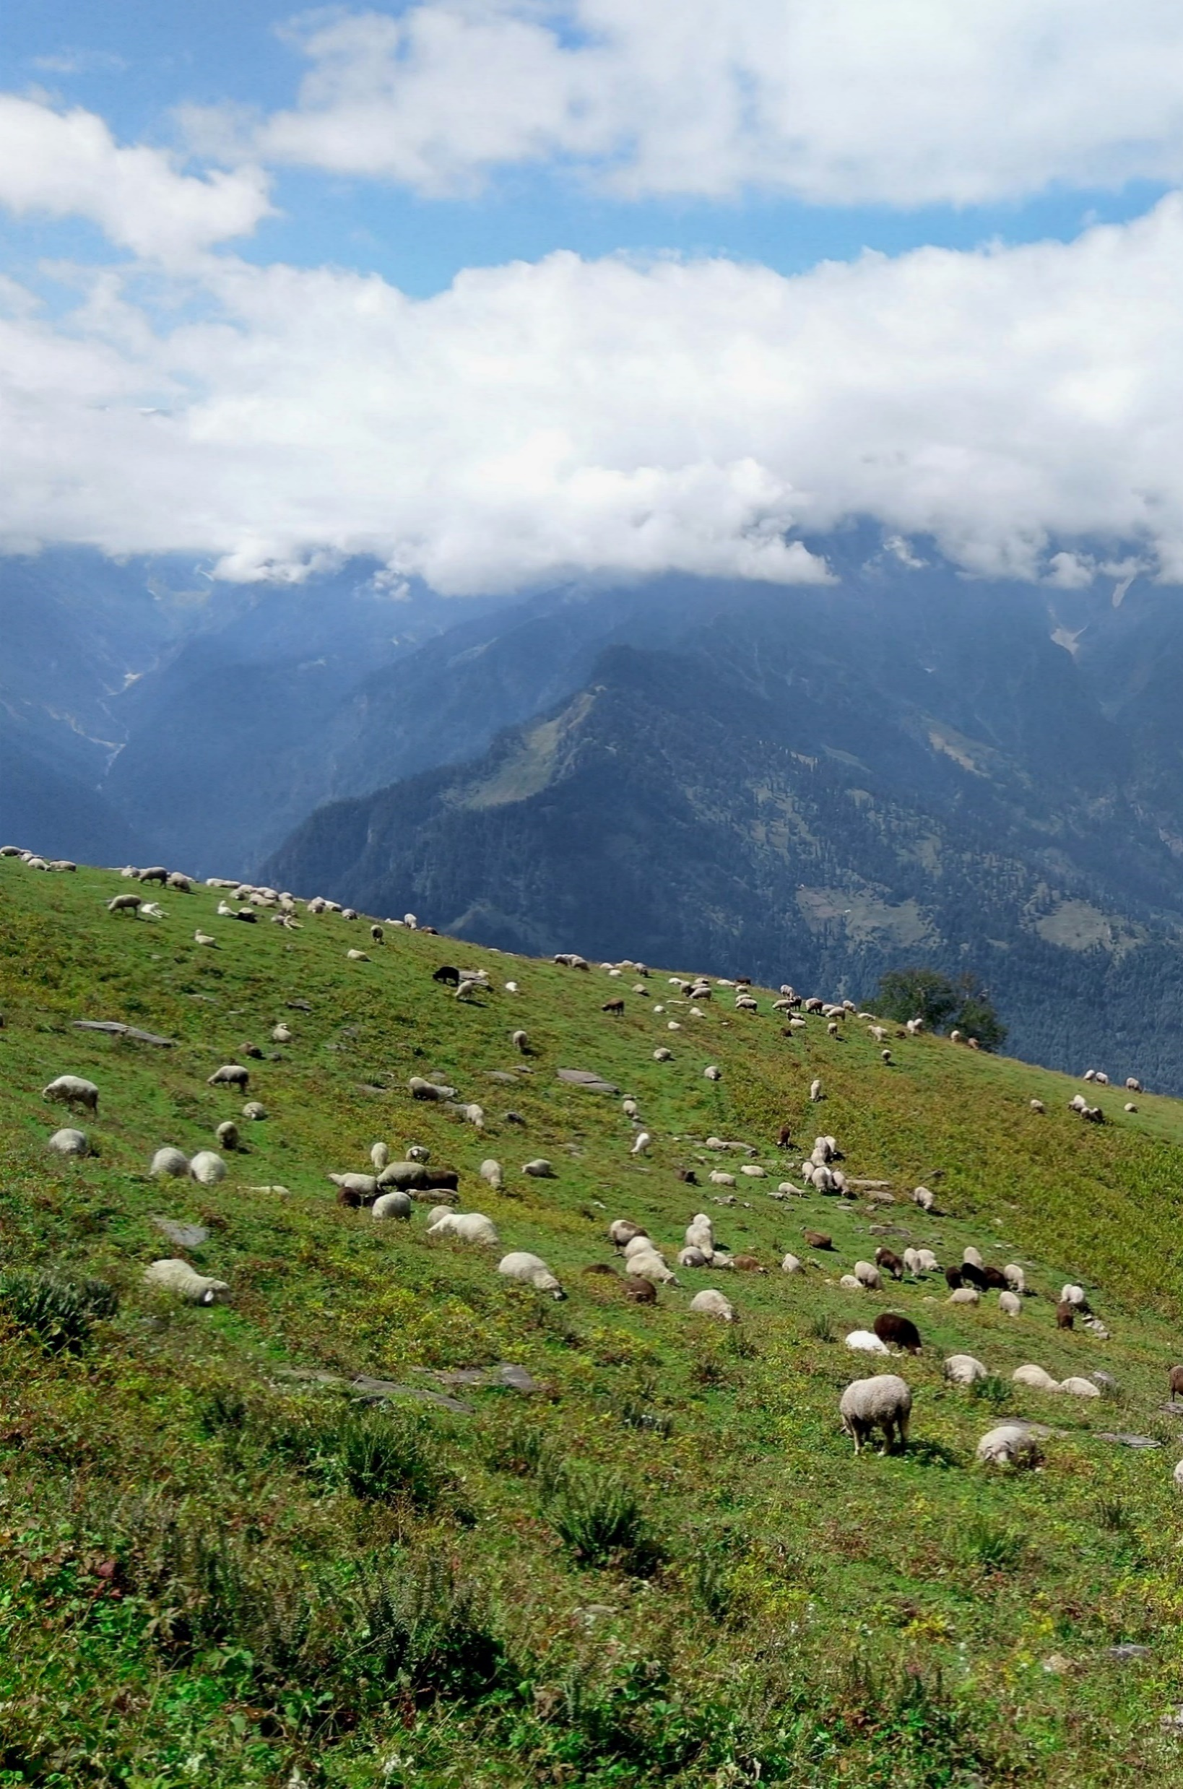
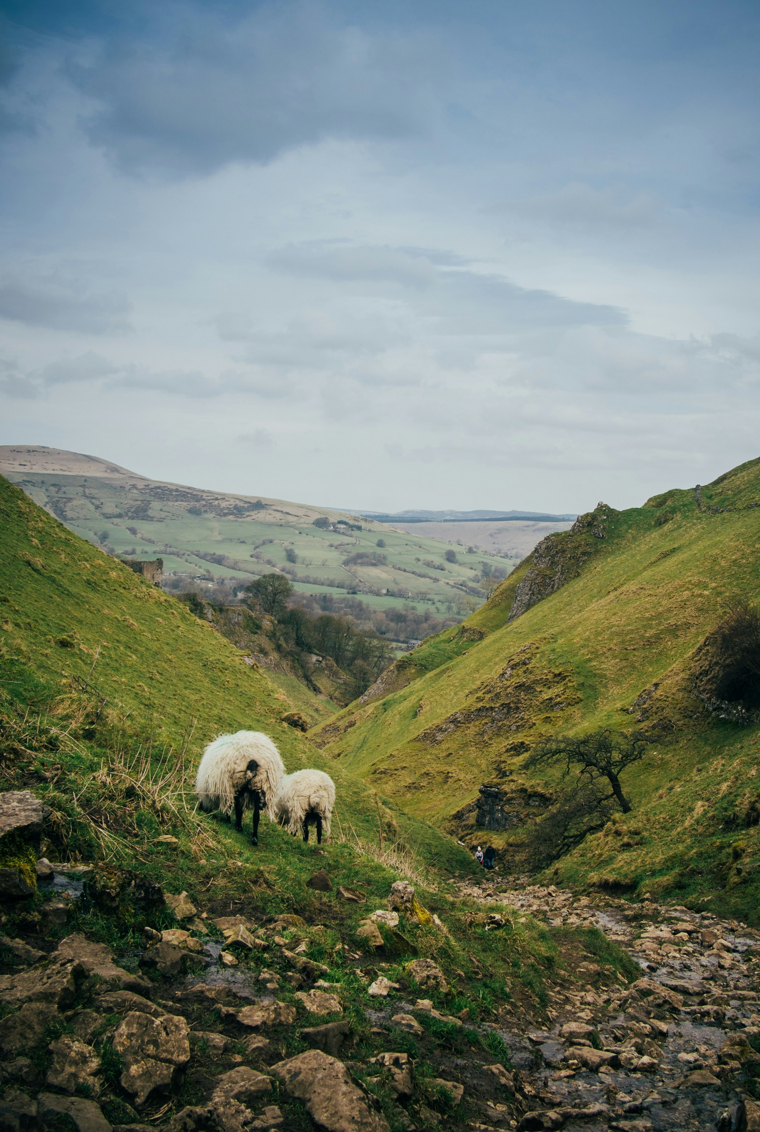
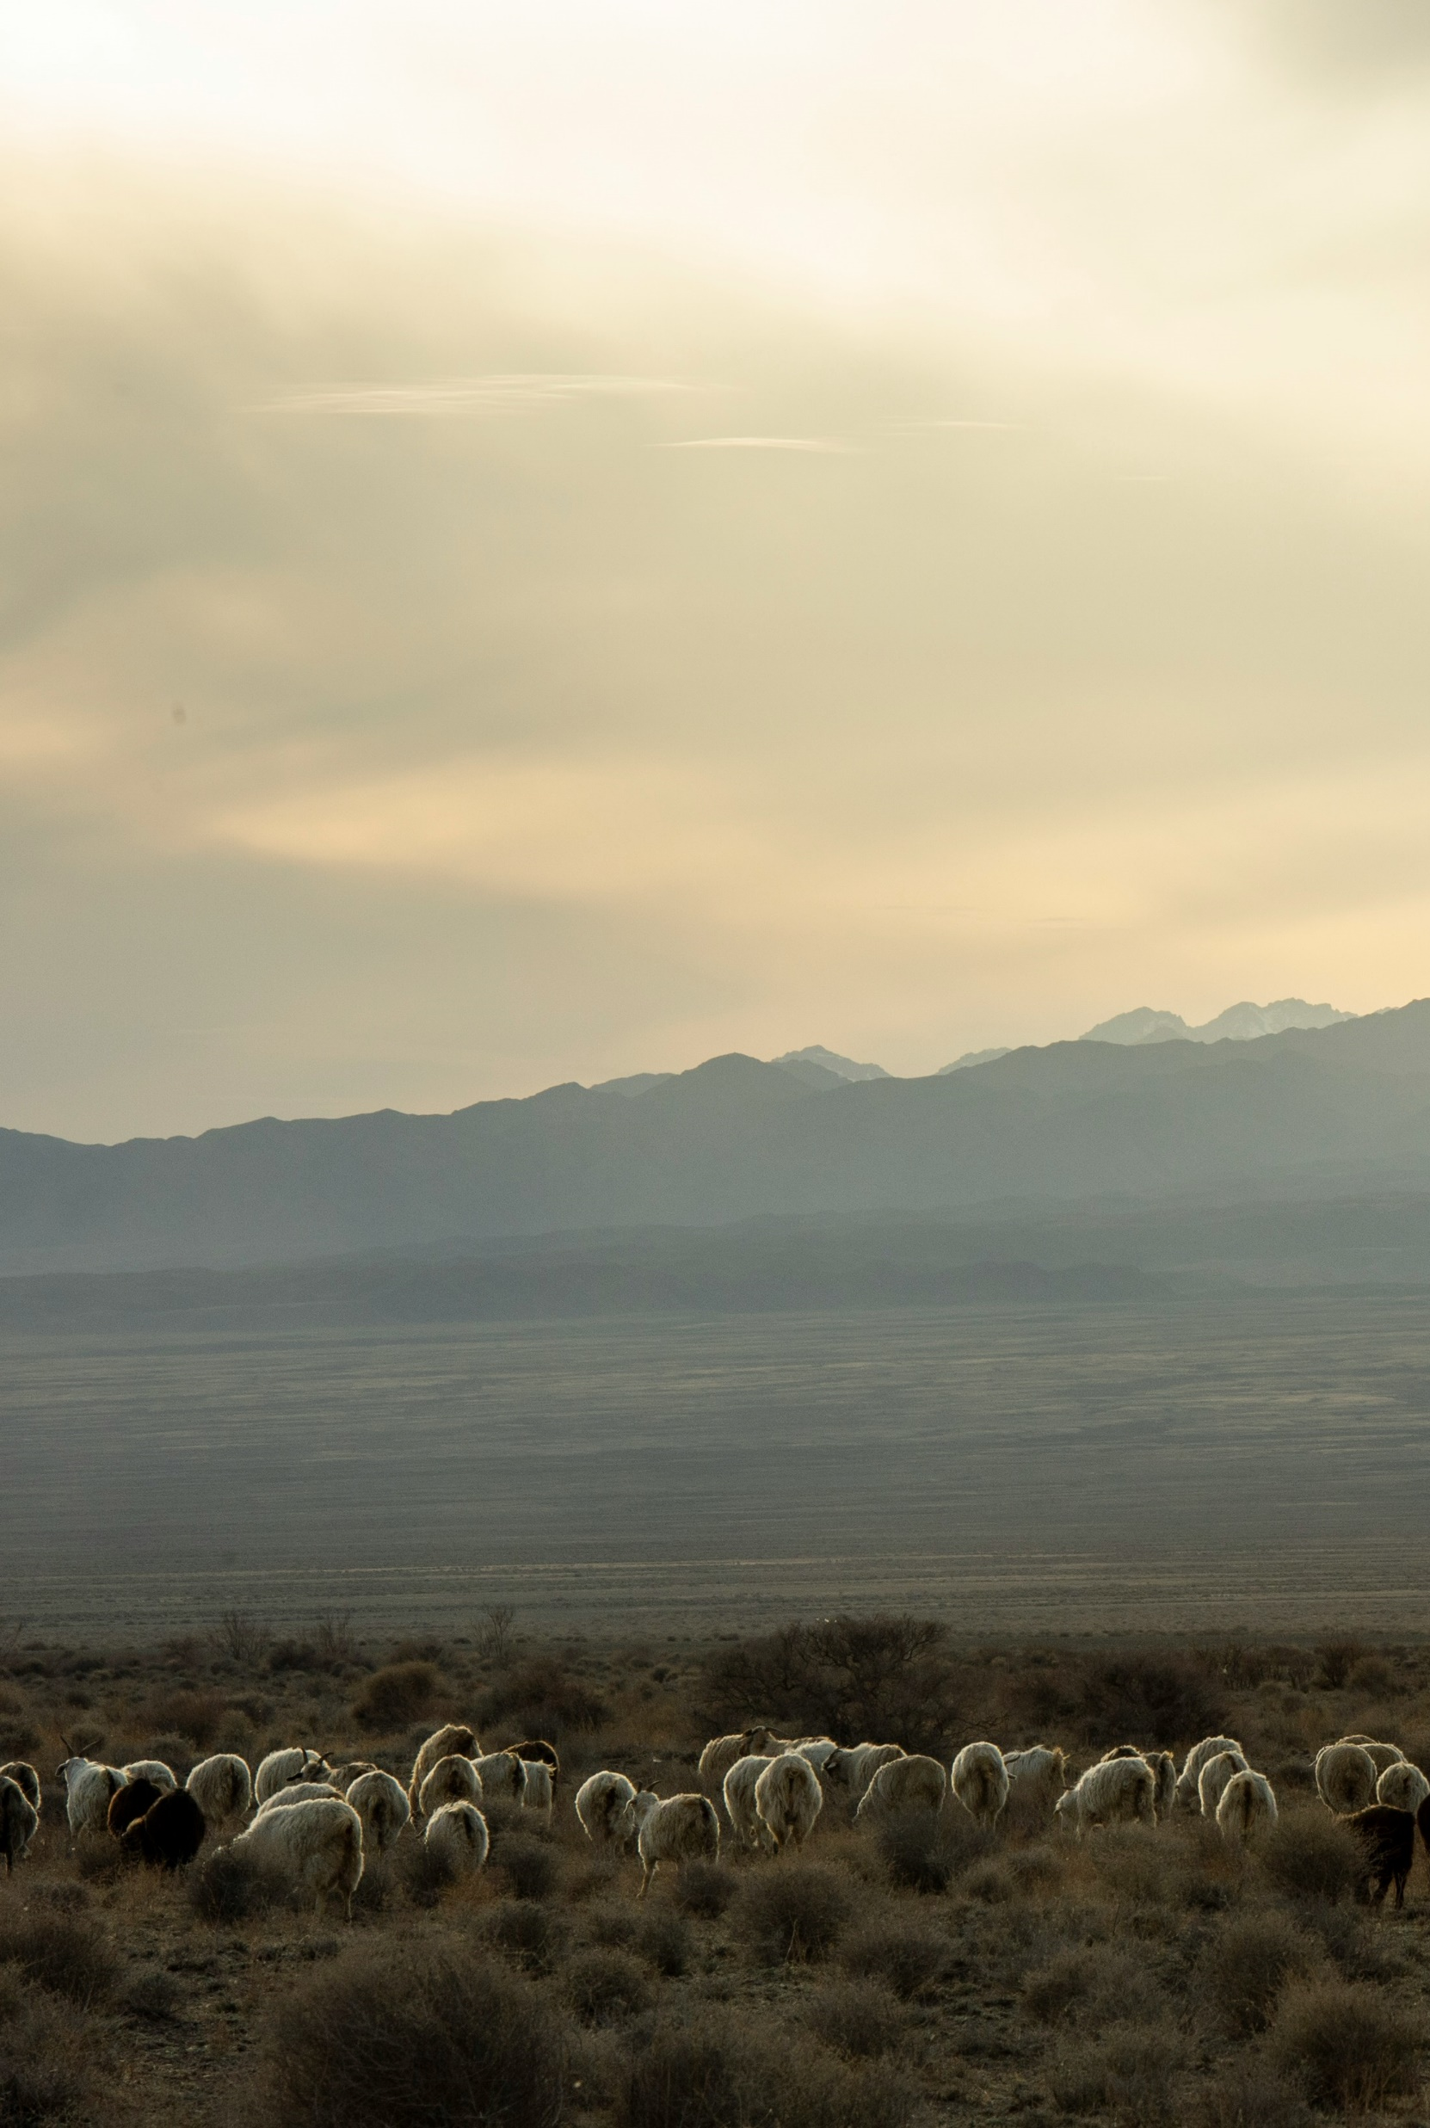
How do you think sheep could benefit the environment?
Photo by: Martin Schmidli
Photo by: Sebin Thomas
Photo by: Greg Wilson
Photo by: Charlotte Venema
Notes:
Ask students:
How do you think sheep could benefit the environment?
Have you ever wondered how ranchers and land managers use sheep to help take care of our environment?

Slide 3



What is Targeted Grazing?
Targeted Grazing is “the application of a particular kind of grazing animal at a specified season, duration, and intensity to accomplish specific vegetation management goals¹.
How can sheep hit the “bullseye” through targeted grazing?
Weed Control
Fire Mitigation
Enhancing Biodiversity
Reducing Herbicide Use
Arrows
Archer
1—Frost, R., Walker, J., Madsen, C., Holes, R., Lehfeldt, J., Cunningham, J., Voth, K., Welling, B., Davis, T.Z., Bradford, D., Malot, J., and Sullivan, J. 2012. Targeted Grazing: Applying the Research to the Land. Rangelands 34(1):2-10.
Notes:
Analogy of a target board: Imagine the landscape as a big field, just like the area you see on an archery target. The whole field is like the outer rings of the target.
But instead of arrows, we have sheep! Land managers and ranchers are like archers, sending out sheep to hit the bullseye through targeted grazing.

Slide 4
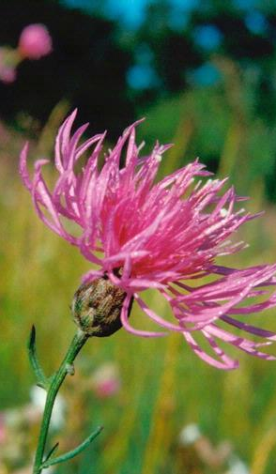
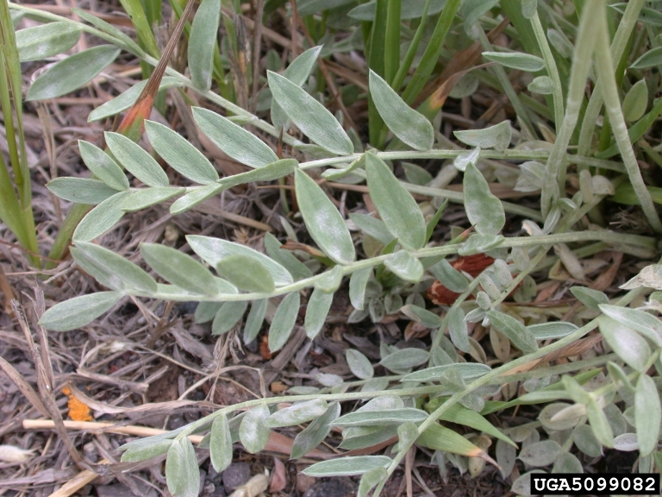
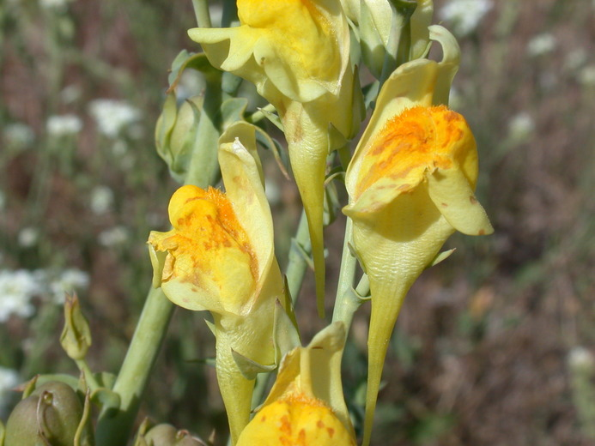

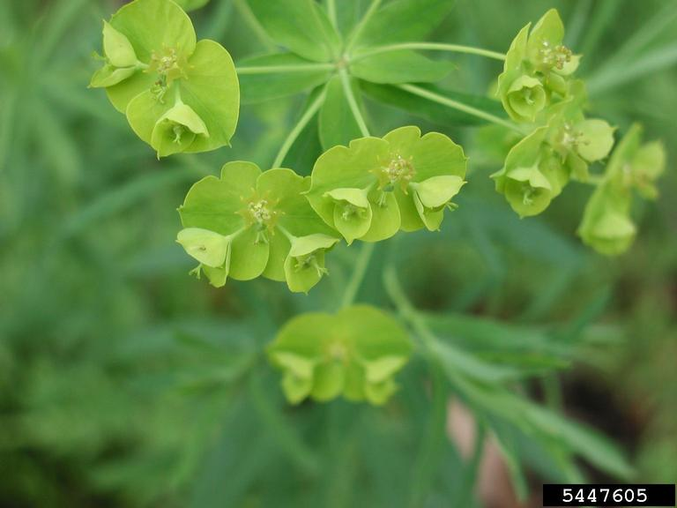
Weed Control
White Locoweed (Oxytropis sericea)
Photo: Mary Ellen (Mel) Harte, bugwood.org
Dalmatian Toadflax (Linaria dalmatica)
Photo: Steven Thorsted, Creative Commons
Cheatgrass (Bromus tectorum)
Photo: Raechel Hunsaker, Brigham Young University
Spotted Knapweed (Centaurea stoebe)
Photo: John M. Randall, The Nature Conservancy, Bugwood.org
Leafy Spurge (Euphorbia esula)
Photo: Leslie J. Mehrhoff, University of Connecticut, bugwood.org
Notes:
Weed Control: Grazing sheep can be used to target and control invasive plant species⁴. For example (select two or three species to discuss with the class):
Cheatgrass is a type of grass that invades areas quickly, especially after events like fire, drought, or overgrazing by livestock. It competes with native plants by using up soil moisture and nutrients early in the growing season before native plants are ready to grow. Sheep grazing can help control cheatgrass, allowing native plants access to soil water and nutrients.
Leafy spurge, an invasive forb (a forb is an herbaceous flowering plant), is highly palatable and sheep can graze it down reducing its growth and spread. Over time, grazing weakens leafy spurge’s root system inhibiting its ability to regrow⁵.
Dalmatian toadflax is a widespread invasive forb that competes with desirable native plants. Sheep grazing can reduce the presence of this weed, allowing more nutritious native plants to grow⁶.
White locoweed, a native forb, poses potential toxicity if consumed by grazing livestock and wildlife. Sheep, however, have the ability to metabolize these toxins. Thereby, sheep grazing can reduce the risk of white locoweed poisoning in other animals⁷.
Spotted knapweed is an invasive forb that often forms monocultures. Sheep grazing can reduce the presence of this species, saving ranchers and land managers money, while also fostering greater biodiversity in the plant community^{8,9}.

Slide 5
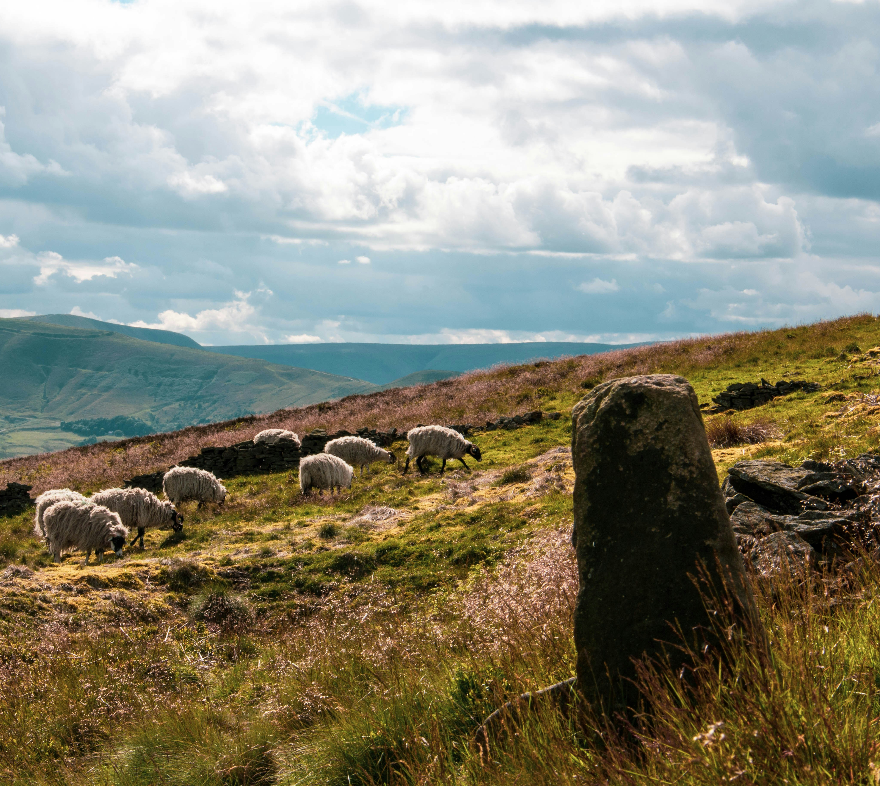

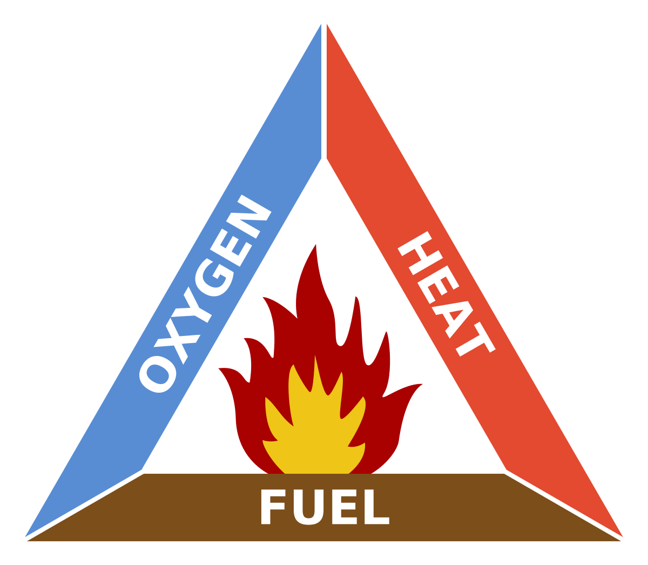
Photo: Matt Palmer
Fire Mitigation
Notes:
Fire Mitigation: Targeted grazing can decrease the severity of wildfires by reducing the amount of fuel (i.e., plants) available to burn. For example, cheatgrass often grows rapidly in the spring and dries out early in the summer, providing fuel for wildfires¹⁰. By grazing sheep in the spring, cheatgrass is consumed, reducing the overall amount of fuel on the rangeland.

Slide 6
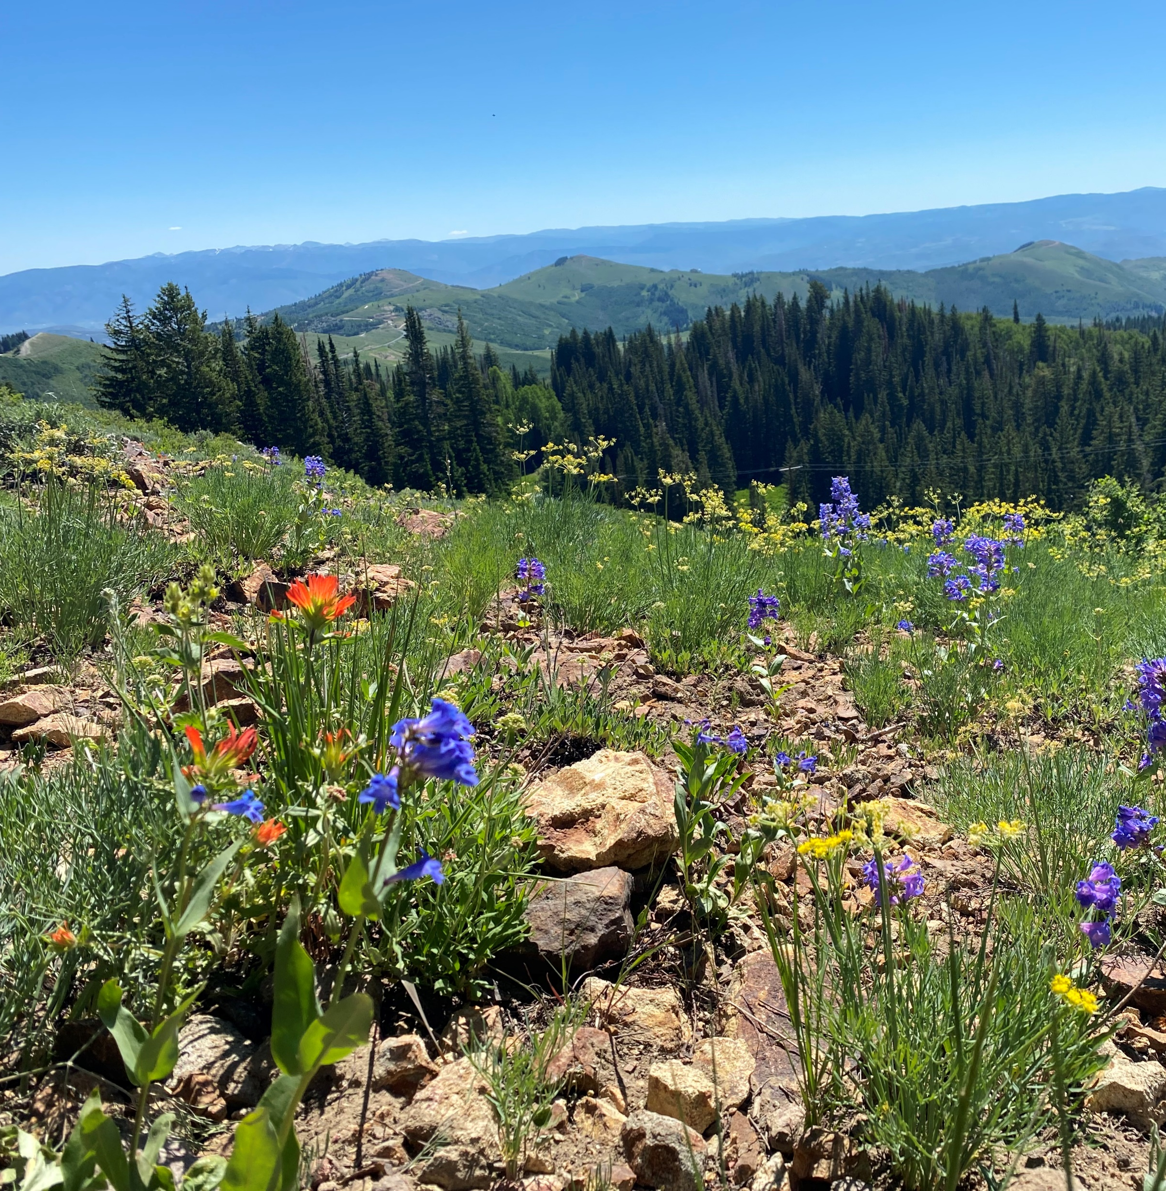
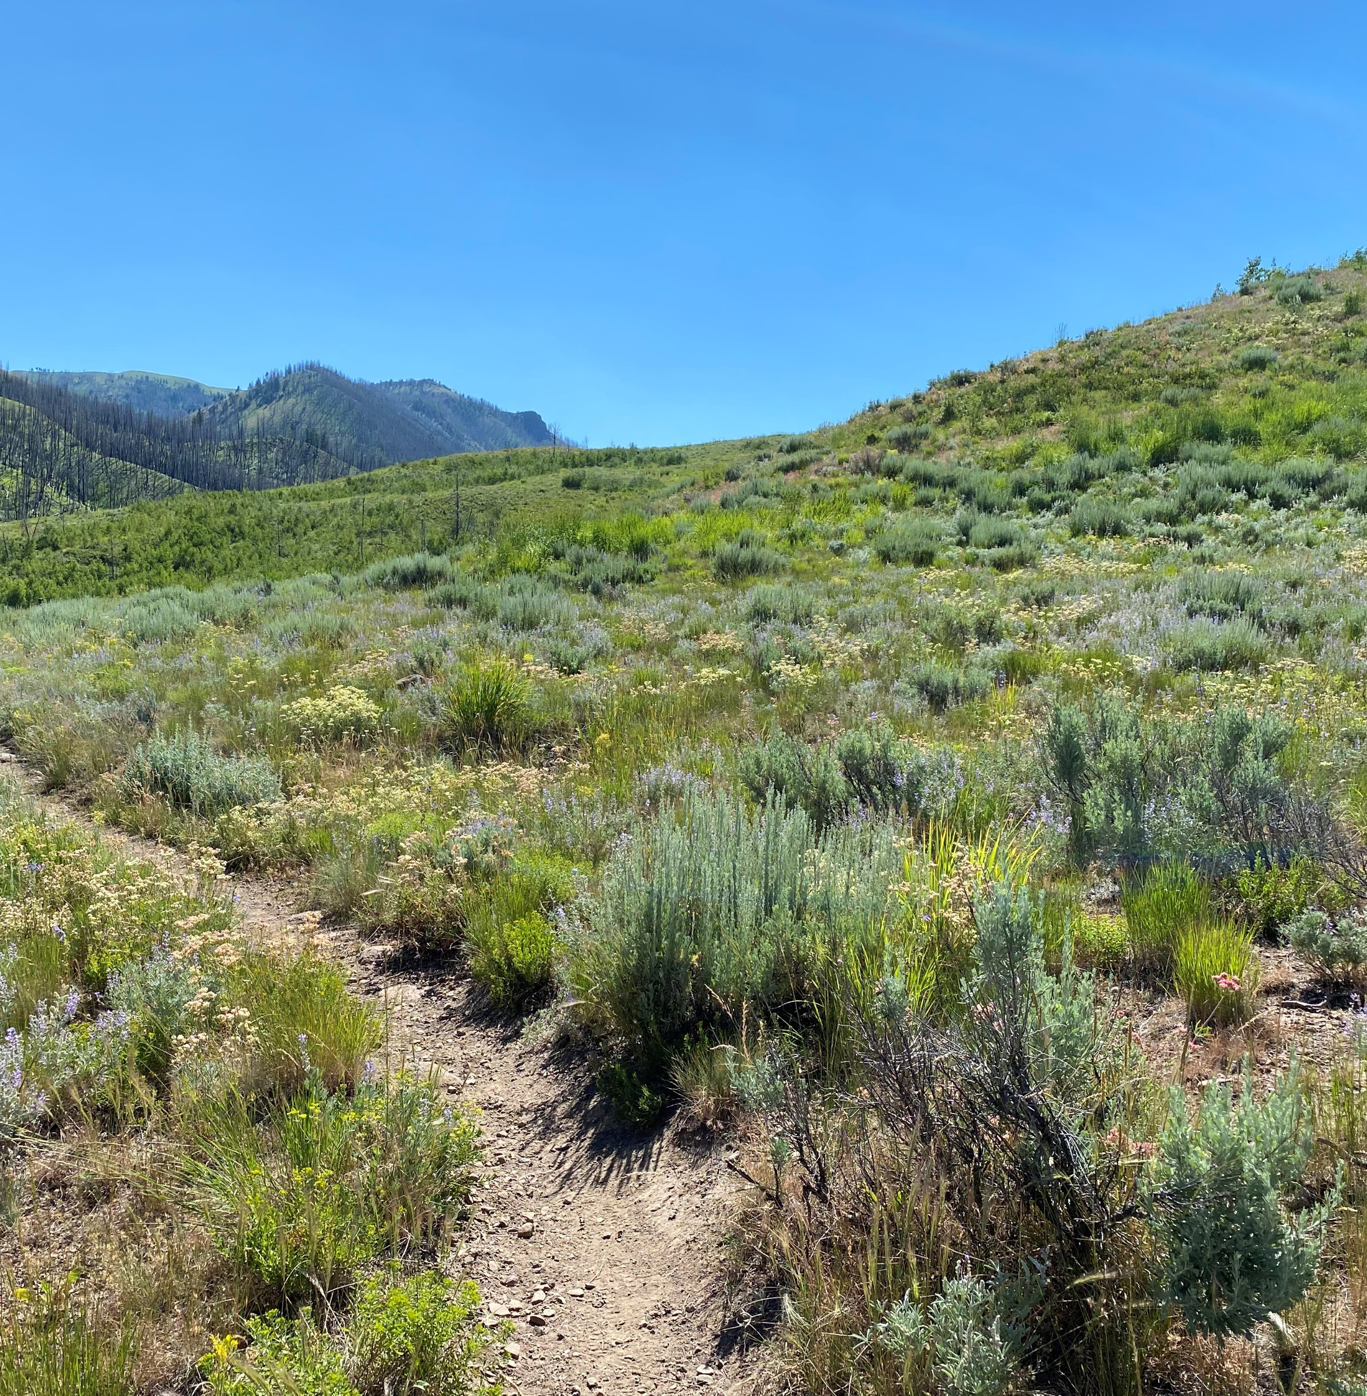
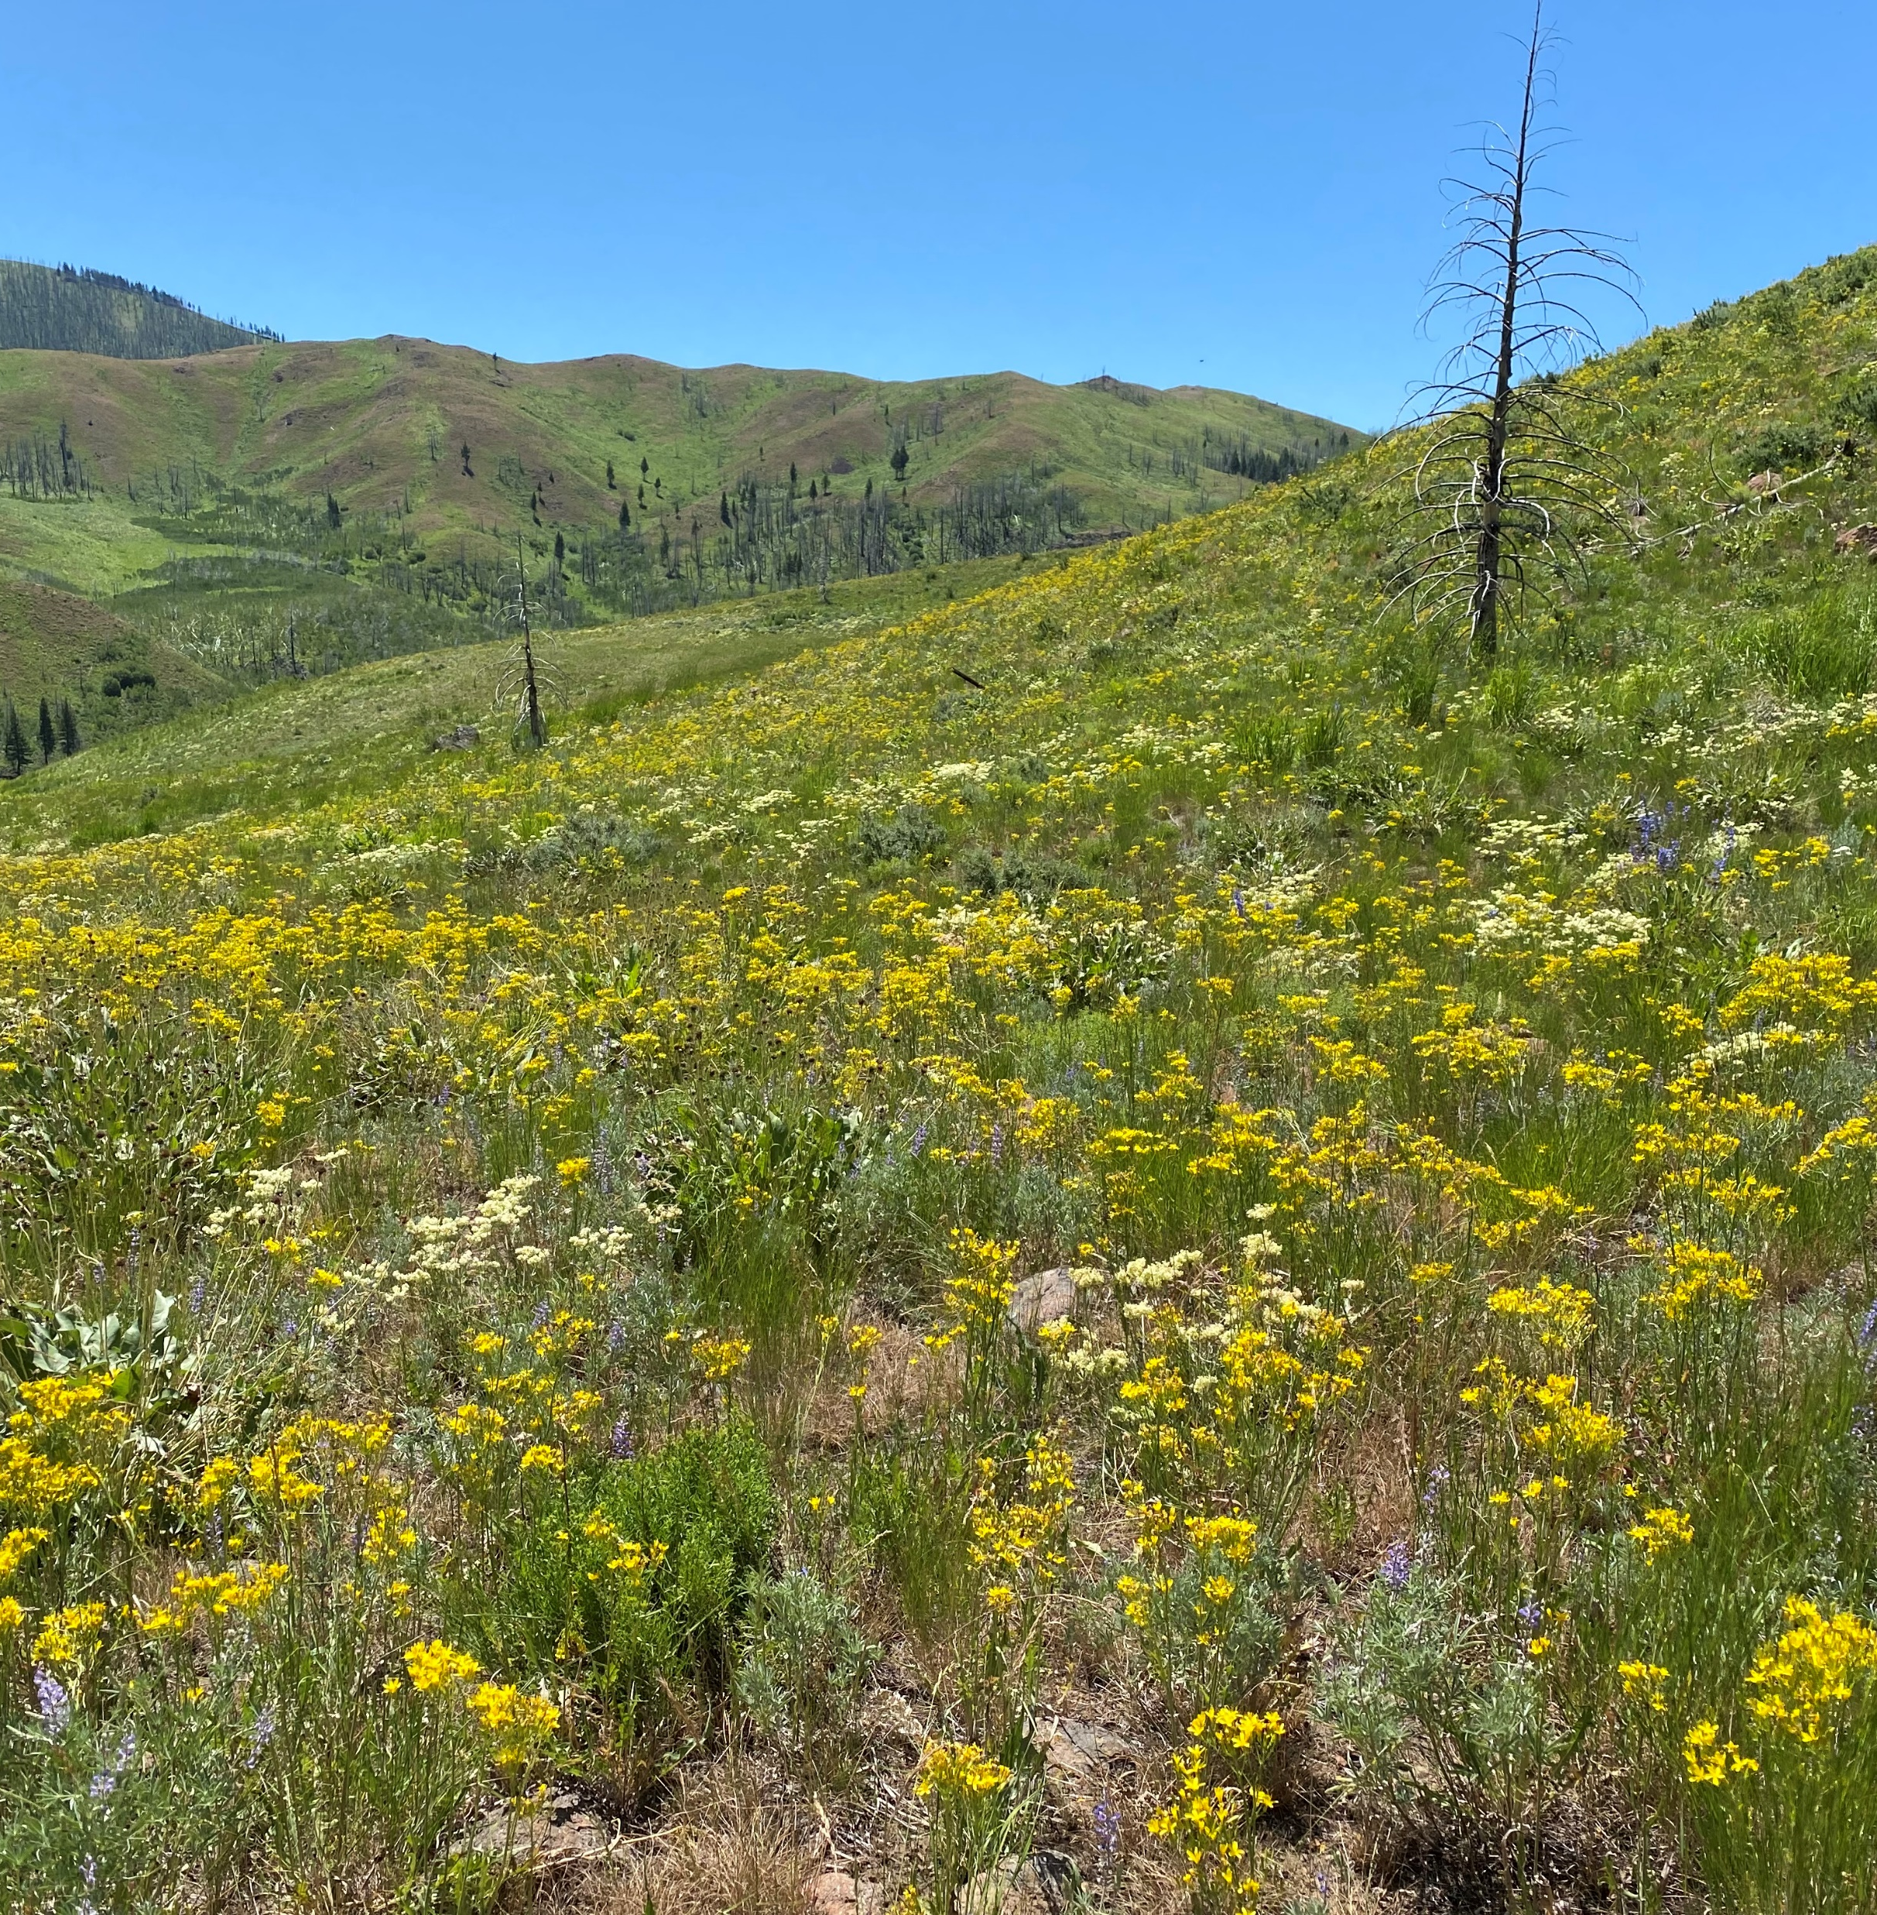
Enhance Biodiversity
Photos: Raechel Hunsaker
Notes:
Enhancing Biodiversity: Targeted grazing can diversify vegetation by selectively grazing certain areas, which allows different plant species to thrive¹¹. This can prevent any single species from dominating the landscape, hence, providing a variety of habitats and food sources for various wildlife species, including pollinators¹².
Having a mosaic of different vegetation structures can make a rangeland site more ecologically resilient because different plant communities respond to disturbance in different ways¹³.
Biodiversity also provides more food sources for pollinators, a wider variety of habitat and forage for wildlife, and more competition against invasive plant species.
A variety of root structures and depths that take up nutrients in the soil makes it more difficult for invasive plant species to establish¹⁴.

Slide 7
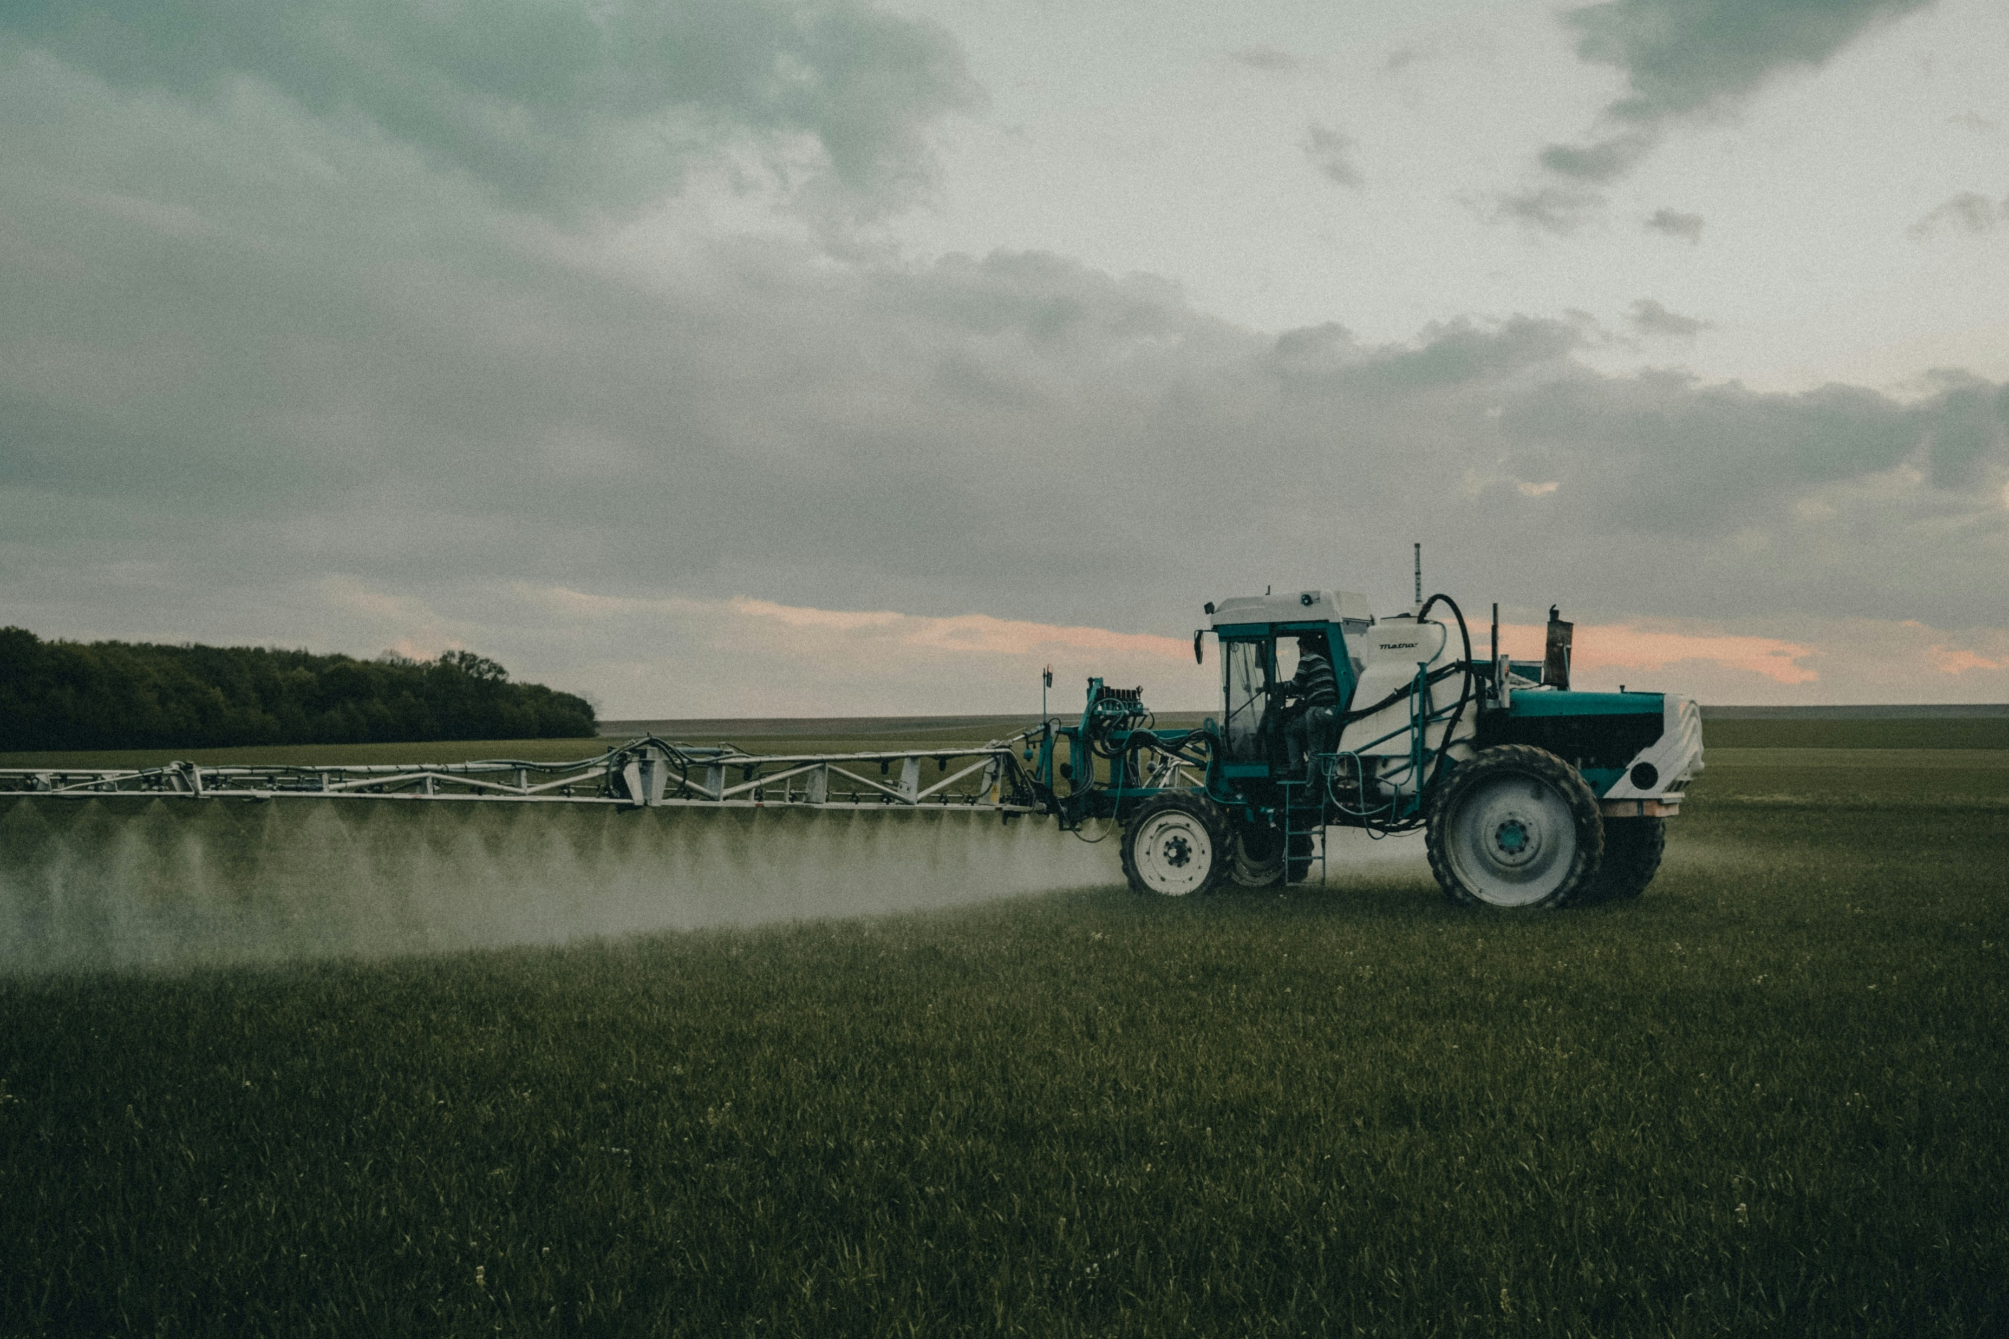
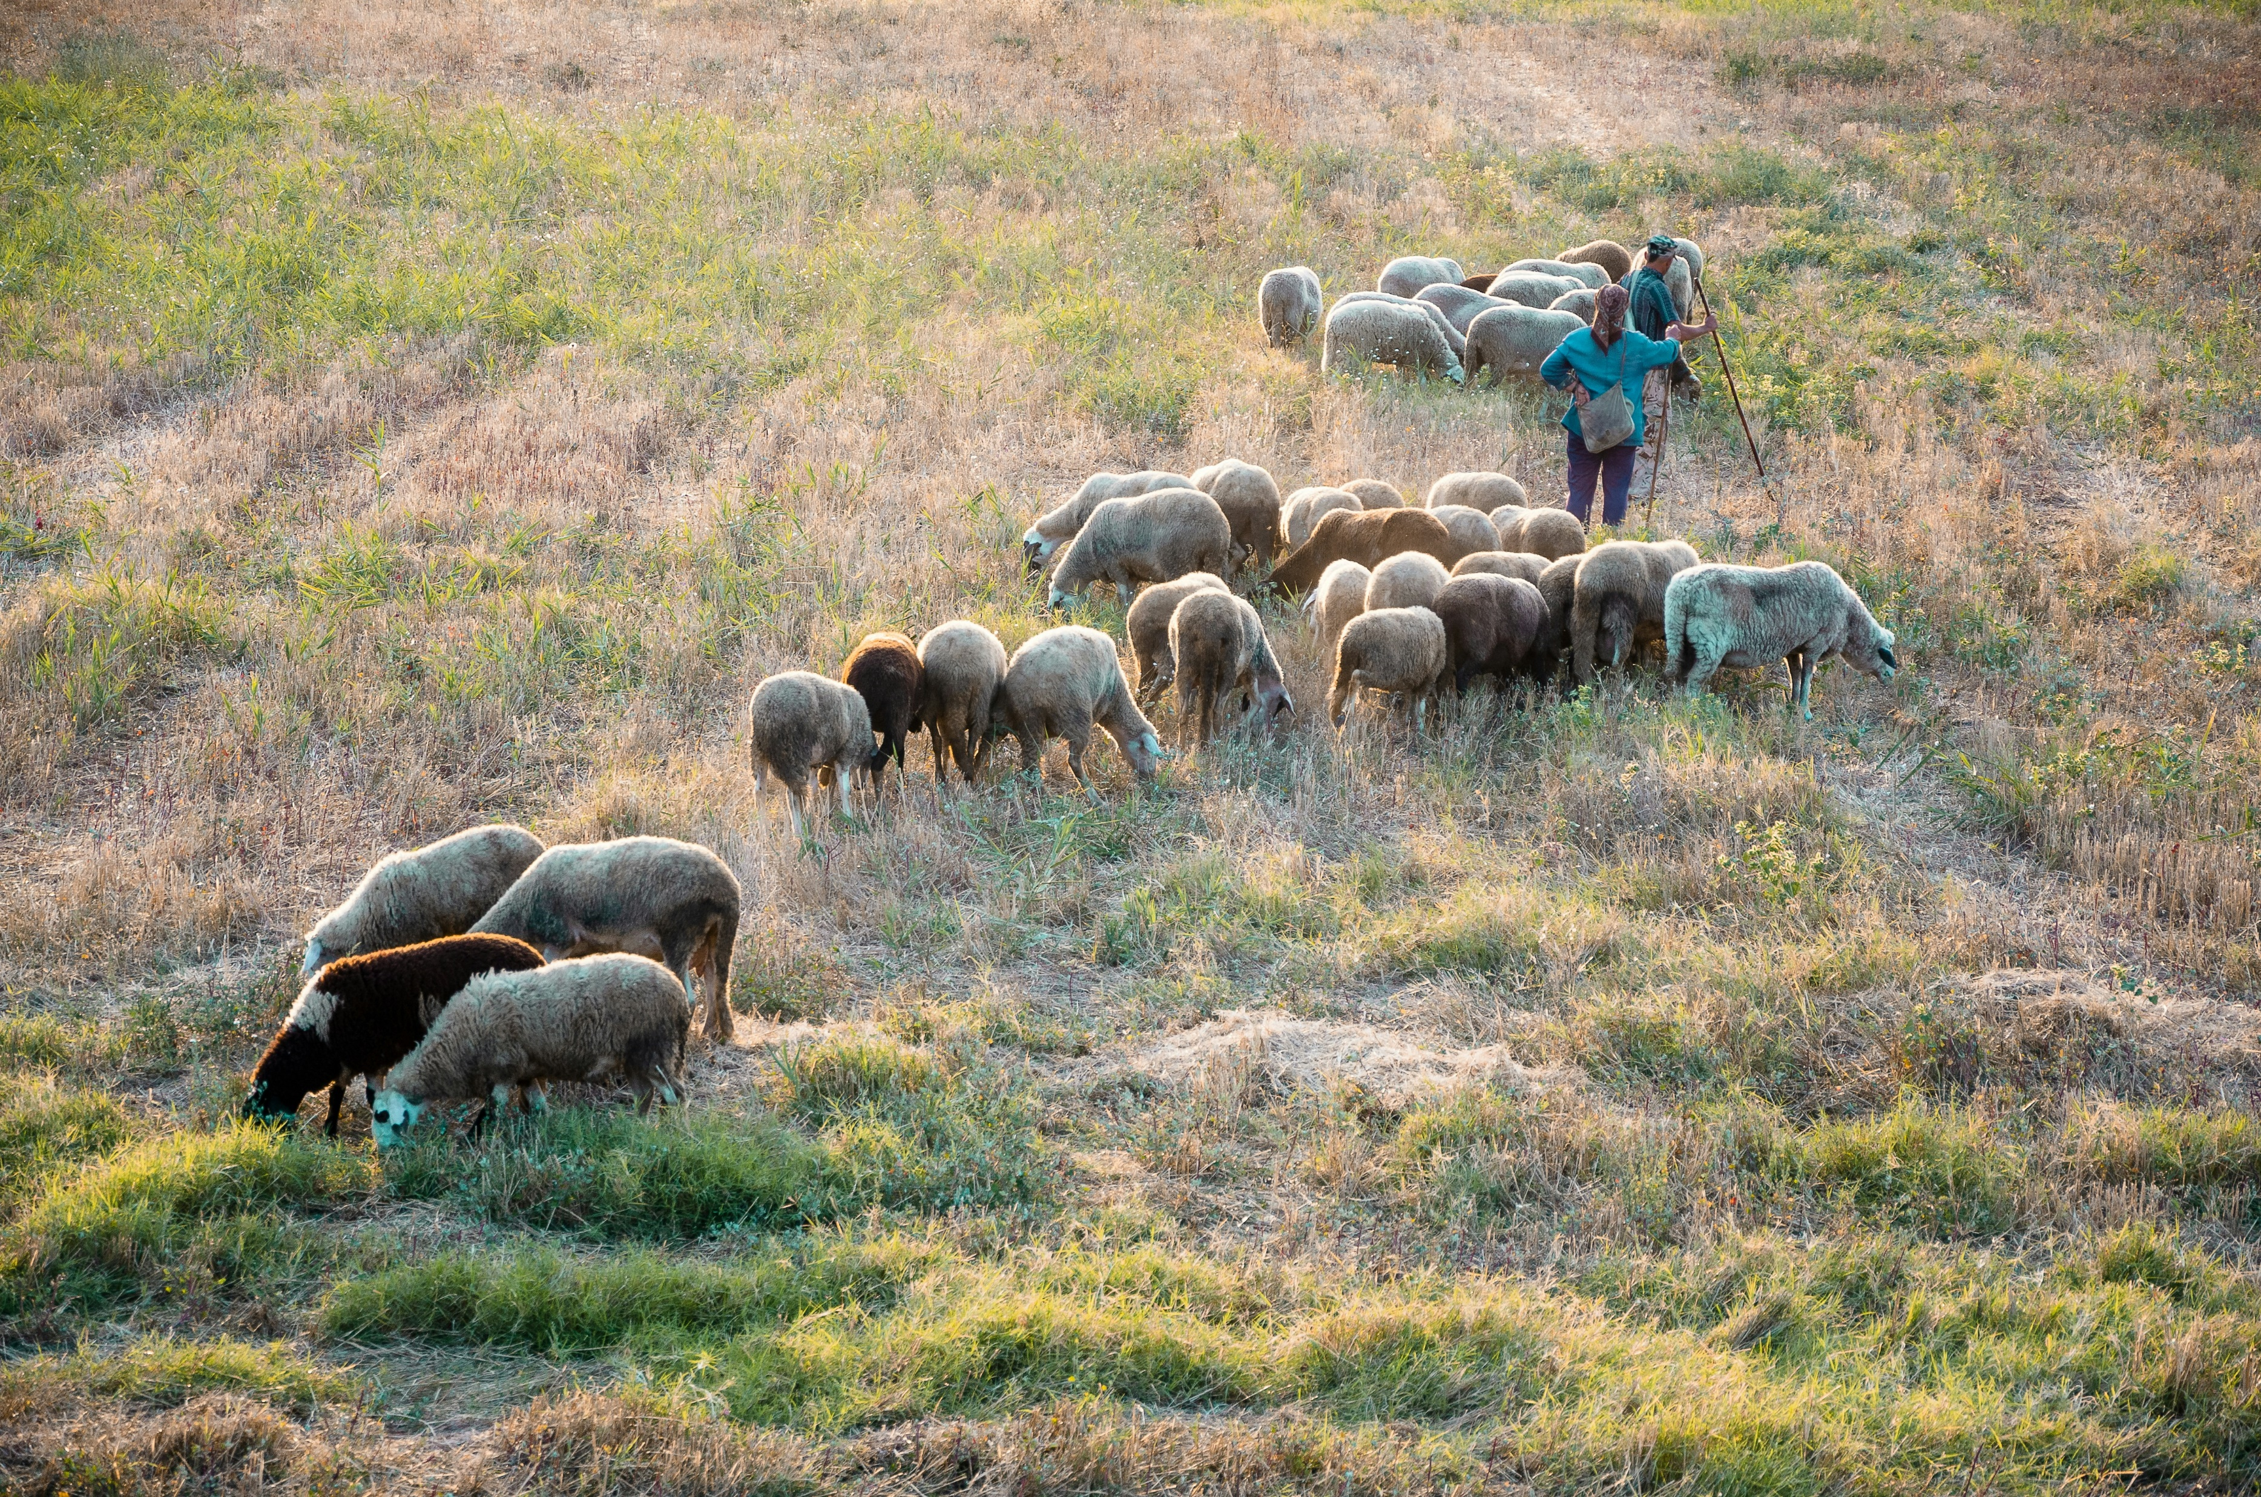
Reduce Herbicide Use
Photos: Teo Sticea and Nikolay Marinov
Notes:
Reducing Herbicide Use: Targeted grazing can serve as an environmentally friendly alternative to herbicides for controlling unwanted vegetation¹⁵.
Herbicides can have unintended consequences on non-target plants, animals, and ecosystems¹⁶.
Over time, plants can develop resistance to herbicides, leading to the need for stronger or more frequent applications¹⁷.
Excessive herbicide use can contribute to the loss of biodiversity by eliminating native plant species that provide habitat and food for wildlife.
Herbicides may provide short-term weed control benefits, however, there can be long-term economic costs associated with environmental damage, decreased land productivity, and the need for continual herbicide applications¹⁸.

Slide 8
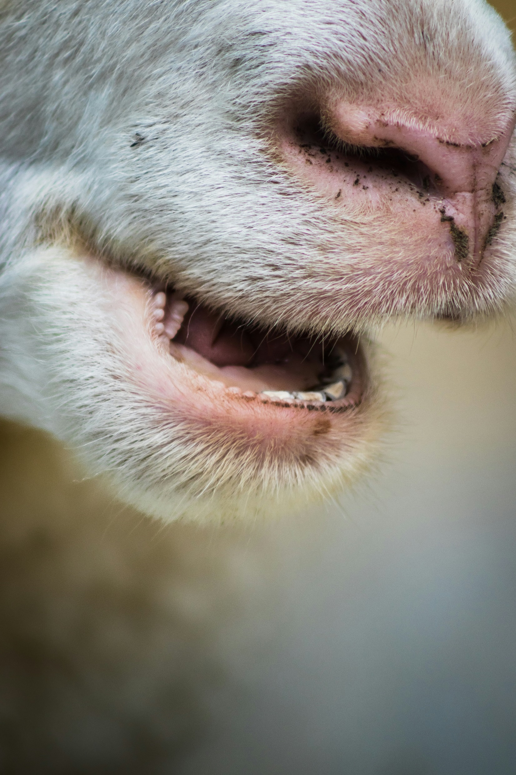
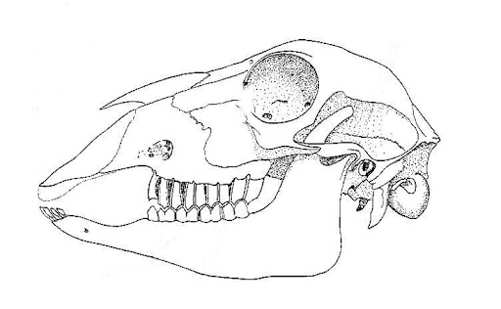
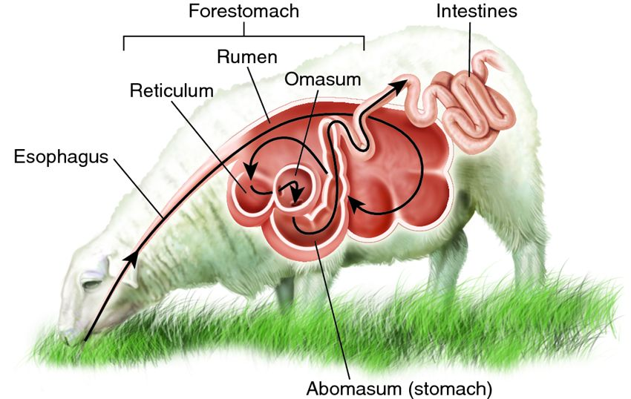
Mouth Made for Munching + More!
dental pad
incisors
premolars
molars
Photo: Joshua Bayliss
Biological Teaching Resources by D.G. Mackean
Notes:
Explain that sheep are good animals for targeted grazing because of their mouth structure, stomach, and their adaptability to rugged terrain^{19,20,21}.
Teeth: Sheep’s front teeth (incisors) are adapted for cropping and shearing, enabling them to bite off leaves and twigs easily.
Mobile lips: Sheep have highly mobile lips that can grasp and manipulate plant parts with precision. This allows them to select specific plant species and graze more selectively.
Rumen: Sheep have a special four compartment stomach. One of the compartments is called a rumen, which is like a big fermentation tank. The rumen helps sheep digest tough plants like grass and weeds that other animals might not be able to eat.
Gut microbes: Sheep rumen also contain microbes that can break down certain toxins found in plants, allowing sheep to safely consume them in moderation. It should be noted that not all toxic plants can be safely consumed by sheep. It is crucial for shepherds and land managers to be aware of the plants in the grazing area and ensure that sheep are not exposed to harmful levels of toxic plants.
Agility: Sheep can access and graze in areas that may be challenging for larger animals like cattle due to their smaller size and lighter weight. This includes areas with rough or steep terrain, rocky slopes, and dense vegetation.

Slide 9
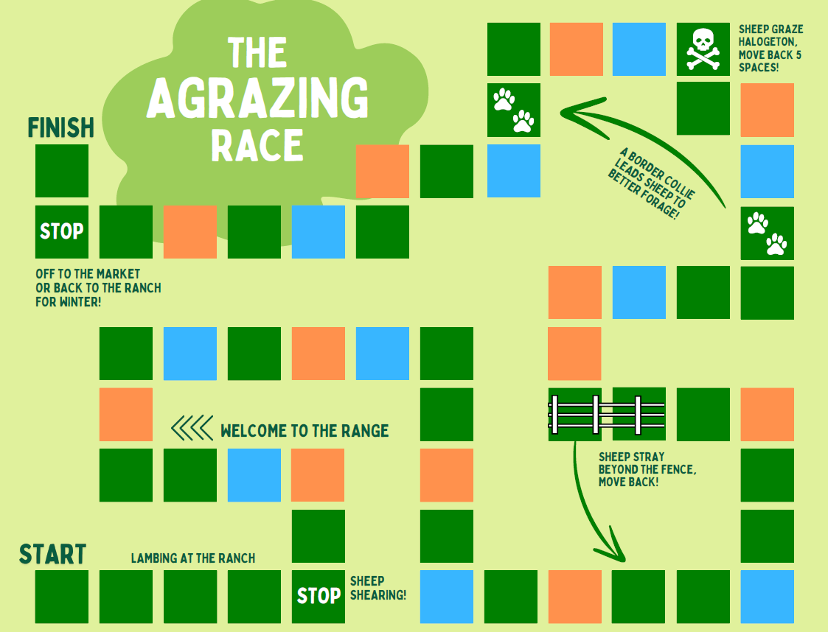
The “AGRAZING RACE”
  Get into groups of 3-4
  Gather 1-2 dice, a gameboard, cards, and game instructions.
  Select a sheep “player” to represent your sheep on the board.
  Follow the ‘AGRAZING Race’ game instructions for game play.
Notes:
Overview: The “Agrazing” Race is a fun and educational board game where players navigate their sheep through a rangeland, facing challenges and reaping rewards along the way. The objective is to be the first player to reach the end of the board and make it to the market or back to the ranch for winter!

Slide 10
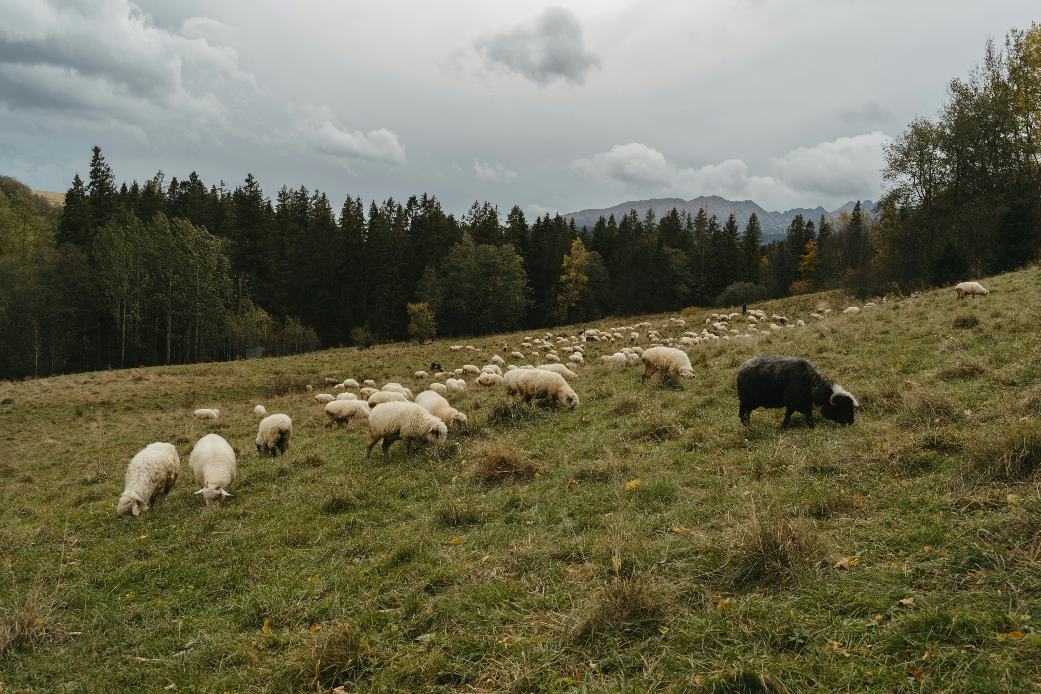
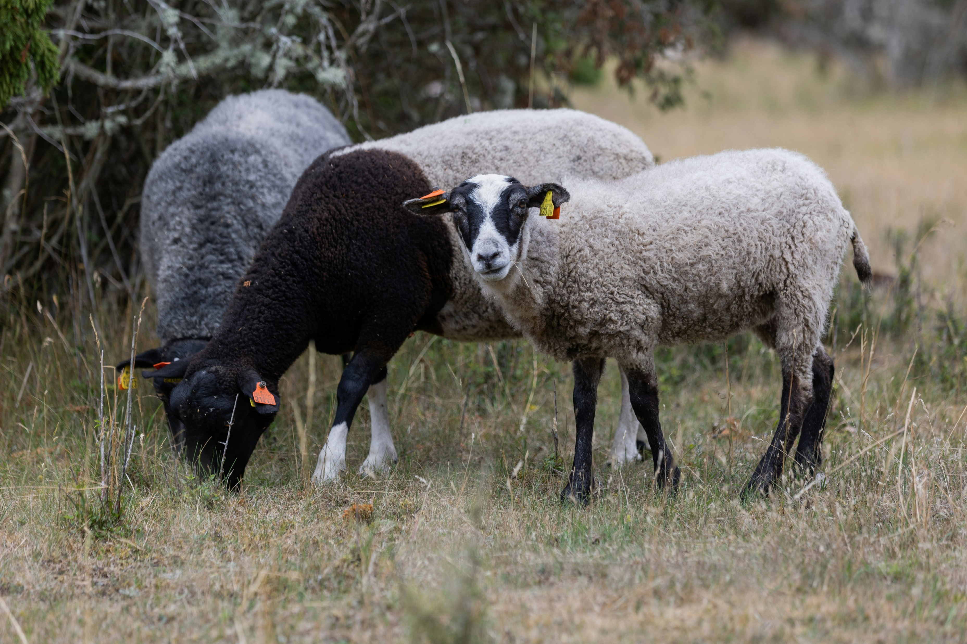
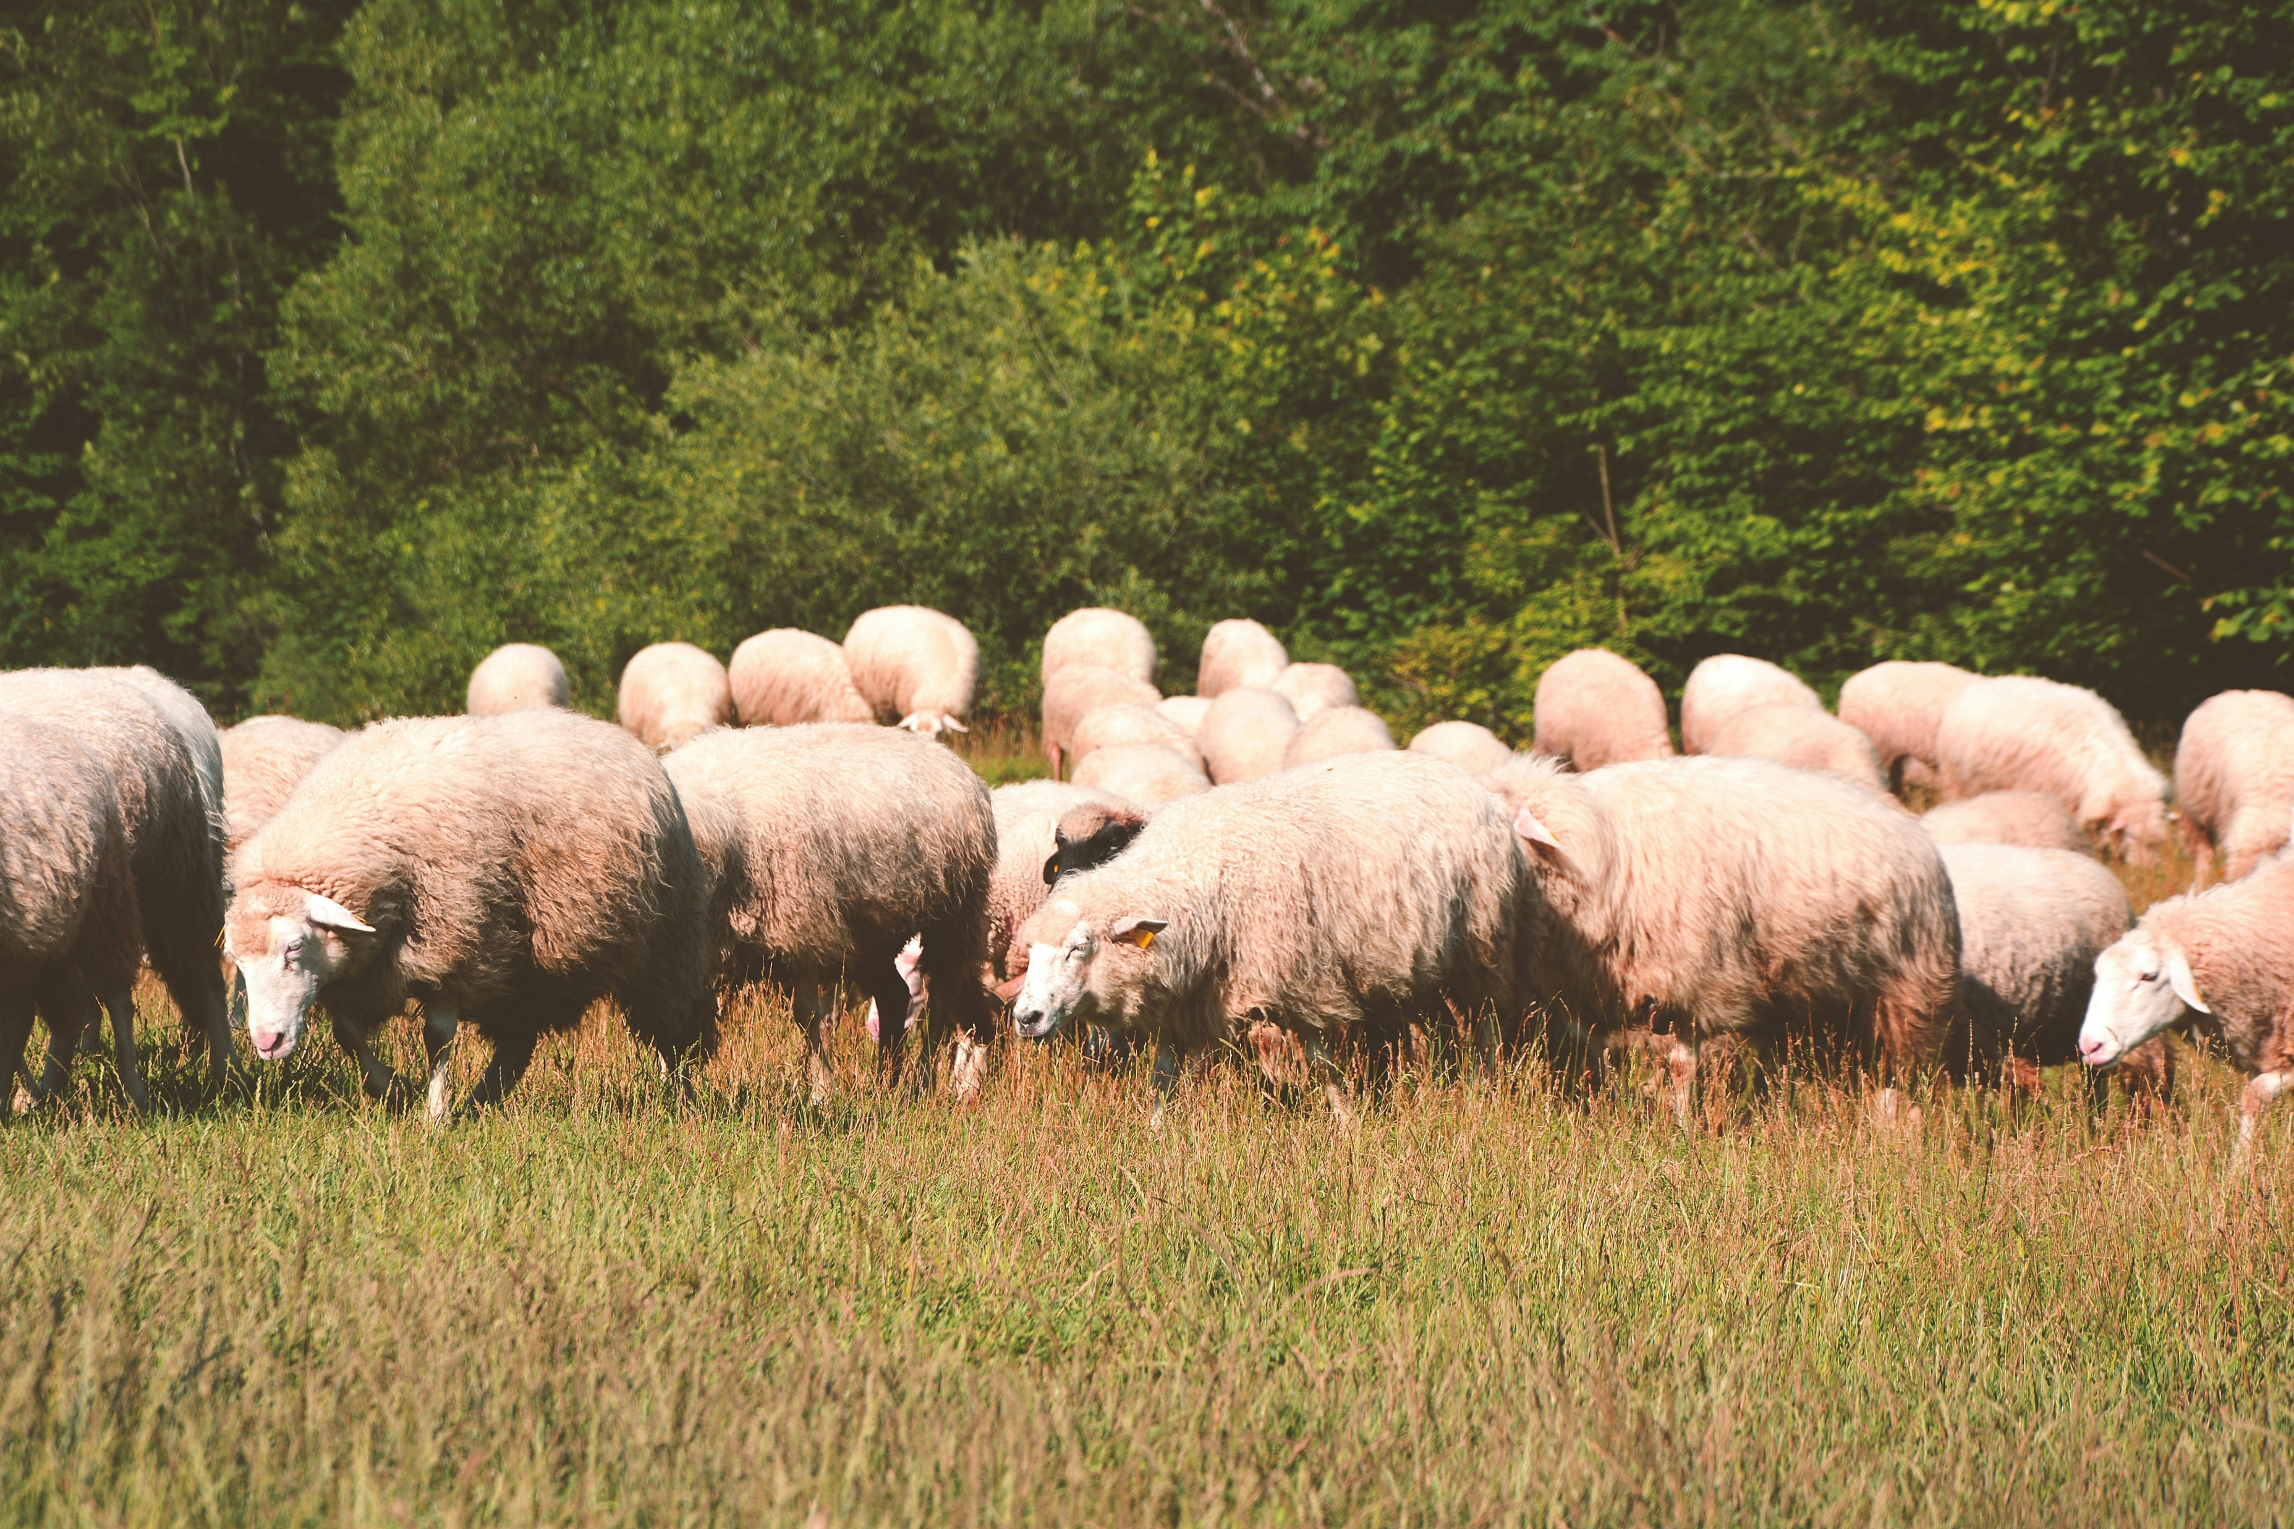
So, the next time you see sheep grazing on the rangelands…
Photo: Polina Kuzovkova
Photo: Carl Tronders
Photo: David Jusko
…think about all the ways these
eco-friendly helpers benefit our environment!
Notes:
Reflection/Conclusion (15 minutes)
Come back together as a class and discuss key concepts students learned throughout the lesson.
Prompt students to reflect on their understanding of sheep targeted grazing and the potential benefits it can have on rangelands.
Allow each student five minutes to share what they learned with the person sitting next to them.
Answer any questions students may have about sheep and targeted grazing.

